Slide 1
Common
Estate Planning Errors

Slide 2

Poor Client Interaction
1. Failure to gather sufficient information.

Slide 3

Poor Client Interaction
2. Believing client without independent verification

Slide 4

Poor Client Interaction
3. Neglecting communications with client

Slide 5

Poor Client Interaction
4. Failure to act timely

Slide 6
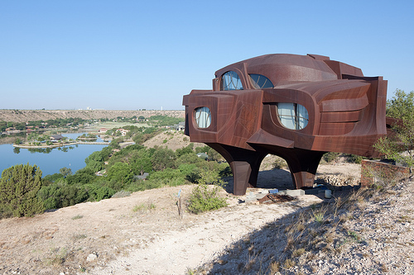
Poor Client Interaction
5. Failure to document unusual requests

Slide 7
Poor Client Interaction
6. Failure to recognize will contest omens:
  Disinheriting close relatives for distant relatives, friends, or charities
  Unequal division among children
  Excessive restrictions on gifts to heirs
  Elderly or disabled testator (sad, but true)
  Sudden or significant change in disposition plan
  Strangely acting client

Slide 8
Errors in Will Drafting
1. Proof proofreading of documents
  “I leave $10.000 to my friend, Freddy.”
  “I found inspiration in cooking my family and my friends.”
  “The police are no where.”
  “The police are now here.”

Slide 9
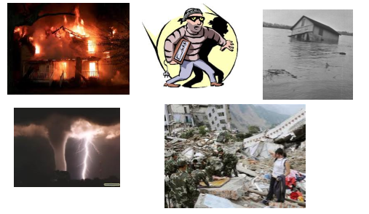

Errors in Will Drafting
2. No provision regarding ademption

Slide 10
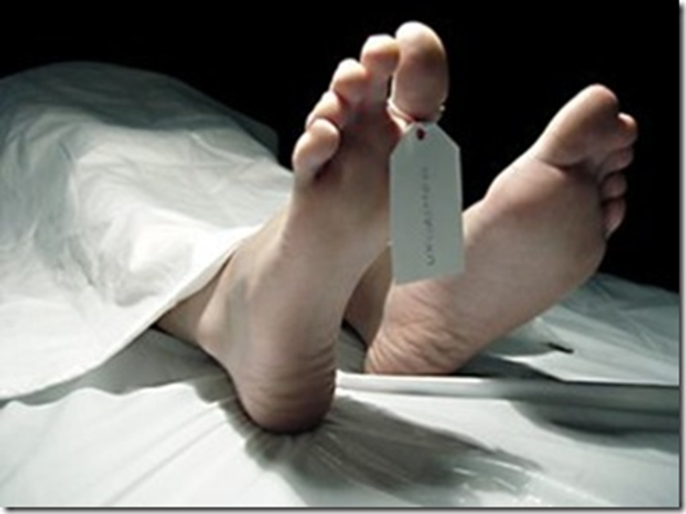
Errors in Will Drafting
3. No provision regarding lapse

Slide 11

Errors in Will Drafting
4. Including “just debts” provision

Slide 12
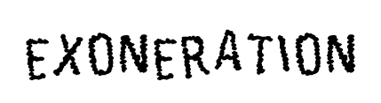
Errors in Will Drafting
5. Failure to discuss exoneration

Slide 13

Errors in Will Drafting
6. Failure to extend survival period

Slide 14

Errors in Will Drafting
7. Failure to address abatement

Slide 15

Errors in Will Drafting
8. Failure to address tax apportionment

Slide 16
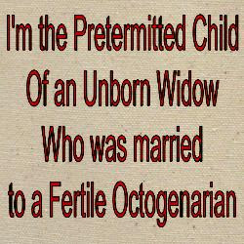
Errors in Will Drafting
9. Lack of provision regarding pretermitted children

Slide 17

Errors in Will Drafting
10. Failure to address adopted, non-marital, and ART children

Slide 18

Errors in Will Drafting
11. Failure to externally integrate documents

Slide 19
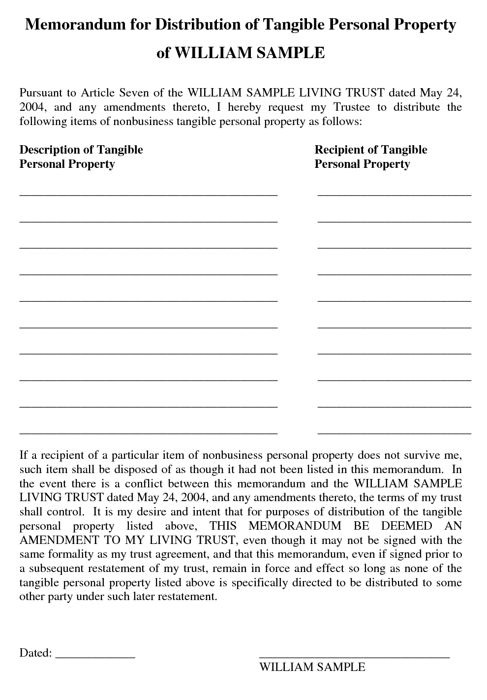
Errors in Will Drafting
12. Referencing a tangible personal property document

Slide 20

Errors in Will Drafting
13. Improper internal integration

Slide 21
Errors in Will Drafting
14. Use of ambiguous language
  “I leave my sister, Pat, my house.”
    Sister = Pam
    Brother = Pat

Slide 22
Errors in Will Drafting
15. Use of precatory language
  I hope
  I wish
  I desire
  I recommend
  It would be nice if

Slide 23
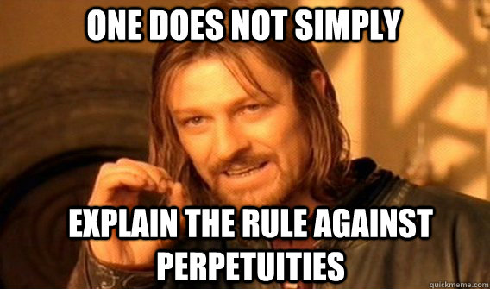
Errors in Will Drafting
16. Violation of Rule Against Perpetuities

Slide 24
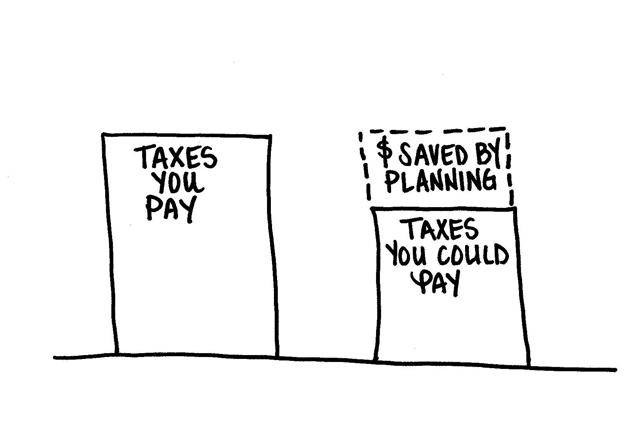
Errors in Will Drafting
17. Inadequate tax planning

Slide 25
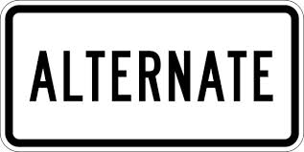
Errors in Will Drafting
18. Failure to indicate alternate or successor executors

Slide 26

Errors in Will Drafting
19. Lack of provision regarding bond

Slide 27
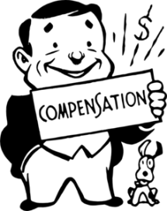
Errors in Will Drafting
20. Lack of compensation provision

Slide 28
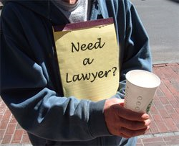
Improper Will Execution
1. Ceremony conducted by a non-lawyer

Slide 29

Improper Will Execution
2. Beneficiary present during will execution

Slide 30

Improper Will Execution
3. No testator signature

Slide 31

Improper Will Execution
4. Testator signs wrong will

Slide 32
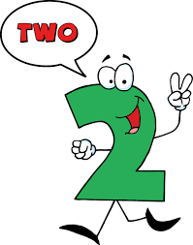
Improper Will Execution
5. Lack of sufficient number of witnesses

Slide 33
Improper Will Execution
6. Presence requirements not satisfied
  Testator signs or acknowledges a prior signature in witnesses’ presence.
  Witnesses attest in testator’s presence.
    The only one of “the presences” required in Texas
  Witnesses attest in each other’s presence.

Slide 34
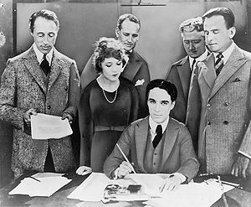
Improper Will Execution
7. Beneficiary as a witness

Slide 35
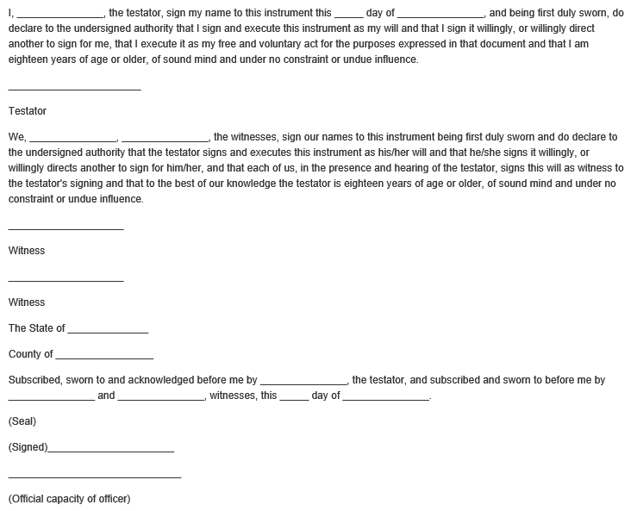
Improper Will Execution
8. Improperly completed self-proving affidavit

Slide 36

Improper Will Execution
9. Execution of duplicate originals

Slide 37
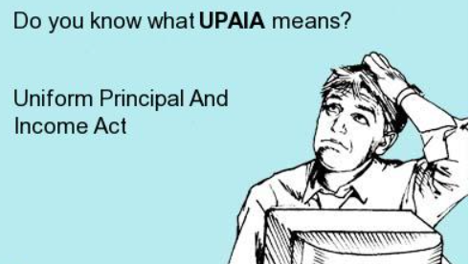
Errors in Trust Drafting
1. Failure to address principal and income issues

Slide 38

Errors in Trust Drafting
2. Omission of spendthrift provision

Slide 39

Errors in Trust Drafting
3. Misstating ability to revoke

Slide 40
Other Troublesome Areas
1. Improper document preservation
  Secure
  Easy to locate
  Safe from “evil” destruction
  Available when needed

Slide 41
Other Troublesome Areas
2. Failure to give client sufficient post-execution instructions
  Don’t make self-help changes.
  Review on regular basis.

Slide 42
Other Troublesome Areas
3. Failure to consider disclaimers
  Tax savings
  Liability avoidance
  Creditor avoidance

Slide 43
Other Troublesome Areas
4. Failure to provide complete estate plan
  Durable power of attorney
  Medical power of attorney
  Designation of guardian
  HIPAA authorization
  Living will
  Body disposition document
  Anatomical gifts
  Mental health treatment declaration

