Slide 1


Slide 2




Slide 3
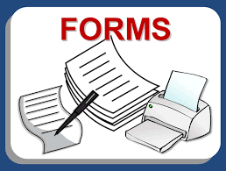

Slide 4
Sources of Forms
Developed by attorney
Form books
Computer programs
  Fill-in-the-blank
  AI
Preprinted
Statutorily supplied
  Optional vs. mandatory
Public records

Slide 5
Form Benefits
Reduction in preparation time
Lower cost of legal services
Increased predictability of results
Error reduction
Litigation reduction

Slide 6
Form Warnings
Lack of individualization
Improper selection
Improper completion
Encourages carelessness
May not comply with local law
May not be current
Fee abuse
Unauthorized practice of law

