Slide 1

Enhancing
Professional Reputation

Slide 2
Earn advanced degree
LL.M. in Estate Planning
  University of Miami – best in nation
LL.M. with estate planning specialization
J.S.D. with dissertation on estate planning topic

Slide 3
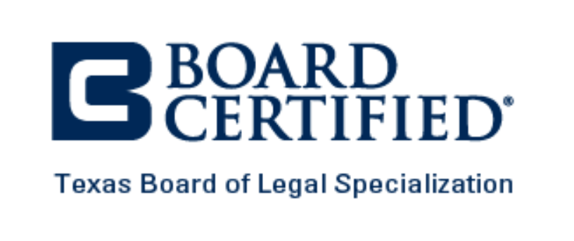
Board certification

Slide 4




Attend CLE programs
EPJ
SBOT
  Nuts and Bolts
  Intermediate
  Advanced
  Advanced Drafting
  Advanced Strategies
Heckerling
Notre Dame
Many others

Slide 5



Join estate planning organizations
REPTL Section of SBOT
  Leadership program
RPTE Section of ABA
Local bar association sections
Local estate planning organizations

Slide 6

American College of Trust and
Estate Counsel

