Slide 1


Slide 2

Self-Help Techniques

Slide 3

Importance of Knowledge
You need to know what your clients see and hear before they come to you.

Slide 4
Books written for lay audience
Some excellent!
Some terrible!
Some designed to sell a product.
Advice = Examine top sellers on Amazon and evaluate.

Slide 5

Will kits

Slide 6

Word of mouth
Information and disinformation from:
  Family members.
  Friends.
  Radio.
  TV.
  Internet.
  Magazines.
  Newspapers.
  Social media.

Slide 7

Seminars

Slide 8
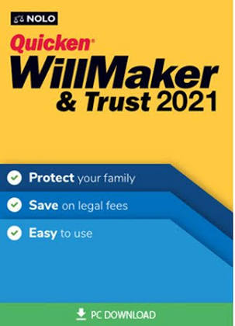

Computer programs
Stand-alone software
Internet sites

Slide 9
You’ve got to ask yourself one question:
Why should client hire you rather than use these very inexpensive self-help techniques?
  Personal attention.
  Personal advice.
  Customized provisions beyond what the AIs can create.
  Recognizing potential of contests and taking appropriate steps.

