Slide 1

Legal Assistants

Slide 2

Benefit of Using a Legal Assistant
1. Provide economical services

Slide 3
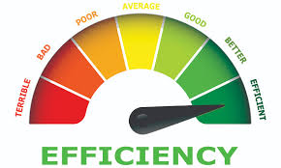
Benefit of Using a Legal Assistant
2. Increased attorney efficiency

Slide 4

Benefit of Using a Legal Assistant
3. Improved work product quality

Slide 5

Benefit of Using a Legal Assistant
4. Provide client with additional contact person

Slide 6

Proper Use of Legal Assistants
1. Gather information

Slide 7

Proper Use of Legal Assistants
2. Draft and proofread documents

Slide 8

Proper Use of Legal Assistants
3. Legal research

Slide 9

Improper Use of Legal Assistants
1. Supervising document execution

Slide 10

Improper Use of Legal Assistants
2. Giving legal advice to clients

Slide 11

Improper Use of Legal Assistants
3. Making discretionary decisions

Slide 12

Recommendations
1. Select with care

Slide 13


Recommendations
2. Comprehensive instruction
  Seek Board Certified Legal Assistant in Estate Planning and Probate

Slide 14

Recommendations
3. Careful supervision

Slide 15

Recommendations
4. Explain legal assistant’s role/status to client

