Slide 1

Assignment due Monday!

Slide 2

Attorney-Client
Relationship

Slide 3
Gather Sufficient Information
Without complete information, you cannot construct an intent-fulfilling estate plan.
To assist, use:
  Checklists
  Forms

Slide 4

“Trust, but verify” [doveryai no proveryai]
Confirm what the client tells you especially about the contents of other documents such as beneficiary designations.

Slide 5
Do not neglect communications with the client
Keep client posted on progress with preparing the estate plan.
Return phone calls promptly.
Return e-mails and text messages promptly.
Warning – texting to landlines!

Slide 6
Act timely
Client could die or become disabled at any time.
Consider a “temporary” estate plan.
  Short holographic will.
    “I revoke all prior will and codicils. I leave all my property to A. I name B as independent executor to serve without bond.”

Slide 7
Document unusual requests
Failure to document a client’s intent which is out of the mainstream may make it difficult to prove later that it was actually what the client wanted.

Slide 8
Recognize circumstances increasing likelihood of contest
Exclusion of natural objects of bounty
Unequal treatment of children
Sudden or significant change to estate plan
Imposition of excessive restrictions on gifted property
Elderly or disabled client
Client with unusual behavior

Slide 9

Use plain language as much as possible
Clients should be able to understand their estate planning documents.

Slide 10

Avoid transference
Your goal is to do what the client wants – not what you would do if you were in the client’s situation.

Slide 11

Be honest about what you can accomplish

Slide 12

Explain fees

Slide 13


Prepare newsletters

Slide 14

Conduct seminars

Slide 15

Fees

Slide 16

The Test
Your fee to prepare the estate plan must be reasonable.

Slide 17
The Factors
Time and labor
Preclusion of other work
Customary fee in community
Amount involved and results obtained
Time limitations
Nature and length of professional relationship with client
Attorney’s experience, reputation, and ability
Fixed or contingent fee
Cost of direct materials

Slide 18
Methods of Setting Fees
1. Hourly rate
  Appears fair.
  But, may be to opened ended for client.
  But, may be “blank check” to attorney

Slide 19
Methods of Setting Fees
2. Fixed Fee
  Appears fair and allows client to budget.
  But, difficult for attorney to ascertain amount of work needed up front.
  But, may be “blank check” to client

Slide 20
Methods of Setting Fees
3. Range of Fees
  Appears fair.
  But, uncertainty for both client and attorney.

Slide 21
Methods of Setting Fees
4. Percentage of size of estate
  Difficult to justify as value does not equate necessarily with more difficult or longer work.

Slide 22
Methods of Setting Fees
5. Percentage of money saved by the estate plan (the reverse contingency fee)
  May be fair if tax savings is the client’s primary goal.
  But, may give tax benefits too great a weight over carrying out the client’s intent.

Slide 23
Methods of Setting Fees
6. Combination of methods based on client
  Avoid the “one size fits all” approach to fee-setting.

Slide 24
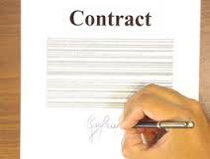
Written Fee Agreement
Always get the fee agreement in writing!!

Slide 25
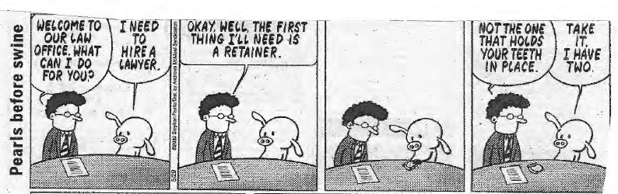

Slide 26
Advice on getting paid
1. Collect a retainer (advance of fees).
2. Choose clients with care.
3. Bill promptly with itemized/detailed bill.
    Don’t wait until end – use interim billing.
    Accept credit cards, CashApp, Zelle, Venmo, PayPal, etc.
4. Reminder to late-paying clients.
5. Sue only as a last resort
    Often better to just “take the hit” than sue a client.

