Slide 1
Client Contact
Introduction

Slide 2
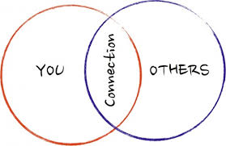
Importance
If you cannot interact well with clients, you will not be able to prepare a good estate plan, even if you are able to get clients.

Slide 3

About what are your estate planning clients thinking?

Slide 4

Consequences of Death
1. Cessation of Experiences

Slide 5

Consequences of Death
2. Fear of Afterlife

Slide 6
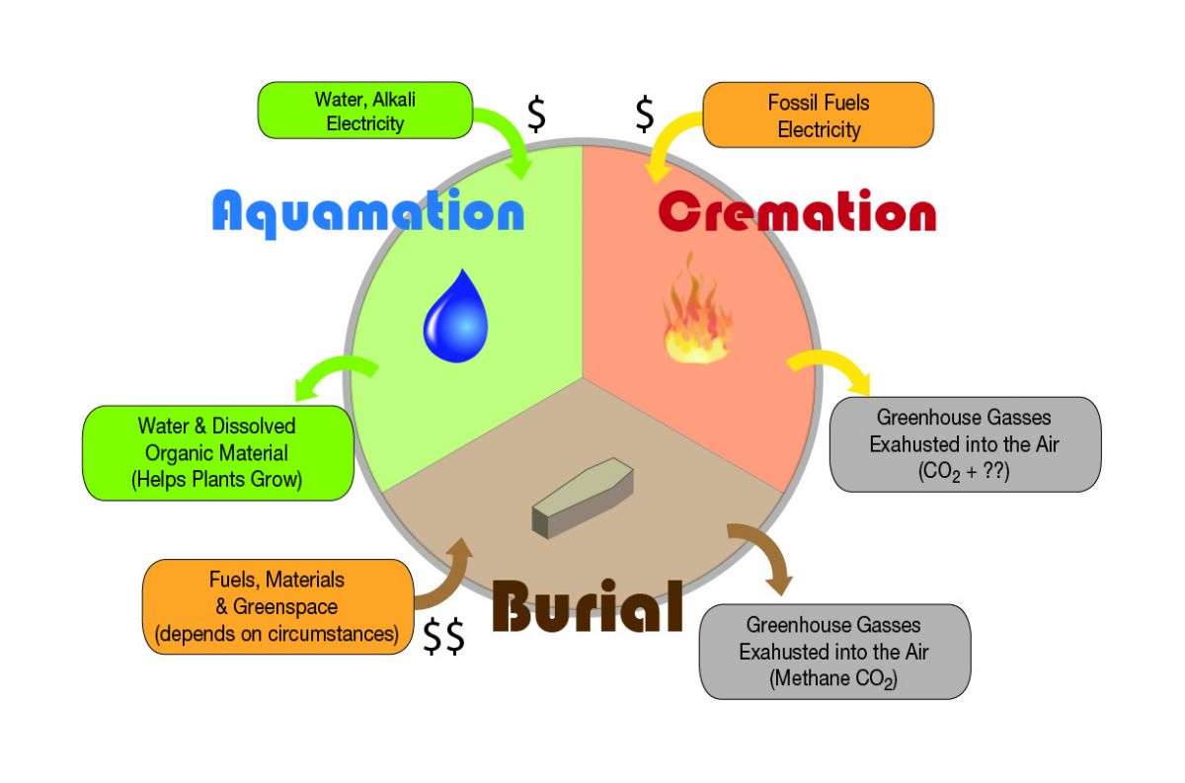

Consequences of Death
3. Fear of What Happens to Body

Slide 7

Consequences of Death
4. Inability to Care of Dependents

Slide 8

Consequences of Death
5. Death will Cause Grief

Slide 9

Consequences of Death
6. End of Projects

Slide 10

Consequences of Death
7. Fear of Painful Death

Slide 11
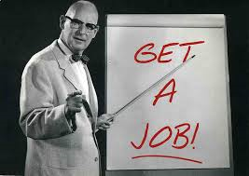
Securing Employment

Slide 12

Potential Clients
Every competent adult in the state in which you are licensed.

Slide 13
Possible Positions
Solo in general or specialized practice
Associate or partner in general practice
Associate or partner in boutique firm
Associate or partner in related fields, e.g., elder law, transfer tax, financial planning, estate litigation, etc.
Legal clinics
Court – clerk or judge
Professional fiduciary
IRS
Planning giving office at a school or charity
JAG Corps

Slide 14

Obtaining Clients

Slide 15
1. Existing Clients
All clients need estate planning regardless of why they originally came to your office.

Slide 16
2. Referrals
Sources:
  Family
  Friends
  Happy Clients
  Colleagues
Warnings:
  Loyalty
  Conflicts of Interest

Slide 17
3. Original Clients
How to Cultivate:
  Advertise
    https://www.youtube.com/watch?v=E5V38eAwuXo
    https://www.youtube.com/watch?v=jr2gdPY-88w
  Speak to civic groups

Slide 18

Client Interview
Part 1

Slide 19
Schedule Appointment
Who?
  You
  Secretary
  Internet site
Length of initial appointment?

Slide 20
Pre-Interview Questionnaire
Pros
  Attorney can “prep” for interview.
  Saves time at interview.
  Client can complete without pressure and has time to look up the requested information.
  Include educational materials.
Cons
  Client may not like doing it – refuse or procrastinate.
  Client may not understand what is being asked.
  Client may be embarrassed or afraid to reveal certain information in writing.

Slide 21
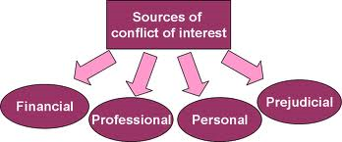
Check for Conflicts

Slide 22
Location of Interview
Options
  Your office
  Client’s home
  Hospital or other medical facility
Exclude “guests”

Slide 23
Reception Area Considerations
Comfortable
Dignified
ADA compliant
No smoking
Reading material
  Current
  Relevant to EP
  Attorney/Firm info
Attentive receptionist
Keep confidentiality
Directions to restrooms
Music?
TV?
Children’s materials?
Wi-Fi?
Water, coffee, snacks
Postings required by state law
I’m confident you can think of many other factors!

Slide 24
Initial Interaction
How does attorney and client meet?
  Attorney gets client from reception area, or
  Secretary brings client to attorney’s office
Ascertain how client would like to be addressed.
Small talk to “break ice” and establish rapport.
Ascertain if client has previously been to a lawyer.
Notes:
Ask – How many of you have been to an attorney professionally? [Me = never]
This can be a very scary and intimidating event for the client.

Slide 25
Fee Discussion for Initial Interview
Review fee for this consultation.
Customary for the initial interview to be gratis.
Warning: Avoid discussing fees for preparing the estate plan until you learn what your client needs.

Slide 26
Explain Attorney-Client Privilege
Important for client to understand that client can safely reveal:
  Marital problems
  Feelings about children and other relatives
  Children born of wedlock
  Medical conditions
  Nature, source, and value of assets
Without honest and complete information, you cannot prepare an effective estate plan.

Slide 27
Allow client to explain situation
Let client explain reason for client’s visit.
  “How can I help you?”
  “What brought you in to my office today?”
  “What’s your problem?”
You need to determine what aspect of estate planning the client is most concerned.
Client has “rehearsed” story; let client tell it.
Avoid cross-examination type questions. Client is not a “hostile witness.”
Notes:
Be an active listener!
Remember, that with Estate Planning, more compassion and understanding is needed than with other areas of law as client is thinking about client’s death, not a pleasant thing to do.

Slide 28
Explore facts
Repeat essential facts to confirm your understanding.
Probe for additional information with guided questions.
Consider use of checklists to assist.

Slide 29
Ascertain Client’s Desires
Recipients of property – identity
Recipients of property – timing
Use of property
Persons to manage property
Tax concerns
Disability planning
  Property
  Health Care
Death planning
Notes:
These are the things we reviewed on the first day of class.

Slide 30
Explain Fees
Explain how you will charge if client hires you to prepare estate plan.
  We will discuss how to set fees during our next class.

Slide 31
Ascertained if hired
Do not assume you are hired.
Do not pressure client to make a decision on the spot.
If hired, obtain a written employment contract and fee agreement.
  You will be preparing one for our client as Assignment 2.

Slide 32
Conclusion of Interview (if hired)
Review plan of action
  Be sure both attorney and client know what is to happen next – who does what by when.
Promise to keep client well-informed.
Give client a file in which to keep information.
Schedule next appointment.

Slide 33
Post-Interview Matters
Letter to Client
  Confirm plan of action.
  Provide additional reading material on estate planning.
  If client did not hire you, send declination letter to prevent later claims that you were hired.
Prepare memo to your file
  Material needed for estate plan.
  Information about client to help you remember him/her.
Notation on calendar to follow-up with client.

Slide 34

Information and
Document Collection

Slide 35
Examples of information needed
Warning: Do not have client collect or supply information not needed to prepare the estate plan.
Prior estate planning documents | Birth certificates – client and children
Adoption records -- client and children | Marriage licenses Divorce decrees
Military records | Deeds
Insurance policies | Retirement plans
Annuity contracts | Beneficiary designations
Business documents | Evidences of debt
Prior tax returns | Deeds

Slide 36
Who gathers?
Consider the pros and cons of each.
Client
Attorney or staff
Third party

Slide 37


Slide 38

Steps Covered Last Time
Pre-interview questionnaire
Conflicts check
Location of interview
Reception area considerations

