Slide 1
Estate Planning
Prof. Gerry W. Beyer
Fall 2024
https://app.tophat.com/register/
6-digit join code: 597543
Gerry W. Beyer
Governor Preston E. Smith Regents Professor of Law
Texas Tech University School of Law

Slide 2
Will Execution Ceremony
Client = Helen Poston
Student Attorney – Gideon Meier
Notary = Audrey Helm
Office Manager = Breuklyn McDaniel Nivens
Witnesses
  Sara Farnsley
  Cade Cross

Slide 3

Course Materials
1. Teaching Materials on Estate Planning
(5th ed. 2023).

Slide 4
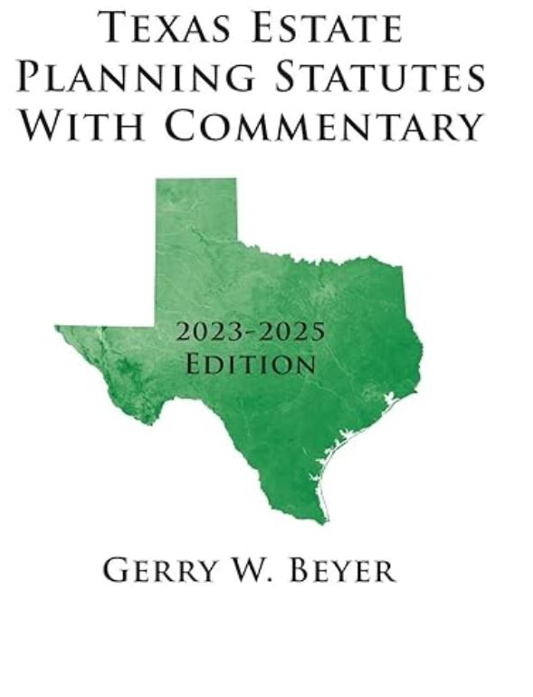
Course Materials
2. Texas Estate Planning Statutes with
Commentary (2023-2025 edition)

Slide 5


Office Information

Slide 6

E-mail Updates

Slide 7

Attendance
Attendance taken
via Top Hat.
Attendance will
close at 1:00 p.m.

Slide 8

Technology Etiquette

Slide 9
Class Procedure
Combination of:
  Lecture
  Socratic Method
  Top Hat Responses
  Discussion

Slide 10
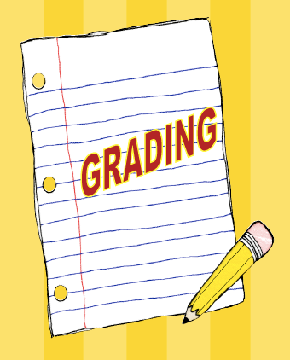
Grading

Slide 11
Components of grade
Intestacy, Wills, and Trusts Problem Set
Six drafting assignments
Tax assignment
Class participation (Top Hat quizzes, client interviews, research, etc.)
No examinations!

Slide 12
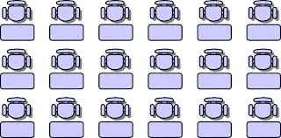
Seating Chart
Wednesday

Slide 13

Course Purposes

Slide 14

Course Outline

Slide 15

Questions?

Slide 16
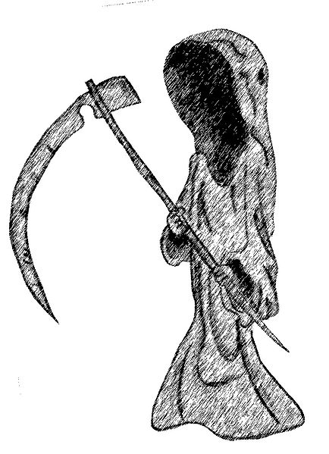
Basic Premise
Life is 100% fatal.
“That game of life is hard to play. I'm gonna lose it anyway. The losing card I'll someday lay.”
The Will Song

Slide 17
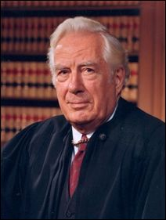
Will or No Will?
Chief Justice United States Supreme Court
Warren Burger

Slide 18
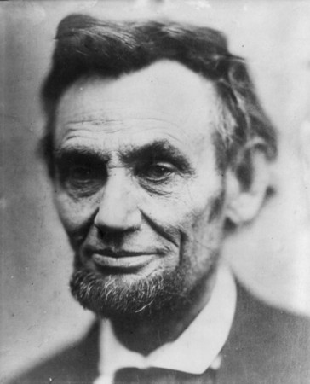
Will or No Will?
President of the United States
Abraham Lincoln

Slide 19
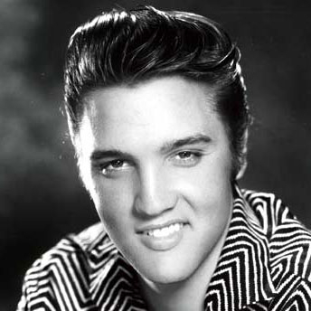
Will or No Will?
“The King”
Elvis Presley

Slide 20
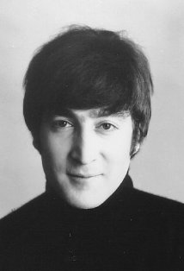
Will or No Will?
Beatles
John Lennon

Slide 21

Will or No Will?
Michael Jackson
“King of Pop”

Slide 22

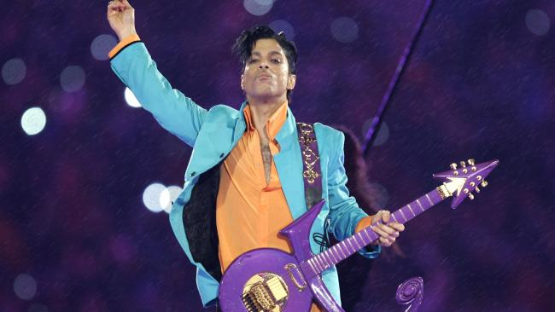
Will or No Will?
Prince

Slide 23
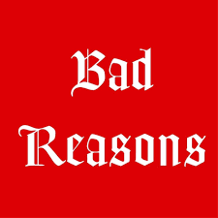
“Bad” Reasons No Planning Done

Slide 24
Basic Planning Process
1. Ascertain Client’s Intent
  Recipients of Property
    Who?
    When?
    Use?
  Person Managing Property
  Tax Concerns
  Disability Planning
  Death Planning

Slide 25
Basic Planning Process (continued)
2 Effectuate Intent
  Gather information
  Conduct research
  Select appropriate technique
  Prepare, execute, and protect documents
  Review and update estate plan on regular basis (e.g., yearly)
  Carry out estate plan upon disability and death

Slide 26

Estate Planning Team
Attorneys
Financial Planners
Life Insurance Underwriters
Fiduciaries
Accountants/CPAs
Family
Friends
Spiritual Advisors

