Slide 1

TRUSTS
Introduction

Slide 2
Basic Idea
Settlor
Legal Equitable
Interest Interest
Trustee Beneficiary

Slide 3
Basic Functioning
Settlor transfers legal title to trustee (honest and reliable) and equitable title to beneficiary (deserving of windfall).
Trustee manages property according to legal duties and settlor’s instructions.
Trustee distributes to beneficiaries according to settlor’s instructions.
Trust ends when duties complete.

Slide 4
Purposes and Uses of Trusts
1. Provide for and protect beneficiary
  Minors
  Incompetents
  People without management skills
  Spendthrifts
  Persons susceptible to influence

Slide 5
Purposes and Uses of Trusts
2. Flexibility of asset distribution
  Spread benefits over time.
  Give trustee discretion whom to pay and how much to pay.
  Set standards.
  Impose conditions.

Slide 6
Purposes and Uses of Trusts
3. Protection against settlor’s incompetence
  The “stand by” trust

Slide 7
Purposes and Uses of Trusts
4. Professional management of property

Slide 8
Purposes and Uses of Trusts
5. Probate avoidance.

Slide 9
Purposes and Uses of Trusts
6. Tax benefits

Slide 10
Warning!
Trusts, although very helpful, are not always worth the cost, expense, and hassle.

Slide 11
Governing Law
Common law.
Modern trend is to codify.
Many states, including Ohio, have a version of the Uniform Trust Code.

Slide 12
Trust Intent

Slide 13
Threshold Requirement
A trust is created only if the settlor manifests an intention to create a trust.

Slide 14
Basic Elements
1. Split of legal and equitable title.
2. Imposition of enforceable (fiduciary) duties on the holder of legal title.

Slide 15
Basic Principals
1. Exact use of trust language not needed.

Slide 16
Basic Principals
2. “Weak” language showing intent may be sufficient.

Slide 17
Basic Principals
3. Settlor need not know or understand technical trust words.

Slide 18
Basic Principals
4. Use of trust language is not conclusive.

Slide 19
Basic Principals
5. Duties must be legally enforceable; not moral or ethical.
  Precatory language insufficient.

Slide 20
Basic Principals
6. Present intent needed.
  Intent to create a trust in the future is insufficient.

Slide 21
Statute of Uses
Source of trust intent requirements.
History of Uses:
  Before 15th Century – honorary only; not enforceable.
  During 15th Century – enforced in equity, even though not at law.
  Uses used to avoid duties of property ownership under feudal land ownership system.

Slide 22
Statute of Uses
English Statute of Uses enacted in 1535.
  Converted beneficiary’s equitable interest into legal interest thereby eliminating legal interest formerly held by the trustee.
  Called “executing the use.”

Slide 23
Statute of Uses
Exception developed at common law
  The “active” use where the trustee had actual duties to perform (not just a mere title holder).

Slide 24
Permissible combination of parties
At time of trust creation
During existence of trust.
  [live demonstration]
  Attempt to ascertain one rule to resolve all questions.

Slide 25
Permissible combination of parties
Basic principles
  Any combination of parties is permissible as long as sole trustee is not sole beneficiary.
  If all legal and equitable title in one person, merger occurs and no trust exists.

Slide 26
Distinguishing trusts from other legal relationships
Litigants often want a relationship to be a trust to enhance recovery chances.
Key to distinguishing is to remember that only a trust has both:
  Split of legal and equitable title, and
  Imposition of enforceable duties on holder of legal title.

Slide 27
Methods of Trust Creation

Slide 28
A. During Settlor’s Lifetime
1. Self-Declaration of Trust
  Settlor = Trustee

Slide 29
A. During Settlor’s Lifetime
2. Transfer or Conveyance in Trust
  Settlor ≠ Trustee

Slide 30
A. During Settlor’s Lifetime
Often called:
  “Inter vivos trust”
  “Living trust”

Slide 31
B. Upon Settlor’s Death
In settlor’s will
Precondition to trust validity = will validity
“Testamentary trust”

Slide 32
The Settlor

Slide 33
Generally
Creates trust by manifesting trust intent.
Also called:
  Trustor (old)
  Grantor (tax, overbroad)
  Donor (overbroad)
Corporations, partnerships, etc. can be settlors.

Slide 34
Capacity
Inter vivos trust = inter vivos gift capacity (or testamentary capacity in some states)
Testamentary trust = testamentary capacity

Slide 35
Retention of Powers by Settlor
Issue = How many powers may the settlor retain over the trust and its property?

Slide 36
Retention of Powers by Settlor
Modern Approach = Settlor may retain:
  Legal title (serve as trustee)
  Life interest
  Power to amend, modify, and revoke
  Power to change beneficiary
  Control over trust administration
  Ability to add property to trust

Slide 37
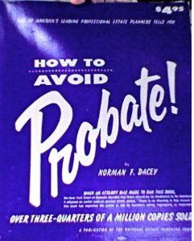
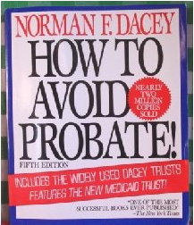
Retention of Powers by Settlor
“Dacey” Trusts
5 editions from 1965-1993.

Slide 38
Statute of Frauds

Slide 39
Basic Idea
Under certain circumstances, a trust must be evidenced by a writing.
Why? Whom does the writing requirement protect?

Slide 40
Possible exceptions
1. Oral trust of personal property.
2. Clear and convincing evidence.
3. Part performance (estoppel).

Slide 41
Notarization
Usually not required.
But, prudent practice so trust may be recorded.

Slide 42
Trust Purposes

Slide 43
General Rule
A trust may be created for any purpose that is not illegal.
Same basic rules as previously discussed for conditional gifts in wills.

Slide 44
Remedy
1. If defrauding creditors, set aside conveyance to trust up to amount of claim.
2. If otherwise improper purpose:
  Resulting trust (settlor regains property), or
  Permit trustee to retain property free of trust.
    How decide?

Slide 45
Trust Property

Slide 46
Basic Requirement
A trust must have property.
A trust is a method of holding title to property; a conveyancing relationship

Slide 47
Types of Property
Any transferable property:
  Real (present & future)
  Personal (tangible, intangible, choses in action, right to be a beneficiary, etc.)

Slide 48
Types of Property
But not property the settlor cannot immediately transfer:
  Non-assignable contract right
  Spouse’s share of community property
  Property to be acquired in the future
  Expectancy to inherit from someone still alive

Slide 49
Delivery
Real Property = deed
Personal Property = possession, deed of gift, title registration, etc.

Slide 50
Trustee

Slide 51
Generally
Holds legal title.
Must act in accordance with fiduciary standards.
Trustee’s legal title cannot be reached by trustee’s creditors and is not in trustee’s estate upon death.

Slide 52
Capacity
Trustee must be able to:
  Take title,
  Hold title, and
  Transfer title to trust property.

Slide 53
Capacity
Individuals:
  18 (or disabilities of minority removed), and
  Competent.
  Trustee may be the settlor or a beneficiary (as long as sole trustee is not sole beneficiary).

Slide 54
Capacity
Corporations
  Power to act as trustee under state law

Slide 55
Acceptance
Importance
  No liability until acceptance.

Slide 56
Acceptance
Methods
  Follow terms of trust
  Signature of trustee
  Exercise power or perform duty

Slide 57
Acceptance
Reasons to accept:
Reasons to not accept:

Slide 58
Trustee
[continued]

Slide 59
Acceptance
Trustee does not accept:
  Trust instrument names alternate.
  Trust instrument provides method of selecting alternate.
  In some states, unanimous agreement of beneficiaries.
  Court appointment upon petition of interested person.

Slide 60
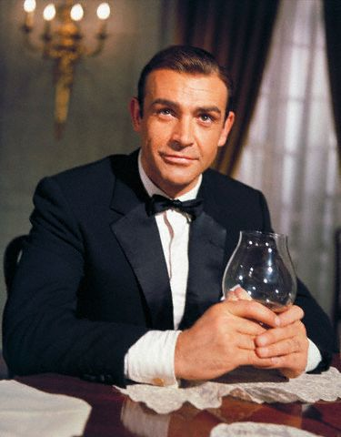

Bond

Slide 61
Bond
Presumption?
  Required, unless settlor waives.
  Not required, unless settlor requires.

Slide 62
Bond
Why require bond?
Why waive bond?

Slide 63
Multiple Trustees
Possible benefits:
Possible dangers:
May majority act?

Slide 64
Resignation
Follow procedure settlor provided in the trust. Otherwise,
Petition court for permission to resign.
But, some states allow trustee to give x day’s notice (e.g., 30) and resign.

Slide 65
Removal
Details later when we cover trust enforcement.

Slide 66
Beneficiary

Slide 67
Generally
Holds equitable title.
Enforces fiduciary duties against trustee.
Capacity = ability to take and hold property.

Slide 68
Description of Beneficiaries
Must be clearly ascertainable.

Slide 69
Description of Beneficiaries
Multiple beneficiaries allowed:
  Concurrent
  Successive

Slide 70
Honorary (Purpose) Trusts
Trust lacking a human beneficiary or charitable purpose.
  Care for pet
  Say masses
  Erect monuments

Slide 71
Honorary (Purpose) Trusts
Traditional approach = invalid
  Not private as no human beneficiary
  Not charitable as lacking charitable purpose

Slide 72
Honorary (Purpose) Trusts
Modern trend
  Pets = 45 states plus D.C. recognize statutory pet trusts
  Other purposes = allowed under UPC and UTC

Slide 73
Incidental Beneficiary
No equitable title but benefits from the trust nonetheless.
Typically, unable to enforce trust.
  Perhaps qualify as “interested person.”

Slide 74
Disclaimers

Slide 75
Transfer of Beneficial Interest

Slide 76
Power to Transfer or Assign
Presumption = able to transfer:
  Inter vivos (by gift or sale)
  At death (via intestacy or by will)

Slide 77
Power to Transfer or Assign
Restrictions:
  Life Interest – Beneficiary only received a life interest.
  Spendthrift provision – Beneficiary prohibited from transferring.

Slide 78
Power to Transfer or Assign
Priority of Assignments
  English view = notice necessary to complete the assignment as against a subsequent assignee
  American view = first assignee prevails

Slide 79
Involuntary transfers (creditors)
General rule = Beneficiary’s creditors may reach
Exceptions:
  Spendthrift provision
  Other state law protections

Slide 80
Spendthrift Provisions

Slide 81
Definition
A provision which typically prohibits:
  Beneficiary from transferring right to future payments of income or principal.
  Beneficiary’s creditors from subjecting the beneficiary’s interest to the payment of their claims.

Slide 82
Purposes
Protect beneficiary (asset protection).
Allow settlor to have trust property used as settlor intended.
Note: No requirement that beneficiary “needs” protection.

Slide 83
Time of protection
Interest protected only while in the trust.
Once trustee pays beneficiary, beneficiary may transfer and creditors may reach.

Slide 84
Methods of Creation
No particular language needed as long as settlor’s intent is clear.

Slide 85
Possible Exceptions to Enforceability
1. Settlor = Beneficiary
  Settlor cannot protect his/her own property from his/her creditors.
  Many offshore and some states allows self-settled spendthrift trusts.

Slide 86
Possible Exceptions to Enforceability
2. Necessaries

Slide 87
Possible Exceptions to Enforceability
3. Child or Spousal Support

Slide 88
Possible Exceptions to Enforceability
4. Federal Tax Claims

Slide 89
Possible Exceptions to Enforceability
5. Tort Claimants

Slide 90
Possible Exceptions to Enforceability
6. Always ineffective vis-à-vis creditors

Slide 91
Discretionary Provisions

Slide 92
Basic Idea
Trustee has discretion regarding:
  which beneficiaries to pay, and/or
  how much to pay.
May (or may not) be subject to a stated standard.
Also called “spray” or “sprinkle” trusts.

Slide 93
Interest of Beneficiary
No interest in income or principal until the trustee exercises discretion.
In effect, beneficiary hopes to receive property under a power of appointment the settlor placed into the trust.

Slide 94
Availability of interest to creditors
General rule = not reachable until paid
Exceptions similar to spendthrift exceptions

Slide 95
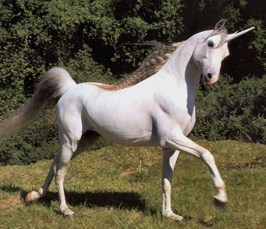
What does “discretion” mean?
No such thing as
“absolute” discretion.
Court will make sure that when trustee exercises discretion that it is in good faith, not out of spite, is honest, and free from prejudice.

Slide 96
Discretionary Provisions
[continued]

Slide 97
Discretion vs. Reasonableness
Does grant of discretion remove reasonableness requirement so trustee liable only for bad faith (evil) conduct?

Slide 98
Remedy for abuse of discretion
Court exercise?
Court instruction?

Slide 99
Support Provisions

Slide 100
Definition
Use of trust funds limited to beneficiary’s support, e.g.,
  Health
  Education
  Maintenance
  Support
Distributions may be mandatory or discretionary.

Slide 101
Drafting Considerations
1. Define support
  Default = level of support to which beneficiary accustomed before becoming a beneficiary.
  Does support of beneficiary include support of beneficiary’s dependents?

Slide 102
Drafting Considerations
2. Are beneficiary’s other resources to be considered?
  If yes, how?
    First dollars?
    Last dollars?

Slide 103
Pour Over Provisions

Slide 104
Life Insurance Trusts

Slide 105
Definition
Beneficiary of a life insurance policy is a trust, rather than the individual the insured ultimately wants to benefit upon his/her death.

Slide 106
Why used?
Obtain all benefits of a trust for life insurance proceeds, often the deceased’s most valuable asset.
Virtually essential if client has a minor or disabled child.
Helps create unified estate plan if trust used for other funds.

Slide 107
Recognition
Contract right to receive proceeds is sufficient to be trust property.
Life insurance may be made payable to trustee of inter vivos trust.
Life insurance may be made payable to trustee of testamentary trust.

Slide 108
Inter vivos or testamentary?
Reasons to use inter vivos trust:
Reasons to use testamentary trust:

Slide 109
Characteristics
1. Transfer other property to trust?
  Funded
  Unfunded

Slide 110
Characteristics
2. Allow settlor to undo plan?
  Revocable
  Irrevocable

Slide 111
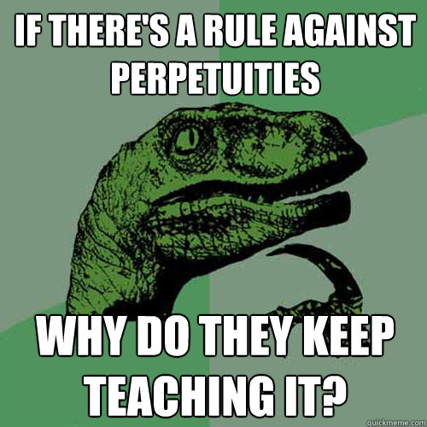
Rule Against Perpetuities

Slide 112
Basic Rule
“An interest is not good unless it must vest, if at all, not later than 21 years after some life in being at the time of the creation of the interest, plus a period of gestation.”

Slide 113
Interests Affected by RAP: The Test
All of the following must be true for RAP to apply:
Future interest (not present interest),
Contingent (not totally vested), and
Held by a transferee (not grantor).

Slide 114
Interests Affected by RAP: The Interests
Thus, if you classify an interest as one of the following, you must check for a RAP violation:
Contingent remainders,
Vested remainders subject to open, and
Executory interests including beneficial interests in trusts.

Slide 115
Armageddon RAP Test
6:00 a.m. = all lives in being give birth to a healthy baby.
Noon = all lives in being die but were successful in saving all of the babies born earlier in the day.
At 12:01 p.m., do you know for sure that the interest will vest (or not vest) by the end of 21 years?
  If yes = RAP not violated; interest is OK.
  If no = RAP is violated; interest is void

Slide 116
Parts of trust needed RAP compliance
1. Time of trust creation
Example 19-67

Slide 117
Parts of trust needed RAP compliance
2. Beneficial interests while trust ongoing
Example 19-68

Slide 118
Parts of trust needed RAP compliance
3. Beneficial interests when trust ends
Example 19-69

Slide 119
Rule Against Perpetuities
[continued]

Slide 120
What happens if RAP violated?
1. Common Law
  Entire trust void; not just the portion that violated RAP.
    Even if violation based on “wild” hypotheticals.

Slide 121
What happens if RAP violated?
2. Wait and See
  Based on reality, not hypotheticals.

Slide 122
What happens if RAP violated?
3. Expand period

Slide 123
What happens if RAP violated?
4. Cy pres
  Court reforms or construes interests that violate RAP.
  Follow settlor’s ascertainable general intent.

Slide 124
What happens if RAP violated?
5. Uniform Statutory Rule Against Perpetuities Act
  90 year time period from the of the grant (rather than lives in being),
  with a wait and see approach
  then, reformation if interest still has not vested.
    Thus, has never really been used because the Act is too recent to have allowed the 90 year time period to run.

Slide 125
What happens if RAP violated?
6. RAP repeal
  e.g., Alaska, Arizona, Colorado, Delaware, District of Columbia, Idaho, Illinois, Maine, Maryland, Missouri, Nebraska, New Jersey, Ohio, Rhode Island, South Dakota, Virginia Wisconsin.
  Why do states repeal RAP?

Slide 126
What happens if RAP violated?
7. Ohio -- § 2131.08 – General Rule
  “Any interest in real or personal property that would violate the rule against perpetuities * * * shall be reformed, within the limits of the rule, to approximate most closely the intention of the creator of the interest. In determining whether an interest would violate the rule and in reforming an interest, the period of perpetuities shall be measured by actual rather than possible events.”

Slide 127
What happens if RAP violated?
7. Ohio -- § 2131.09 – Opting Out
RAP will not apply if:
  (1) either:
    (a) the trustee has an unlimited power to sell all trust assets or
    (b) one or more persons, one of whom may be the trustee, have the unlimited power to terminate the entire trust, and
  (2) the instrument creating the trust specifically provides that the RAP does not apply to the trust.

Slide 128
Savings Clause
“ If a court of proper jurisdiction finds that this trust violates the Rule Against Perpetuities, the remaining trust property shall be distributed to [Beneficiary].”

Slide 129
Charitable Trusts

Slide 130
Introduction – Basic Purposes
Basic categories of charitable purposes:
  Relief of poverty
  Advancement of education
  Advancement of religion
  Promotion of health
  Government or municipal purposes

Slide 131
Size of charitable class
General rule = sufficiently large or indefinite class of beneficiaries so community is interested in enforcement of trust.
Exception?

Slide 132
Mortmain Provisions
Statute which limits gifts to charity under specified circumstances.
Often held to be unconstitutional under 14th Amendment’s equal protection clause.
Ohio has not had once since 1985.

Slide 133
Determination of Charitable Purpose
Altruistic motive
Who determines?
  Court, or
  Settlor?

Slide 134
Standard
“Generally accepted”
Advancement of ideas
  Held by many?
  Unique to settlor?
Whims?
Religious purposes

Slide 135
Other Charitable Trust Issues
Tax benefits
Exempt from RAP
Enforcement
Cy pres
Split interest trusts

