Slide 1
Other Will Issues

Slide 2
Conditional Wills

Slide 3
Defined
A will which states that it is effective only if a stated event occurs (or does not occur).
“This will is effective only if I die in 2012.”
“This will is effective only if Gladys Knight wins DWTS in 2012.”

Slide 4
Determining if a will is conditional
1. Presumption
Will is general, not conditional.
Events presumed to be inducements, not condition precedents.

Slide 5
Determining if a will is conditional
2. Examples – Inducements only
“I am going on a journey and I may never come back alive so I make this will.”
“I am going into open heart surgery tomorrow from which I might die so I make this will.”

Slide 6
Determining if a will is conditional
3. Example – Conditional
“Because I am sick and waiting for a heart surgery, and providing ahead of any emergency, I make the following disposition to be fulfilled in case my death occurs during the surgery.”
Testator survives the surgery and dies later.

Slide 7
Conditional Gifts

Slide 8
Condition Precedent
Event must occur before beneficiary may claim the gift.
“I leave $10,000 to X if she is a law school graduate at the time of my death.”

Slide 9
Condition Subsequent
Beneficiary receives and retains the gift until the condition is violated.
“I leave my house to X but if X is convicted of a crime, then the house goes to Y.”
X has a fee simple subject to a shifting executory limitation.
Y has a shifting executory interest.

Slide 10
Validity of Conditions
Note: Same basic rules as for trust conditions.

Slide 11
Validity of Conditions
1. Statement of Use
Normally, precatory.

Slide 12
Validity of Conditions
2. Illegal or against public policy purpose
Ineffective.

Slide 13
Validity of Conditions
3. Personal habits.
Often upheld.

Slide 14
Validity of Conditions
4. Marriage
Depends on facts.

Slide 15
Validity of Conditions
5. Divorce
Likely invalid.

Slide 16
Recommendations
1. Make condition clear.
2. Provide gift over.
3. Use a different estate planning technique such as a trust [preferred method].

Slide 17
Combination Wills

Slide 18

1. Joint Wills
Single document containing wills of two or more persons.

Slide 19
2. Reciprocal Wills
Separate wills with parallel dispositive plans.
“Sweetheart wills”
“I leave all to wife. If wife is dead, I leave all to children.”
“I leave all to husband. If husband is dead, I leave all to children.”

Slide 20
3. Contractual Wills
Will executed (or not revoked) pursuant to a valid contract.

Slide 21
3. Contractual Wills
Establishing contractual nature of will:
Common law = Extrinsic evidence allowed
Modern law = Will itself and, perhaps, other writings

Slide 22
3. Contractual Wills
Revocability of Contract
While both alive – generally revocable upon notice unless contract provides otherwise.
After one dies – generally irrevocable.
Note – will remains revocable even though revocation breaches contract.

Slide 23
3. Contractual Wills
Revocability of Will
Will is revocable but doing so may be breach.

Slide 24
3. Contractual Wills
Remedy for breach
Constructive trust imposed on person who received property in favor of person who should have received property.

Slide 25
3. Contractual Wills
Advice
Avoid.
Other techniques (e.g., trust) work better.

Slide 26
Election Wills

Slide 27
Basic Idea
A will which attempts to devise/bequeath property which a beneficiary owns.
“I leave Bill Smith’s car to Margaret and I leave Bill Smith $1,000.”
“I leave my house [proper legal description] to Bill Smith. I leave the rest of my estate to Margaret.”

Slide 28
Choices available to Beneficiary
1. Elect against the will
Beneficiary retains all of beneficiary’s property.
Beneficiary may not receive any property under the will.

Slide 29
Choices available to Beneficiary
2. Elect under the will
Beneficiary consents to disposition of beneficiary’s property in the will.
Beneficiary receives devise/bequest under the will.

Slide 30
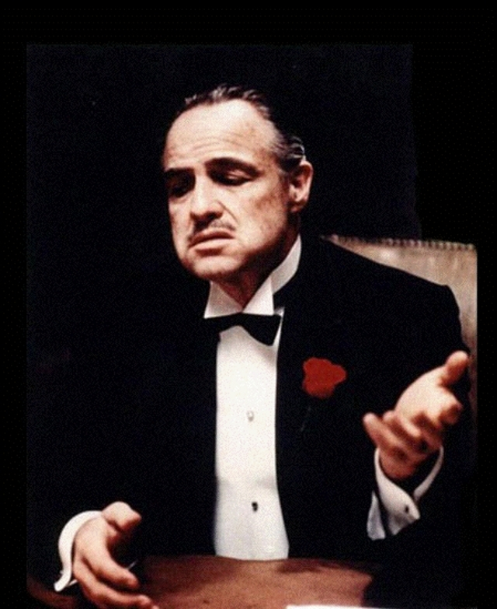
Use by “Controlling” Spouse in Community Property Jurisdictions
The wage-earning spouse wants to control where wages go upon death but normally can only control ½ because it is community property.
So, wage-earning spouse gives away all the community but leaves property (e.g., a life estate in entire community and separate) to spouse.

Slide 31
Warning for married testators
Do not create an election will by mistake.
E.g., by describing a specific gift so that it includes the surviving spouse’s community share.
Advice – include anti-election provision

Slide 32
Disclaimer

