Slide 1
Will Contests: Introduction

Slide 2
Who has motive to contest?
1. Heirs who would benefit by an intestate distribution.

Slide 3
Who has motive to contest?
2. Beneficiary of prior will who would take if new will is invalid.

Slide 4
Statute of Limitations
Tremendous state differences

Slide 5
Practice Tip
Should you contest will before or after its admission to probate? Why?

Slide 6
Failure to Satisfy Will Requirements

Slide 7
Failure to satisfy will requirements
Lack of legal capacity
Lack of testamentary capacity
Lack of testamentary intent
Failure to comply with formalities

Slide 8
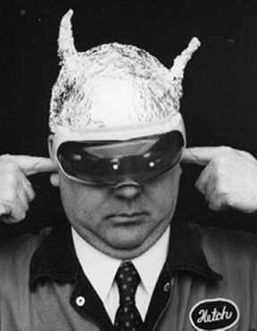
Insane Delusions

Slide 9
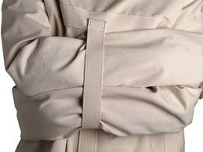
“Classic” Definition
Testator believes a state of supposed facts that:
1. Do not exist, and
2. No rational person would believe.

Slide 10
Examples
1. Gulf Oil
2. Maringo

Slide 11

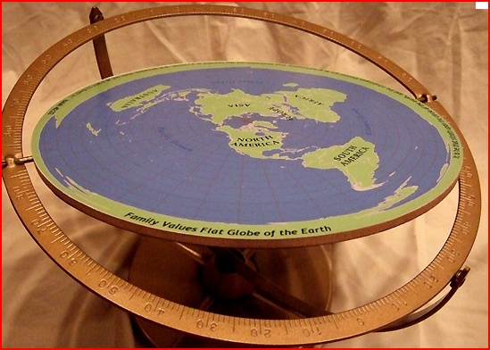
Analysis of Definition
Is classic definition a good test?
How tell an insane delusion from a false belief?

Slide 12

Nexus Requirement
Even if testator had an insane delusion, will remains valid unless insane delusion impacts property disposition.

Slide 13
Undue Influence

Slide 14
Basic Elements
1. Influence
Existence
Be exerted

Slide 15
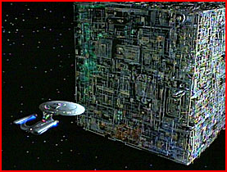
Basic Elements
2. Subvert testator’s mind
“Resistance is futile”

Slide 16
Basic Elements
3. Causation
Testator executed a will testator would not have executed but for the influence.

Slide 17
Proving Undue Influence
1. Direct Evidence
Rare

Slide 18
Proving Undue Influence
2. Circumstantial Evidence
a. Unnatural disposition

Slide 19
Proving Undue Influence
2. Circumstantial Evidence
a. Unnatural disposition
b. Opportunity (access)

Slide 20
Proving Undue Influence
2. Circumstantial Evidence
a. Unnatural disposition
b. Opportunity (access)
c. Relationship

Slide 21
Proving Undue Influence
2. Circumstantial Evidence
a. Unnatural disposition
b. Opportunity (access)
c. Relationship
d. Susceptibility/ability to resist

Slide 22
Proving Undue Influence
2. Circumstantial Evidence
a. Unnatural disposition
b. Opportunity (access)
c. Relationship
d. Susceptibility/ability to resist
e. Beneficiary connected with will preparation or execution.

Slide 23
Effect of Mere Influence

Slide 24
Effect of Mere Opportunity

Slide 25
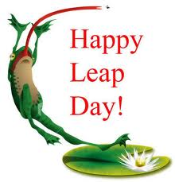

Slide 26
Mortmain Statute
Statute which limits gifts to charity under specified circumstances.
Often held to be unconstitutional under 14th Amendment’s equal protection clause.

Slide 27
Attorney as Will Drafter and Beneficiary -- Impact on Gift
Gift deemed or presumed void?
Scope?
Exceptions?

Slide 28
Attorney as Will Drafter and Beneficiary -- Impact on Law License
Rules of Professional Conduct 1.8(c)
Presumption – violates Rules
Impact – Gift not automatically voided but attorney subject to discipline

Slide 29
Attorney as Will Drafter and Beneficiary -- Impact on Law License
Beneficiaries within scope of prohibition:
Attorney
Parent of attorney
Child of attorney
Sibling of attorney
Spouse of attorney

Slide 30
Attorney as Will Drafter and Beneficiary -- Impact on Law License
Exceptions:
1. Gift not substantial.
2. Testator related to beneficiary.

Slide 31

Attorney as Will Drafter and Beneficiary -- Advice
Don’t do it, even for family members.

Slide 32
Duress

Slide 33
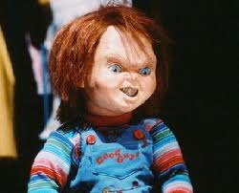
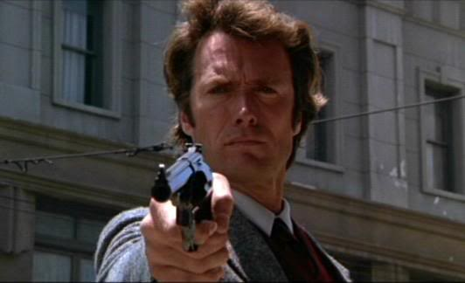
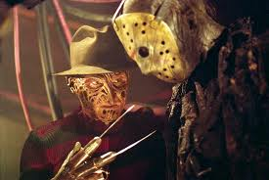
Duress
Same as undue influence but connotes physical (as compared to cerebral) pressure.

Slide 34
Fraud

Slide 35
Elements
1. False representation to testator.

Slide 36
Elements
1. False representation to testator.
2. Knowledge of falsity.

Slide 37
Elements
1. False representation to testator.
2. Knowledge of falsity.
3. Testator reasonably believed representation.

Slide 38
Elements
1. False representation to testator.
2. Knowledge of falsity.
3. Testator reasonably believed representation.
4. Causation

Slide 39
Types of Fraud
1. Fraud in the Factum (Fraud in the Execution)
Testator deceived as to identity or contents of instrument.
“I did not know I was signing a will.”
[actually, no testamentary intent]

Slide 40
Types of Fraud
2. Fraud in the Inducement
Testator deceived as to extrinsic fact and makes will based on that fact.
“I knew I was signing a will but would not have done so if I knew the truth.”
[actually, no testamentary intent]

Slide 41
Mistake

Slide 42
Types of Mistake
1. Mistake in the Factum/Execution
Testator did not know testator was signing a will but not because of someone’s evil conduct.
No testamentary intent.

Slide 43
Types of Mistake
2. Mistake in the Inducement
Testator mistaken as to extrinsic fact and makes will based on that fact.
“I knew I was signing a will but would not have done so if I wasn’t mistaken.”

Slide 44
Types of Mistake
Remedy for mistake in the inducement
Typically, no remedy. Courts usually have no right to vary or modify the terms of a will or to reform it on the grounds of mistake.
Some courts/statutes may permit reformation if evidence is sufficient.

Slide 45
Will Contest Remedies

Slide 46
1. Denial of Probate
Most common remedy.
Partial invalidity is possible, but rare.

Slide 47
2. Constructive Trust
Equitable remedy to prevent unjust enrichment.

Slide 48
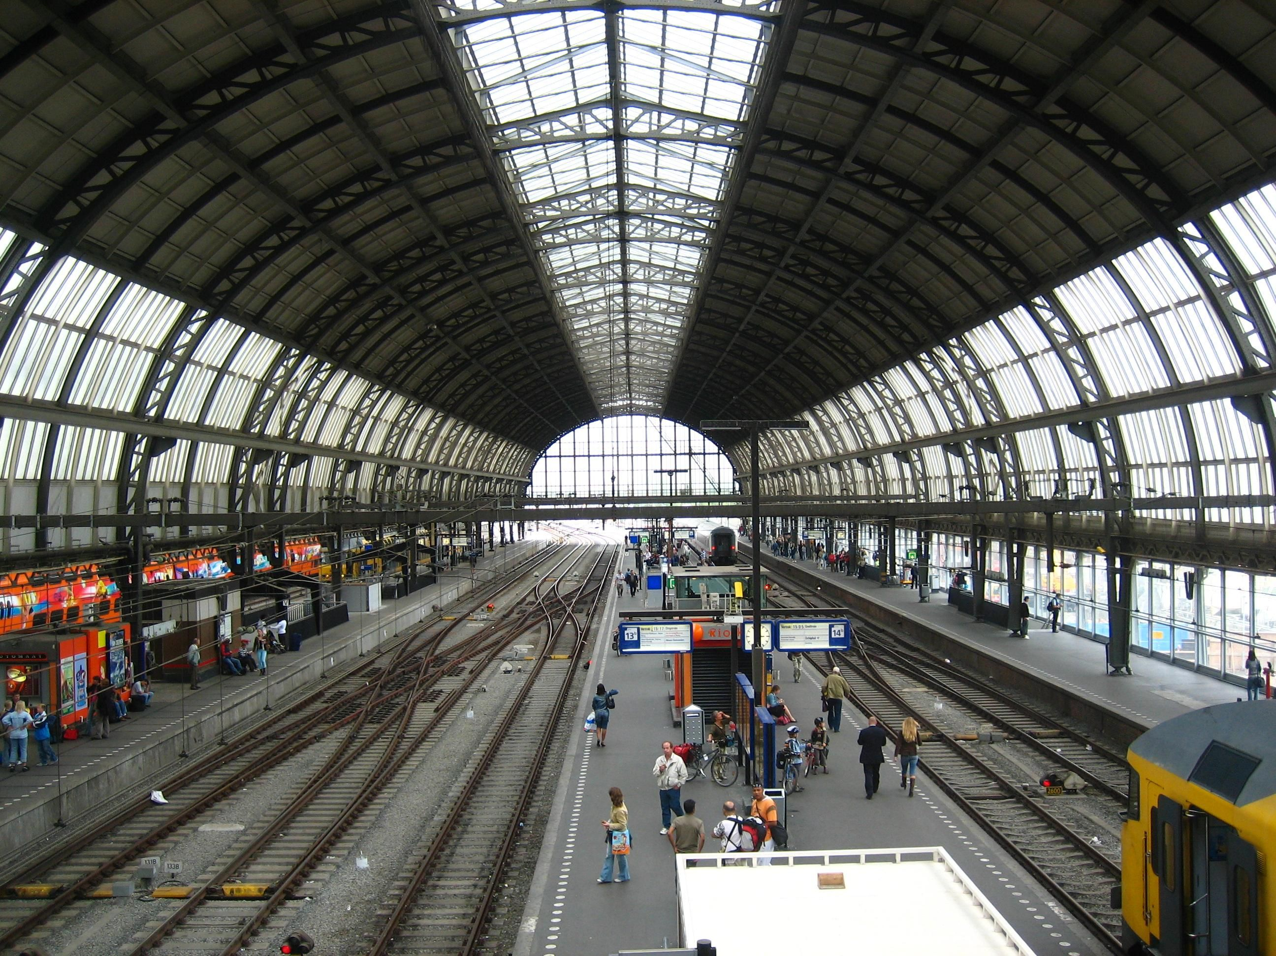

Slide 49
Will Contest Prevention

Slide 50
Reasons to Anticipate Will Contest
1. Exclusion of natural objects of bounty

Slide 51
Reasons to Anticipate Will Contest
1. Exclusion of natural objects of bounty
2. Unequal treatment of children

Slide 52
Reasons to Anticipate Will Contest
1. Exclusion of natural objects of bounty
2. Unequal treatment of children
3. Sudden or significant change in disposition plan

Slide 53
Reasons to Anticipate Will Contest
1. Exclusion of natural objects of bounty
2. Unequal treatment of children
3. Sudden or significant change in disposition plan
4. Excessive restrictions on gifts to beneficiaries who are also heirs

Slide 54
Reasons to Anticipate Will Contest
1. Exclusion of natural objects of bounty
2. Unequal treatment of children
3. Sudden or significant change in disposition plan
4. Excessive restrictions on gifts to beneficiaries who are also heirs
5. Elderly or disabled testator

Slide 55
Reasons to Anticipate Will Contest
1. Exclusion of natural objects of bounty
2. Unequal treatment of children
3. Sudden or significant change in disposition plan
4. Excessive restrictions on gifts to beneficiaries who are also heirs
5. Elderly or disabled testator
6. Testator who behaves strangely

Slide 56
Techniques – The “Tool Box”
1. Include in terrorem (no contest) (forfeiture) provision
Beneficiary who contests and loses forfeits testamentary gift.

Slide 57
Techniques – The “Tool Box”
1. Include in terrorem (no contest) (forfeiture) provision
Strictly construed.
Good faith/probable cause exception is common.

Slide 58
Techniques – The “Tool Box”
1. Include in terrorem (no contest) (forfeiture) provision
Drafting guidelines:
Create substantial risk

Slide 59
Techniques – The “Tool Box”
1. Include in terrorem (no contest) (forfeiture) provision
Drafting guidelines:
Create substantial risk
Describe triggering conduct

Slide 60
Techniques – The “Tool Box”
1. Include in terrorem (no contest) (forfeiture) provision
Drafting guidelines:
Create substantial risk
Describe triggering conduct
Indicate beneficiary of forfeited property

Slide 61
Techniques – The “Tool Box”
2. Do not explain reasons for property disposition.

Slide 62
Techniques – The “Tool Box”
3. Avoid bitter or hateful language.

Slide 63
Techniques – The “Tool Box”
4. Use holographic “back up” will.

Slide 64
Techniques – The “Tool Box”
5. Enhance will execution ceremony.

Slide 65
Techniques – The “Tool Box”
6. Video-record will execution ceremony.

Slide 66
Techniques – The “Tool Box”
7. Select witnesses thoughtfully.

Slide 67
Techniques – The “Tool Box”
8. Obtain affidavits of individuals familiar with testator.

Slide 68
Techniques – The “Tool Box”
9. Document transactions with testator verifying intent.

Slide 69
Techniques – The “Tool Box”
10. Obtain other evidence to document testator’s actions.

Slide 70
Techniques – The “Tool Box”
11. Preserve prior will if better than intestacy.

Slide 71
Techniques – The “Tool Box”
12. Reexecute same will on regular basis.

Slide 72
Techniques – The “Tool Box”
13. Consider a more “traditional” disposition.

Slide 73
Techniques – The “Tool Box”
14. “Trick” disinherited potential heir with inter vivos gift.

Slide 74
Techniques – The “Tool Box”
15. Use non-probate techniques.

Slide 75
Techniques – The “Tool Box”
16. Convince disinherited potential heir to agree not to contest (contract).

Slide 76
Ante-Mortem Probate

Slide 77
Basic Idea
Obtain declaratory judgment while testator is alive that will is valid.
Thus, cannot contest after testator dies.
Allowed in Alaska, Arkansas, North Dakota, and Ohio.

Slide 78
Advantages
Testator available for observation and to testify.
Reduces will contests.
Carries out testator’s intent.

Slide 79
Disadvantages
Disruptive to family.
Contents of will revealed.
Potential for testator embarrassment.
Cost.

Slide 80
Family Settlement Agreements

Slide 81
Basic Idea
All heirs and beneficiaries contractually agree on distribution of testator’s property.

Slide 82
Tortious Interference with Expectancy

