Slide 1


Slide 2
Interpretation and Construction

Slide 3
Interpretation
Determine testator’s actual intent from will or permissible extrinsic evidence.

Slide 4
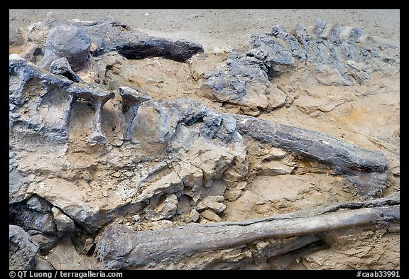
Construction
Determine testator’s presumed intent from will or permissible extrinsic evidence.

Slide 5
When issue arises?
1. Before probate (not often)
2. After probate (most common)

Slide 6
Who raises issue?
1. Personal Representative
2. Beneficiaries and heirs

Slide 7
Ambiguity

Slide 8
1. Patent Ambiguity
Ambiguous on its face
“I leave &^,#@( to Erica Evans.”
“I leave my zdcix to Chad Decker.”
“I leave _____________ to Ryan Nichols.”

Slide 9
2. Latent Ambiguity
Makes sense on face but cannot be carried out as written.
“To my sister Pat.”
Testator has a sister named Chris and a brother named Pat.
“I leave my car to X.”
Testator owns three cars.
“I leave my house at 15426 Comstock to X.”
Testator owns a house at 15428 Comstock.

Slide 10
3. No Apparent Ambiguity
Meaning is clear but can extrinsic evidence be used to “create” an ambiguity?
Jurisdictions are divided:
Clear meaning rule, or
Admit extrinsic evidence

Slide 11
Integration

Slide 12
1. External Integration
Putting together different documents to create testator’s will.
How to avoid problems?

Slide 13
2. Internal Integration
Continuity within instrument.
Goal = avoid fraudulent page insertion/substitution
How to avoid problems?
See pp. 182-183

Slide 14
Incorporation by Reference

Slide 15
Basic Idea
Treat written material that is not physically part of the text of the will text as being in the will.
A “legal fiction” (pretending).

Slide 16
Requirements
1. Testator must intend to incorporate.

Slide 17
Requirements
2. Incorporated writing must be in existence when testator executes the will.

Slide 18
Requirements
3. Incorporated writing must be reasonably identified.

Slide 19
Issues
1. Validity of incorporated writing irrelevant.

Slide 20
Issues
2. Codicil incorporates will (basis of republication)

Slide 21
Issues
2. Codicil incorporates will (basis of republication)
What result if:
a. Valid will + Valid codicil

Slide 22
Issues
2. Codicil incorporates will (basis of republication)
What result if:
b. Valid will + Invalid codicil

Slide 23
Issues
2. Codicil incorporates will (basis of republication)
What result if:
c. Invalid will + valid codicil

Slide 24
Interpretation and Construction [continued]

Slide 25
Facts of Independent Significance

Slide 26
Basic Idea
Can we look outside the four corners of the will to ascertain at-death property distribution?

Slide 27
Defined
Something which has a legal purpose independent of disposing of property at death.
Thus, can be effective to impact new owner of property without compliance with will formalities.

Slide 28

Examples
1. Safe deposit box contents

Slide 29
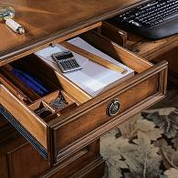
Examples
2. Note in desk drawer

Slide 30
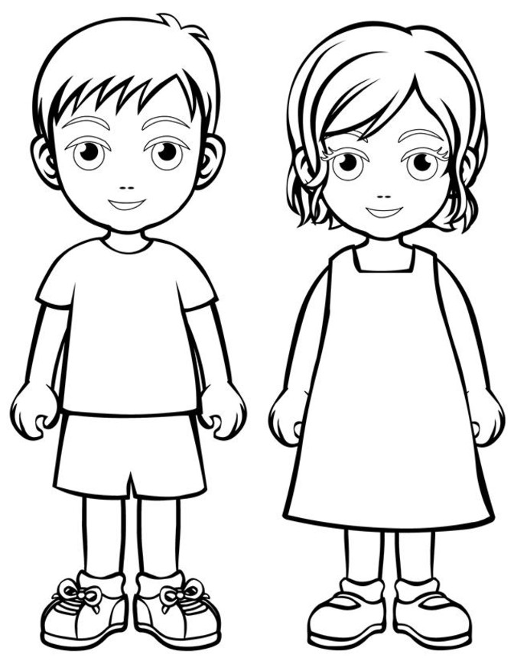
Examples
3. Identity of class gift members

Slide 31
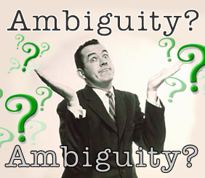
Examples
4. Evidence to resolve ambiguities

Slide 32
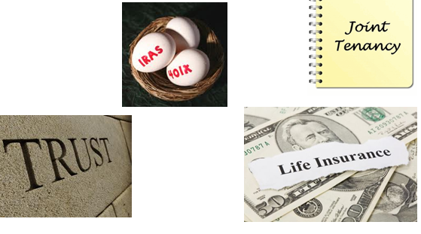
Examples
5. Non-probate transfers

Slide 33

Examples
6. Tagging items of personal property
To my daughter, Doris.

Slide 34
Tangible Personal Property Document

Slide 35
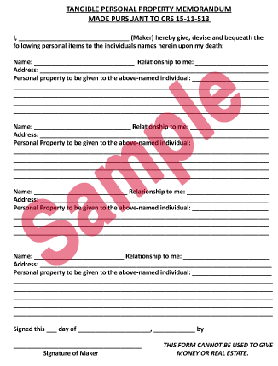

Slide 36
Pour Over Provisions

Slide 37
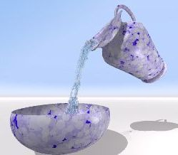
Defined
Will provision leaving property to inter vivos trust.
Why used?
__________
__________
__________
__________
Will
Trust

Slide 38
Historical Development
1. Not allowed.

Slide 39
Historical Development
2. Incorporation by reference.

Slide 40
Historical Development
3. Facts of independent significance.

Slide 41
Historical Development
4. Codification
Uniform Testamentary Additions to Trusts Act (1960)
Uniform Testamentary Additions to Trusts Act (1991)
State tinkering with Uniform Act (Ohio § 2107.03)

Slide 42
Authorization of Technique
Expressly authorizes pour over technique.

Slide 43
Types of trusts into which pour overs allowed
1. Trust created by testator
Before or at time of will execution = OK
After will execution = ??

Slide 44
Types of trusts into which pour overs allowed
2. Trust created by another person
Before or at time of will execution = OK
After will execution = ??

Slide 45
Types of trusts into which pour overs allowed
3. Can pour over funds be the initial trust funding?
Traditional/Ohio view = no
Modern view =yes

Slide 46
Types of trusts into which pour overs allowed
4. Cannot pour over into revoked or terminated trust.

Slide 47
Governance of poured-over property
Amendments made after will execution:
Before the testator’s death?
After the testator’s death?

Slide 48
Precatory Language

Slide 49
Defined
Serious request but not legally binding.
Examples:
“I hope”
“I would like”
“I recommend”
“I wish”

Slide 50
Ramifications
1. To restrict or limit gifts
Generally ineffective.

Slide 51
Ramifications
2. To instruct personal representative
Likely to be effective.

Slide 52
Advice
______________________________
______________________________

Slide 53
Class Gifts

Slide 54
Defined
Beneficiaries described generically.
Examples:
“Children”
“Grandchildren”
“Brothers”
“Siblings”

Slide 55
Individual or Class Gift?
“I leave all my estate to my children,
A and B.”

Slide 56
Time of Determining Class Membership
1. Express language in will.

Slide 57
Time of Determining Class Membership
2. Earlier of:
a. Natural closing of class, and
b. When first class member entitled to property.

Slide 58
Time of Determining Class Membership
3. Examples:
“to all of my grandchildren”
“income to A for life, upon A’s death, remainder to A’s children”
“income to A’s children until last child dies”

Slide 59
Adopted children as class members
Generally included.
But, some states may exclude if adopted as adult.

Slide 60
Practice Tip
Explain how testator wants class membership determined:
Adopted individuals?
If yes, by what age?
Non-marital individuals?
ART individuals?

Slide 61
Dead Persons Statute

Slide 62
Issue
Can evidence of what testator said or did be used as evidence in will litigation?
Traditional approach
Modern view
Ohio Rule of Evidence 601

