Slide 1
Will Revocation

Slide 2
Revocation by Operation of Law

Slide 3
Types
1. Ademption

Slide 4
Types
1. Ademption
2. Divorce

Slide 5
Types
1. Ademption
2. Divorce
3. Lapse

Slide 6
Types
1. Ademption
2. Divorce
3. Lapse
4. Failure to survive by 120 hours

Slide 7
Types
1. Ademption
2. Divorce
3. Lapse
4. Failure to survive by 120 hours
5. Pretermitted child

Slide 8
Types
1. Ademption
2. Divorce
3. Lapse
4. Failure to survive by 120 hours
5. Pretermitted child
6. Murder

Slide 9
Revocation by Physical Act

Slide 10

Requirements to Revoke by Physical Act
1. Mental Capacity

Slide 11
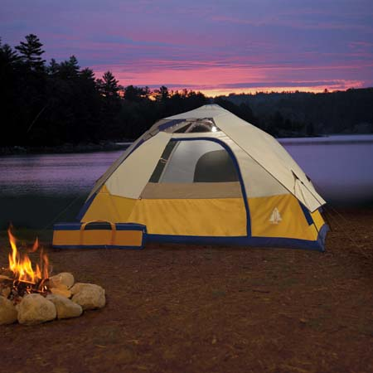
Requirements to Revoke by Physical Act
2. Revocation Intent

Slide 12

Requirements to Revoke by Physical Act
3. Physical Act [Ohio]
Tearing
Canceling
Obliterating
Destroying

Slide 13
Requirements to Revoke by Physical Act
3. Physical Act
By Proxy?
Proxy in testator’s presence?
Proxy upon testator’s written instruction, even if not in testator’s presence?

Slide 14
Requirements to Revoke by Physical Act
4. Concurrence of first three requirements.

Slide 15
Remedy if intent and physical act do not mesh
1. If no evil conduct
No remedy – will is not revoked.

Slide 16
Remedy if intent and physical act do not mesh
2. If evil conduct
Constructive trust.

Slide 17
Partial revocation by physical act
Examples:
I leave $10,000 to Walter Bishop
I leave $10,000 to each of Walter Bishop and Peter Bishop.
Approaches:
Effective to revoke gift
No effect on gift

Slide 18
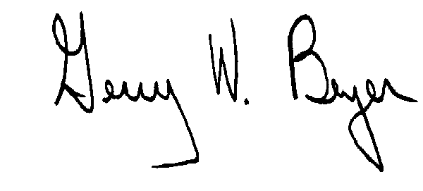
Partial revocation by physical act
1. I leave my house to X.
2. I leave $10,000 to Y.
3. I leave the rest to Z.
What result?

Slide 19
Revocation by Subsequent Writing

Slide 20
Types of revocation writings
1. Will

Slide 21

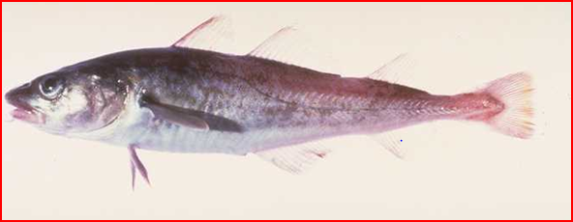
Types of revocation writings
2. Codicil

Slide 22
Types of revocation writings
3. Declaration in writing with will formalities.

Slide 23
Methods of revocation by subsequent writing
1. Express Revocation

Slide 24
Methods of revocation by subsequent writing
2. Revocation by inc0nsistency

Slide 25
Practice question
Client wants to make minor changes to an existing will.
New will?
Codicil?

Slide 26
Presumptions

Slide 27
Proponent’s Burden
Applicant must prove testator did not revoke the will.
How prove a negative?

Slide 28
Presumption of Non-Revocation
Will found in “normal” location, and
No suspicious circumstances.

Slide 29
Presumption of Revocation
Testator possessed will when last seen and it cannot be found after death.

Slide 30
Revival

Slide 31
Fact Pattern
1. Testator executed valid Will 1.
2. Testator executed valid Will 2 which expressly revoked Will 1.
3. Testator validly revokes Will 2 but does not execute a new will.
4. What result?

Slide 32

Approaches
1. Revival
Will 1 takes effect.

Slide 33

Approaches
2. No Revival
Intestacy.

Slide 34
Approaches
3. Intent (UPC)
Will 1 or intestacy, depending on evidence of testator’s intent.

Slide 35
Conditional Revocation

Slide 36
1. Express conditional revocation
“I revoke my will if [condition] occurs.”

Slide 37
2. Implied conditional revocation (Dependent Relative Revocation)
Fact Pattern:
1. Testator executed valid Will 1.
2. Testator validly revoked Will 1.
3. Testator executed Will 2, but it is invalid.
Was revocation of Will 1 impliedly conditioned (dependent) on Will 2 being valid?

Slide 38
Multiple Originals

Slide 39
Presumption
If cannot locate all originals, testator destroyed one original with intent to revoke.

Slide 40
Rebutting Presumption
Evidence may show testator destroyed “extra” originals realizing wisdom of having only one original.

Slide 41

Apply “Cocaine Rule”

