Slide 1
Changing Circumstances
Persons

Slide 2

Marriage

Slide 3
Common Law Marital Property States – The Forced or Elective Share
Protects surviving spouse from disinheritance
Choice between:
  Gifts in will, and
  Statutory share
Replaces dower and curtesy.

Slide 4
Common Law Marital Property States – The Forced or Elective Share
Computation varies among the states:
  Straight percentage
  Percentage that varies depending on number of children
  Percentage based on length of marriage

Slide 5
Common Law Marital Property States – The Forced or Elective Share
Augmented Estate
  Include in computation value of non-probate assets that pass to others
    Survivorship rights in land
    Contractual rights (bank accounts, life insurance, etc.)
    Property gifted inter vivos

Slide 6
Community Property Marital Property States
Surviving spouse already owns 50% of community property.
Thus, deceased spouse’s will can only dispose of 50% of the community.

Slide 7
Changing Circumstances
Persons
[continued]

Slide 8


Slide 9
Impact of Divorce on Will
Common law = none
Modern law = all provisions in favor of ex-spouse ineffective
  Beneficiary
  Executor
  Trustee
  Guardian of children

Slide 10
Divorce issues
Where does property left to ex-spouse go?
What about gifts to other ex-relatives?
What if will written (or treated as written) after divorce?
What if divorce pending?

Slide 11

Pretermitted Heirs

Slide 12
Potential to receive a forced share
Born or adopted after will execution = most states
Born or adopted before will execution = only a few states
  Mistaken belief of death
  Unknown birth

Slide 13
Determination of Forced Share
Significant jurisdictional variation.

Slide 14
Typical situations where no share
1. Intentional omission
  “I make no provision for any child born after I execute this will.”

Slide 15
Typical situations where no share
2. Testator provided for child
  Class gift to children
  Non-probate asset

Slide 16
Typical situations where no share
3. Entire estate to pretermitted child’s other parent

Slide 17
Lapse

Slide 18
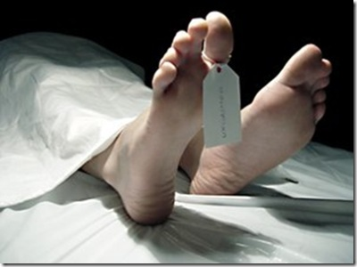
Lapse defined
Gift fails (lapses) because beneficiary dies before testator.

Slide 19
Distribution of Lapsed Gifts
1. Under express terms of will.

Slide 20
Distribution of Lapsed Gifts
2. Saved by legal rule.
  Private Gift – Anti-lapse statute
  Charitable Gift – Cy pres doctrine

Slide 21
Distribution of Lapsed Gifts
3. Via residuary clause.

Slide 22
Distribution of Lapsed Gifts
4. Via intestacy.

Slide 23
Anti-Lapse Statutes
1. Save gift for descendants of deceased beneficiary.

Slide 24
Anti-Lapse Statutes
2. Jurisdictions vary regarding relationship needed between testator and beneficiary to trigger anti-lapse statute.

Slide 25
Partial Lapse in Residuary Clause
Fact Pattern:
  “I leave remainder of my estate to A, B, and C.”
  A dies before Testator.
  Anti-lapse statute is inapplicable.
Issue:
  Who gets A’s share?

Slide 26
Partial Lapse in Residuary Clause
  “I leave remainder of my estate to A, B, and C.”
Orthodox View
  Passes by intestacy.

Slide 27
Partial Lapse in Residuary Clause
  “I leave remainder of my estate to A, B, and C.”
Modern View
  Imply survivorship language.

Slide 28
Ways to avoid anti-lapse statute
Provide alternate gift in will.
Require survival in will.

Slide 29


Slide 30
Cy Pres
Method of saving lapsed charitable gifts.
Testator must have general charitable intent.
Gift saved for equitably equivalent charity.

Slide 31
Survival

Slide 32
Issue
Does an beneficiary need to outlive the testator by a certain length of time?

Slide 33
Policies
Prevent multiple administrations of property.
Avoid proof problems and gruesome evidence.
Carry out intent.

Slide 34
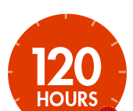
Time Period
By statute = 120 hours (5 days) is typical
Express terms of the will often extend period to 30, 60, or 90 days.

Slide 35
Where does property go?
As if beneficiary who did not survive long enough died first.
In other words, follow the lapse analysis even though beneficiary biologically survived.

