Slide 1
Changing Circumstances Property

Slide 2
Types of Testamentary Gifts

Slide 3

1. Based on type of property
1. Devise -- Gift of real property.

Slide 4

1. Based on type of property
2. Bequest -- Gift of personal property.

Slide 5
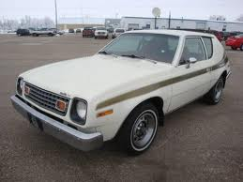
1. Based on type of property
Specific devise or bequest
Ascertainable at time of will execution.
“I leave my 1974 AMC Gremlin to X.”

Slide 6
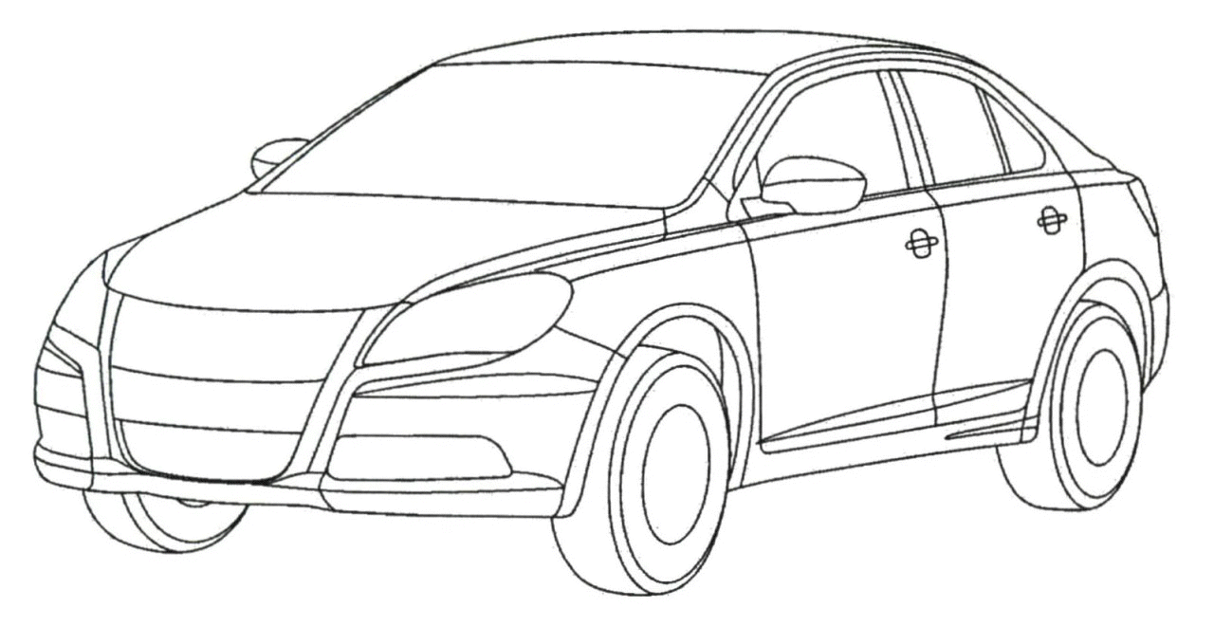
1. Based on type of property
Specific devise/bequest of a general nature
Not ascertainable until time of death.
“I leave my car to X.”

Slide 7
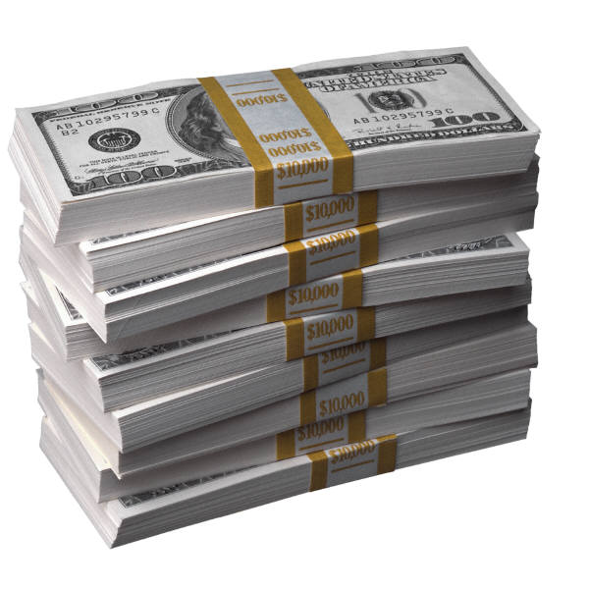
1. Based on type of property
3. General gift – not sufficiently described to be specific
Example = Legacy (gift of money)

Slide 8
1. Based on type of property
4. Demonstrative gift
Gift of money payable out of designated fund.
“I leave $1,000 from my savings account at Frost Bank to X.”

Slide 9
1. Based on type of property
4. Residuary Gift
“Forgotten” items, or
Main gift

Slide 10
2. Based on type of beneficiary
1. Private (non-charitable)

Slide 11
2. Based on type of beneficiary
2. Charitable
Relief of poverty
Advancement of education
Advancement of religion
Promotion of health
Governmental or municipal purposes

Slide 13
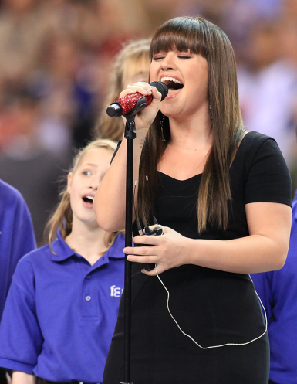
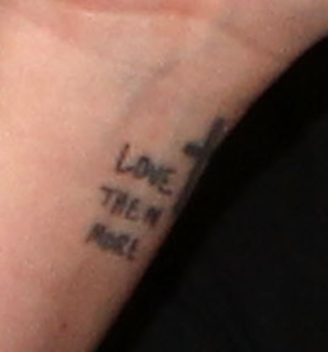
Kelly Clarkson Not National Anthem lyrics – just a tat

Slide 14
Ademption

Slide 15
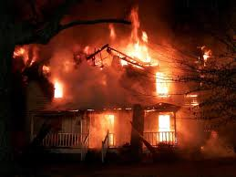

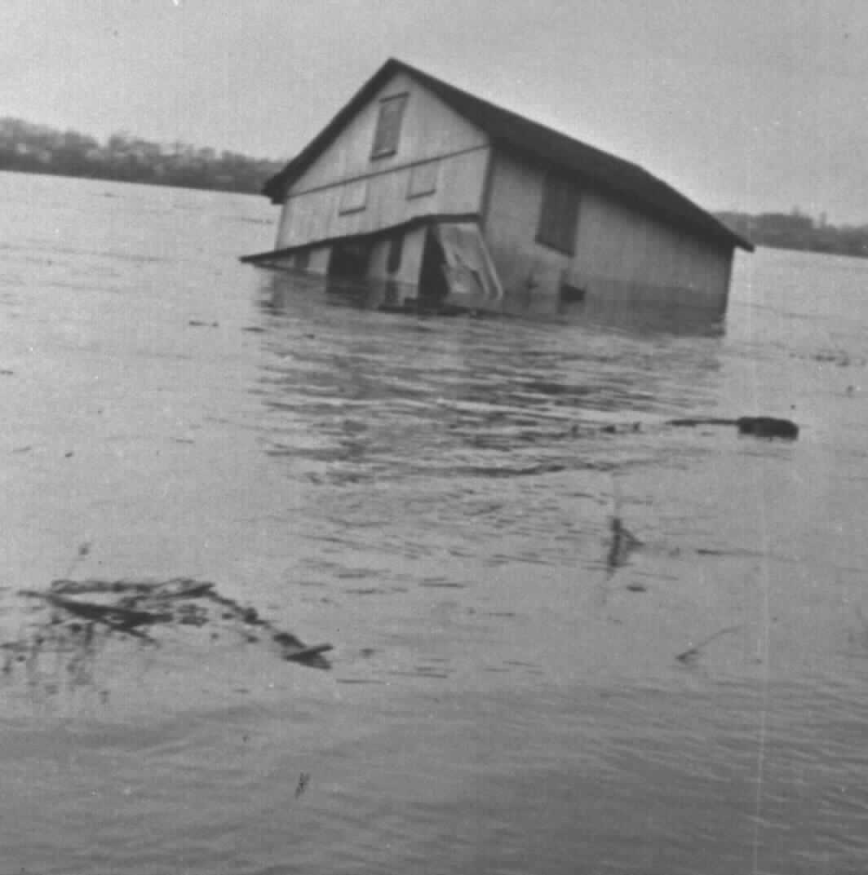
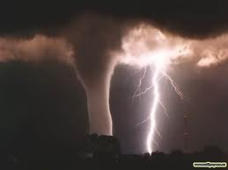
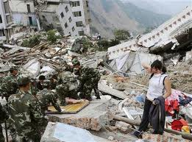
Causes

Slide 16
Basic Principles of Ademption
1. A specific gift adeems, that is, fails.

Slide 17
Basic Principles of Ademption
2. Voluntary partition among c0-owners
Regarding part testator still owns, no ademption.

Slide 18
Basic Principles of Ademption
3. Pro tanto (“only to that extent”)
Regarding part testator still owns, no ademption.

Slide 19
Possible Remedies
1. Beneficiary receives equivalent value
No!

Slide 20
Possible Remedies
2. Executor purchases item for beneficiary
No!

Slide 21
Possible Remedies
3. Tracing
Jurisdictions vary.
Probably yes, if involuntary sale
Possibly yes, if insurance proceeds

Slide 22
Possible Remedies
4. Substantially equivalent gift
Majority = no
Minority = Some states allow beneficiary to receive a substantially equivalent gift if contained in testator’s estate.

Slide 23
Application to corporate stock
Specific
Words of Identification
Words of Possession
General

Slide 24
Practice Advice
1. _____________________________
2. _____________________________

Slide 25
Practice Advice
I leave my 1974 AMC Gremlin to X.
If this car is not in my estate at the time of death,
[this gift adeems.]
[X may select one car from my estate.]
[X receives $25,000.]
[X gets my Sony computer.]

Slide 26
Satisfaction

Slide 27
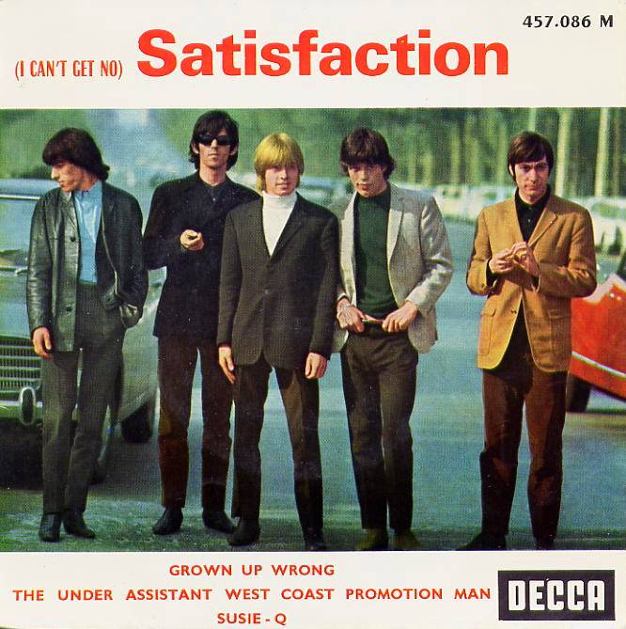
Rolling Stones

Slide 28
Basic Idea
Beneficiary receives gift while testator is still alive so cannot get it “again.”
A type of ademption.
Corollary of advancement.

Slide 29
Troublesome gift
“I leave $150,000 to Son. I leave the remainder of my estate to Daughter.”
Testator then gives $100,000 to Son to pay for his law school expenses.

Slide 30
Proving Satisfaction
Common law = Oral evidence admitted.
Modern law = Writing needed.

Slide 31
Conveyance and Reacquistion
Facts = T to B, B to X, X to T
Issue = Does B receive gift?

Slide 32
Change in Value

Slide 33
General Rule
Appreciation and depreciation are irrelevant.

Slide 34
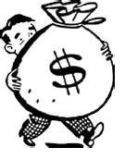
Securities – Cash Dividend

Slide 35
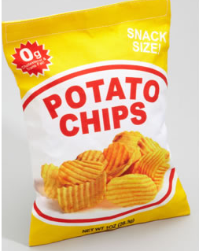
Securities -- Stock split or stock dividend

Slide 36
Interest on Legacies
Most states provide interest
Common law = one year from date of death
Modern = one year from date personal representative appointed

Slide 37
Exoneration

Slide 38
Issue
Specific gift is subject to debt, lien, etc.
Does B:
Get debt paid off (exonerated)?
Take gift subject to debt?
That is, only receive equity in gift.

Slide 39
Jurisdictions divided if will silent
Presumed exoneration
Common law approach
Presumed non-exoneration?
Modern approach
Why the change?

Slide 40
Advice
If client makes specific gifts, determine client’s intent regarding exoneration and include instructions in the will.

Slide 41
Abatement

Slide 42
Issue
When testator dies without enough property to pay all debts and gifts, which gifts have priority?
Note: Priority of debts is covered by estate administration laws.

Slide 43
Typical Abatement Order
1. Intestate Property, if any.
2. Residuary gift (personal, then real).
3. General gifts (personal, then real).
4. Demonstrative gifts
5. Specific gifts (personal, then real).

Slide 44
Abatement Concepts
Within a group, abatement is pro rata.
Testator can specify abatement order.
Abatement order usually does not apply to transfer taxes.

Slide 45
Tax Apportionment

Slide 46
Issue
With regard to estate tax, does:
1. each beneficiary’s gift get reduced for his or her “fair share,” or
2. it get paid under normal abatement order?

Slide 47
Jurisdictions Vary
Traditional view = no apportionment
Modern view = apportionment
Covers both probate and non-probate assets.
Testator can provide otherwise in will.

