Slide 1
Wills Introduction

Slide 2

Will Execution

Slide 3
Basic Elements
1. Legal Capacity
2. Testamentary Capacity
3. Testamentary Intent
4. Formalities

Slide 4
1. Legal Capacity

Slide 5
Obtaining Legal Capacity
Warning: Jurisdictions differ as to which of the below gives a person legal capacity.
18 years old or older.
Married
Divorced
Emancipated minor
In military

Slide 6
2. Testamentary Capacity

Slide 7

“Sound Mind”

Slide 8
Elements of Testamentary Capacity
1. Understand what doing and its effect.

Slide 9
Elements of Testamentary Capacity
2. Know general nature and extent of property.

Slide 10


Elements of Testamentary Capacity
3. Know natural objects of bounty.

Slide 11
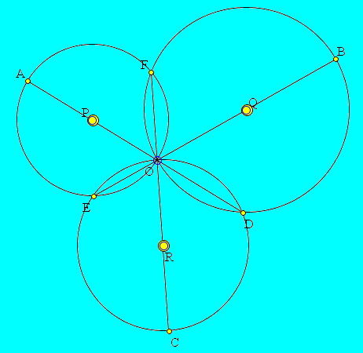
Elements of Testamentary Capacity
4. Achieve above three elements simultaneously.

Slide 12
Testamentary Capacity Issues
1. When = at time of will execution

Slide 13
Testamentary Capacity Issues
2. Effect of incapacity adjudication = rebuttable presumption of lack of capacity
But, could execute will during lucid interval.

Slide 14
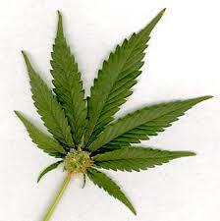




Testamentary Capacity Issues
3. Sane person may lack capacity.

Slide 15
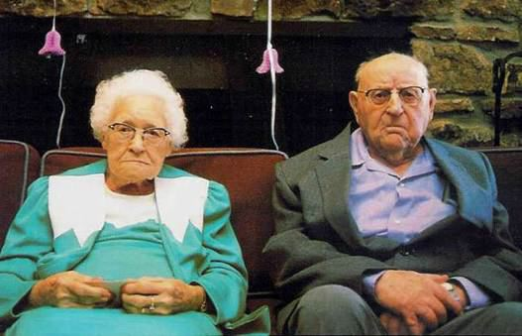
Testamentary Capacity Issues
4. Impact of aging process.

Slide 16

Testamentary Capacity Issues
5. Contract capacity compared.

Slide 17
Testamentary Capacity Issues
6. Evidence
Lay testimony.
Expert testimony.

Slide 18
Testamentary Capacity Issues
7. Client with Questionable Capacity

Slide 19
Testamentary Capacity Issues
8. Reactions of fact finders

Slide 20
3. Testamentary Intent

Slide 21
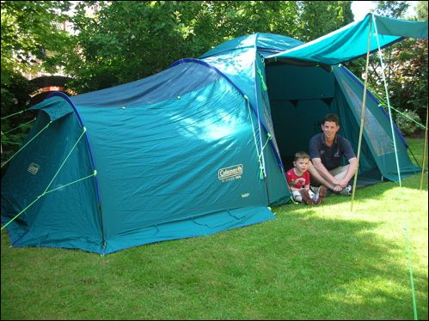
No!

Slide 22

Basic Concept
Testator must intend the very instrument the testator executes to be the will.

Slide 23

Example 5-11, page 81
A classic “letter” case.

Slide 24
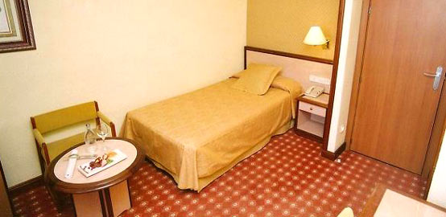
Example 5-12, page 81
A classic “initiation” case.

Slide 25
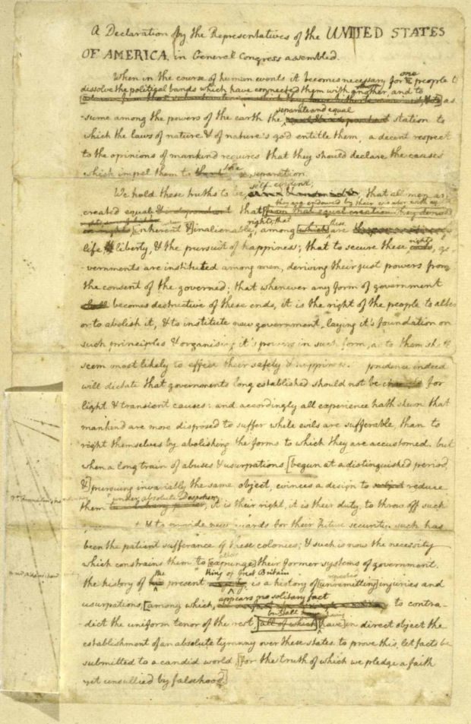
Example 5-13, page 82
Classic “specimen” or “draft” case

Slide 26
4. Formalities Introduction

Slide 27
Formalities depend on type of will
Attested (witnessed)
Holographic (handwritten)
Nuncupative (oral)
Others
Military
Notarized (UPC)

Slide 28
Formalities Policies
Ritual or cautionary
Evidentiary
Protective
Channeling

Slide 29
4. Formalities Attested Wills

Slide 30
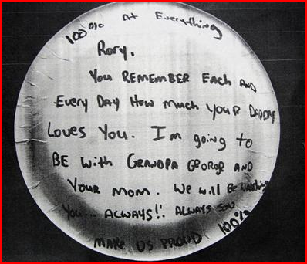
1. In Writing
No requirement regarding what written on or with.

Slide 31
2. Signed by Testator
Any symbol executed or adopted by the testator with present intent to authenticate the will.

Slide 32
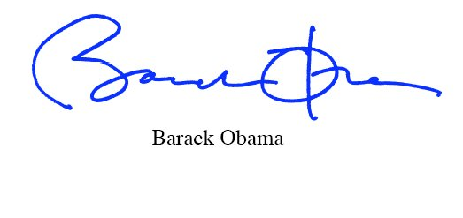
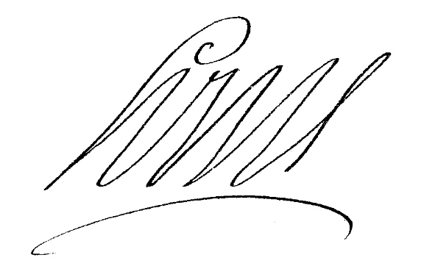



Sample Signatures

Slide 33
Proxy Signatures
By the testator’s direction, and
In the testator’s presence.

Slide 34

Location
States vary – any place or at end
Should be at the end or “foot” of will.

Slide 35
3. Attestation
Number = at least two
Vermont was the last state to require three until July 1, 2006.

Slide 36
Capacity of Witnesses
1. Legal Capacity
Age varies among jurisdictions

Slide 37
Capacity of Witnesses
2. Attestation Capacity
Credible; qualified to testify in court

Slide 38
Capacity of Witnesses
3. Time
When attestation occurred

Slide 39
Capacity of Witnesses
4. Knowledge – “Publication”
Do witnesses need to know they are witnessing a will?
States vary.

Slide 40
Order of Events
What if witnesses attest before testator signs?
Strict View
Continuous Transaction View

Slide 41
Attestation by Mark
States vary.

Slide 42
Attestation by Proxy
States vary.

Slide 43
Location of Attestation
States vary.

Slide 44
Presences
1. Witnesses attest in presence of testator?
States vary
“Conscious Presence”
Visually-impaired testators
Dead testators

Slide 45
Presences
2. Witnesses attest in each other’s presence?
States vary.

Slide 46
Presences
3. Testator signs (or acknowledges a prior signature) in presence of witnesses?
States vary.

Slide 47
Witness as Beneficiary
1. Effect on will
None – will remains valid.

Slide 48
Witness as Beneficiary -- §§ 61 & 62
2. Effect on beneficiary’s gift
Void? [“Purging statute”]
Void unless exception applies?
Irrelevant (UPC)?

Slide 49

Selecting Witnesses

Slide 50
Selecting Witnesses
Normally, little thought given or than to meet basic requirements
Age
Competent
Not a beneficiary

Slide 51
Selecting Witnesses
1. Witnesses familiar with testator

Slide 52
Selecting Witnesses
2. Supernumerary witness

Slide 53
Selecting Witnesses
3. Youthful and healthy witnesses

Slide 54
Selecting Witnesses
4. Traceable witnesses

Slide 55
Selecting Witnesses
5. Witnesses who would favorably impress judge and jury.

Slide 56
Self-Proving Affidavit
Substitutes for in-court testimony of witnesses when will probated.
Saves time, expense, and inconvenience when probating will.
Does not “strengthen” the will.

Slide 57
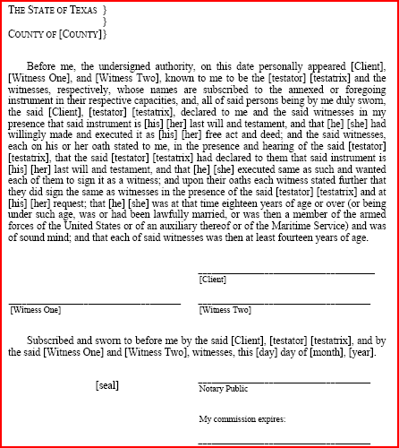
Self-Proving Affidavit
1. Traditional –
two-step with
“double”
signatures.
SPA is separate document.

Slide 58
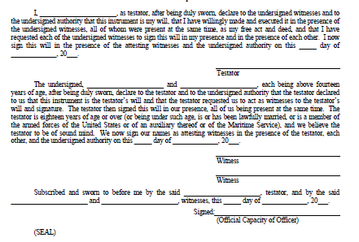
Self-Proving Affidavit
2. Modern – one- step with
“single”
signatures.
SPA is inside
the will.

Slide 59
Will Execution Ceremony -- Purposes
1. Psychological benefits

Slide 60
Will Execution Ceremony -- Purposes
1. Psychological benefits
2. Effectuate client’s intent

Slide 61
Will Execution Ceremony -- Purposes
1. Psychological benefits
2. Effectuate client’s intent
3. Limit exposure to malpractice claims

Slide 62
Will Execution Ceremony – pp. 101-106
1. Before ceremony
2. Ceremony
3. After ceremony

Slide 63
Warning!!!
Drafting a will and supervising a will execution ceremony = the practice of law.
Do NOT engage in this conduct until licensed.
NO exception that testator knows you are unlicensed or you are not being paid.

Slide 64
4. Formalities Holographic Wills

Slide 65
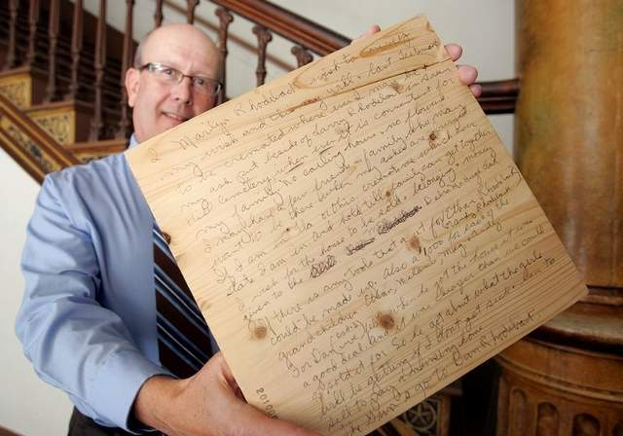
Ramification
In about 50% of the states, removes the attestation requirement.
Policy – less chance for fraud

Slide 66
In Testator’s Handwriting
1. Intent approach.

Slide 67
In Testator’s Handwriting
2. Surplusage Approach

Slide 68
In Testator’s Handwriting
3. Material provision approach

Slide 69
When are/should holographic wills be used if witnesses are not required?
1. _________________
2. __________________
3. __________________

Slide 70
4. Formalities Nuncupative Wills

Slide 71

Oral or spoken wills
I leave all my property to Margaret.

Slide 72
Ohio Requirements -- § 2107.60
1. Made in testator’s last sickness
2. Personal property only
3. Reduced to writing
Within 10 days of speaking of will
Attested by 2 disinterested and competent individuals
Witnesses testify about capacity, etc.
4. Must be offered for probate within three months of death.

Slide 73
4. Formalities Military Testamentary Instruments

Slide 74

Generally

Slide 75
Basic Idea
If will executed with formalities specified by federal law, deemed to satisfy formalities of all states.

Slide 76
Policy
Allow JAGs to prepare wills for service members without hassling with particular requirements of each state.

Slide 77
Issue
Does it violate 10th Amendment?

Slide 78
4. Formalities Statutory Wills

Slide 79
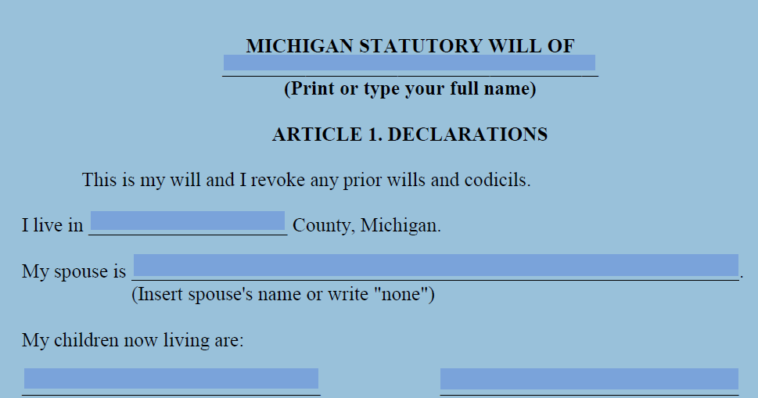
Wills forms provided by state law
California, Maine, Michigan, Wisconsin

Slide 80
4. Formalities Notarized Will

Slide 81
UPC § 2-502(a)(3)
If notarized (acknowledged), no witnesses needed.
Just a few states have enacted:
Colorado
Massachusetts
North Dakota

