Slide 1
Other Intestacy Issues

Slide 2

Ancestral Property
Does source of property impact identity of heirs?

Slide 3
Advancements

Slide 4
Basic Idea
Prepayment of inheritance.
Thus, must account for it when intestate dies.

Slide 5
How prove gift is advancement?
Jurisdictions differ but modern approach is to require a writing:
  1. Contemporaneous writing of advancer (intestate decedent), or
  2. Written acknowledgment by advancee (heir).

Slide 6
Value given to advanced property?
Date of advancement
  Not when advancer (the intestate) dies.

Slide 7
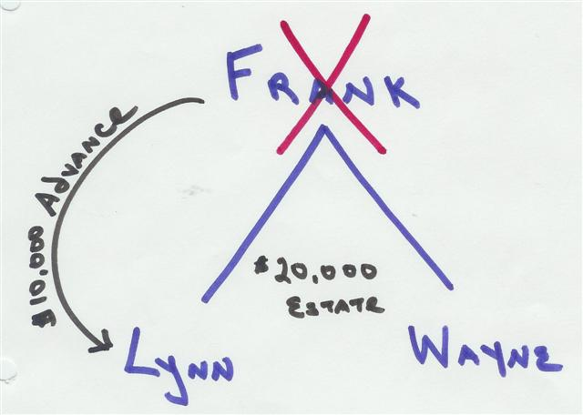
Advancement Example

Slide 8
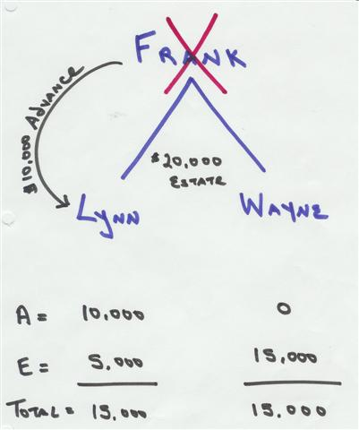
Advancement

Slide 9
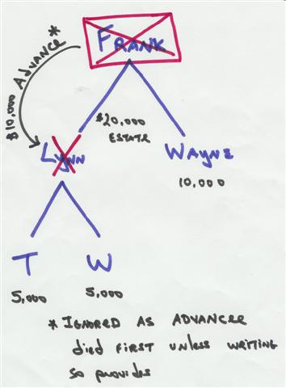
Advancee predeceases advancer

Slide 10
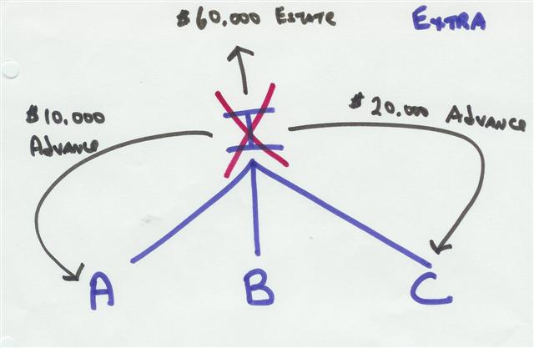
Advancement Problem

Slide 11
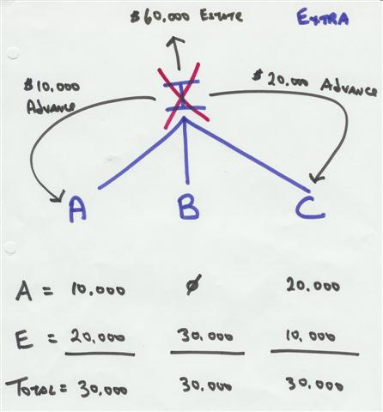
Advancement Problem

Slide 12
Survival

Slide 13
Issue
Does an heir need to outlive the intestate by a certain length of time?

Slide 14
Policies
Prevent multiple administrations of property.
Avoid proof problems and gruesome evidence.
Carry out intent.

Slide 15

Time Period
120 hours (5 days) is typical

Slide 16
Where does property go?
As if person who did not survive long enough died first.

Slide 17
Disclaimers

Slide 18

Reasons to Disclaim
1. Onerous Burdens

Slide 19

Reasons to Disclaim
1. Onerous Burdens
2. Tax Savings

Slide 20

Possible Reasons to Disclaim
1. Onerous Burdens
2. Tax Savings
3. Avoid creditors (except IRS)

Slide 21

Typical Requirements
1. Disclaimer Document
  a. Written, and
  b. Acknowledged.

Slide 22
Typical Requirements
2. Proper Filing
  a. When = 9 months after decedent’s death
  b. Where = in court where probate proceedings pending

Slide 23
Typical Requirements
3. Notice to personal representative typically by
  a. Personal service, or
  b. Registered or certified mail.

Slide 24
Basic Disclaimer Principles
1. Wills, life insurance policies, etc. may provide disclaimer methods and designate who receives disclaimed property.

Slide 25

Basic Disclaimer Principles
2. Irrevocable

Slide 26

Basic Disclaimer Principles
3. Partial disclaimers (“cherry-picking”) allowed.

Slide 27
Basic Disclaimer Principles
4. Acceptance precludes later disclaimer.

Slide 28
Basic Disclaimer Principles
5. Disclaimed property passes as if disclaimant predeceased decedent.

Slide 29
Release and Conveyance of Expectancy

Slide 30
What can you do with expectancy to inherit from a person still alive?
Convey?
Contract to convey?

Slide 31
Equitable Conversion

Slide 32
Basic Idea
Real property treated as personal property, or
Personal property treated as real property.
Example = between (1) signing of real property sales contract and (2) closing

Slide 33
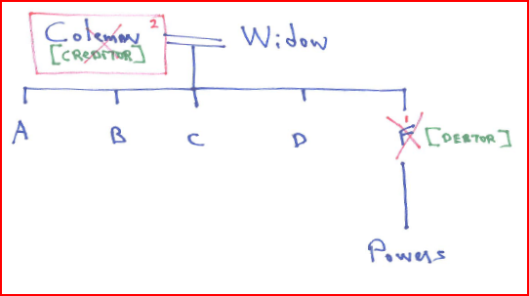
How does inheritance pass if an intermediary predeceases?

Slide 34
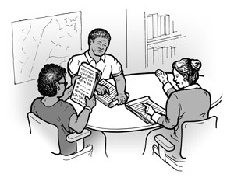
Heir Designation

Slide 35
Choice of Law – Marital Rights
Law of spouse’s domicile at time of property acquisition.

Slide 36
Choice of Law – Succession Rights
Personal Property = Domicile at death
Real Property = Situs of Property

