Slide 1
Heir Qualification

Slide 2
Posthumous Heirs
An heir conceived during the intestate’s life but who is born thereafter.

Slide 3
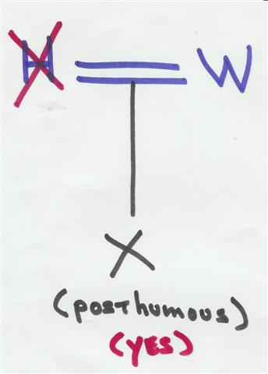
Posthumous Child

Slide 4
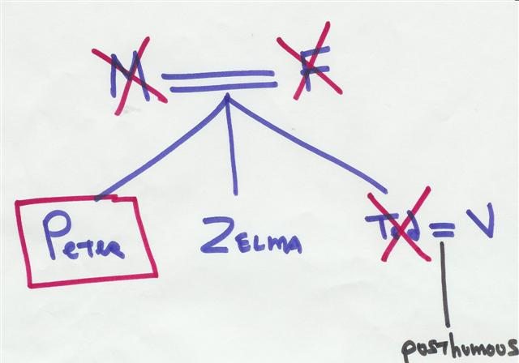
Posthumous Heirs

Slide 5
Adopted Children
History
  Not recognized in England until 1926.
  Law developed in U.S.

Slide 6
Adopted Children
Rights of Adopted Child
  Inherit from adoptive parents?
  Inherit through adoptive parents?
  Inherit from biological parents?
  Inherit through biological parents?

Slide 7
Adopted Children
Rights of Adoptive Parents
  Inherit from/through adoptive child?

Slide 8
Adopted Children
Rights of Biological Parents
  Inherit from/through biological child?
  Special cases?

Slide 9
Adopted Children
Impact of type of adoption?
  Formal or statutory
  By estoppel (equitable adoption)
  Adult adoption

Slide 10
Non-Marital Children
Common Law
Trimble v. Gordon (1977)
Lalli v. Lalli (1978)
State differences

Slide 11
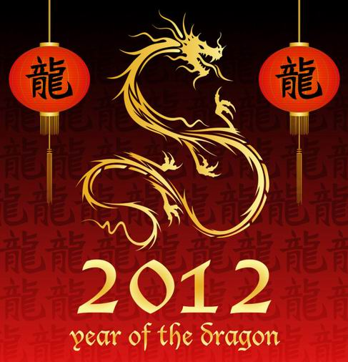
Happy Lunar New Year!

Slide 12
ART Children
Ascertaining parentage
After death reproduction
Practice notes:

Slide 13
Step-Children
General rule – not heirs
Exceptions?

Slide 14
Half & Whole Blood
What did the vampire say after attacking the half-blooded person?

Slide 15
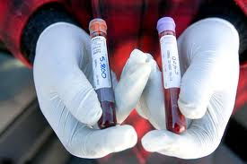
Whole Blood
Collateral relatives of the intestate (e.g., siblings) who share both parents in common.

Slide 16
Half Blood
Collateral relatives of the intestate (e.g., siblings) who share only one parent in common.
X

Slide 17
Approaches
1. Common law = inherit personal property but not real property
2. Modern rule = irrelevant
3. Scottish rule = each half-blood receives half as much as each whole-blood
4. Inherit only if no whole-blooded heirs

Slide 18
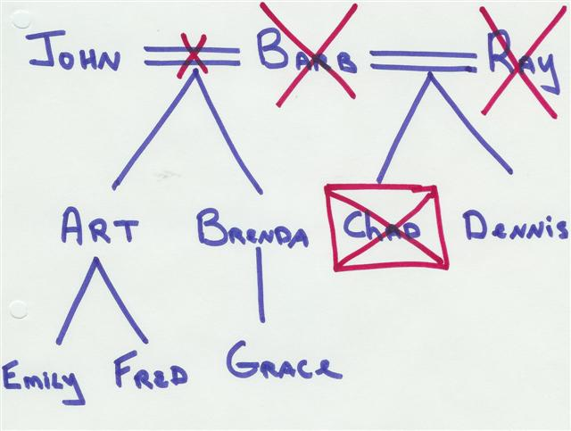
Scottish Rule Example

Slide 19
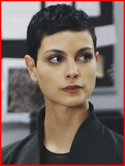
Non-United States Citizens

Slide 20
Unworthy Heirs

Slide 21
1. Forfeiture
Upon felony or treason conviction, all property to government.

Slide 22
2. Civil Death
Upon conviction of serious crime, property passes to heirs.

Slide 23
3. Corruption of the Blood
Upon conviction of serious crime, prohibited from being an heir.

Slide 24
4. Heir Murdering Intestate
Common Law
Early U.S. Law

Slide 25
Judicial Solution =Constructive Trust
Equitable remedy to prevent unjust enrichment.

Slide 26
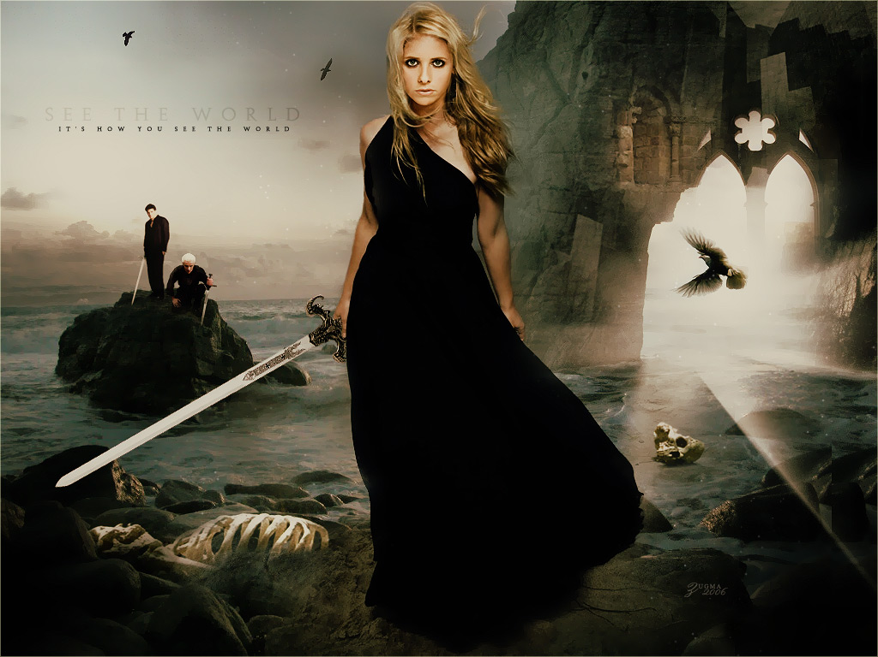
Legislative Solution = Slayer Statute

Slide 27
5. Heir causing death, but not murder
Negligently
Voluntary manslaughter
While insane

Slide 28
5. Heir causing death, but not murder
Competing policies:
  Not deprive of inheritance without just cause.
  Allowing killers to take promotes devious schemes.

Slide 29
6. Suicide
Common law = forfeiture often occurred.
Modern law = irrelevant

Slide 30
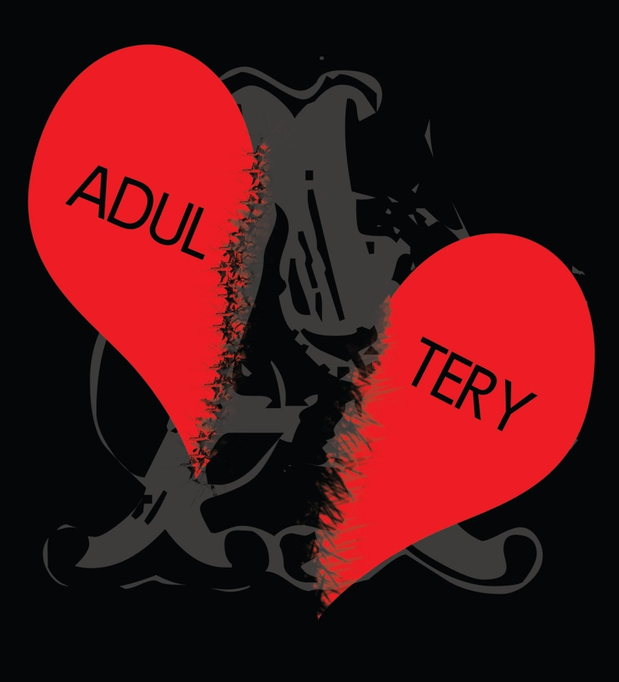
7. Adultery

Slide 31
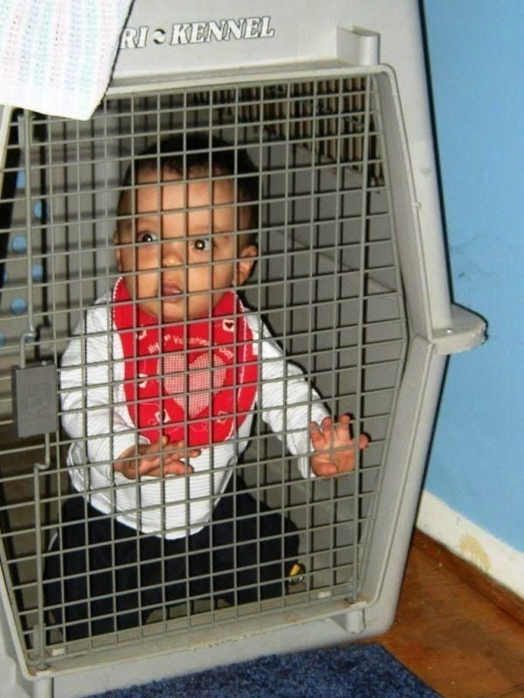
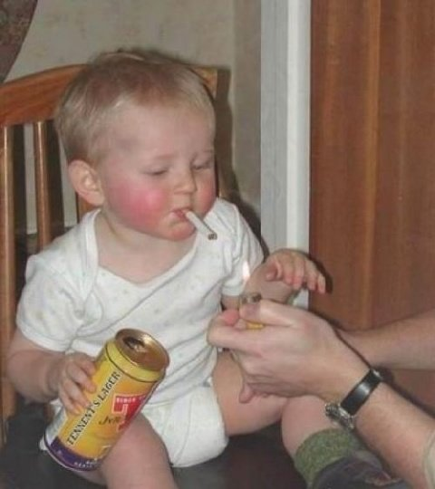
8. Bad Parents

Slide 32

9. Abuse

Slide 33

10. May-December Marriages

Slide 34
Non-Formally Married Partners
Common law marriage
Civil unions and domestic partnerships

