Slide 1
Ancestors, Collaterals, and Escheat

Slide 2
Ancestors
Persons related in ascending lineal line.
Parents
Grandparents
Great-grandparents
etc.

Slide 3
Collaterals
Related, but not lineally.
First-Line
Siblings
Nieces/Nephews
etc.
Second-Line
Aunts/Uncles
Cousins
etc.

Slide 4
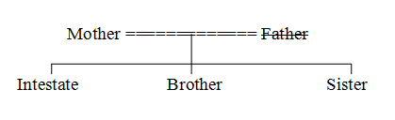
First Line Collateral Example

Slide 5
Parentelic System
Search each side of the family until an ancestor, or a descendant of an ancestor, is located.
Use same multi-generation method as for descendants.

Slide 6
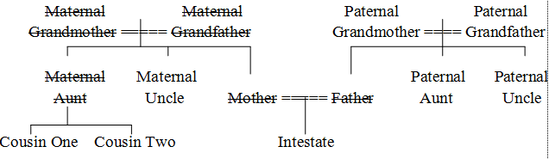
Parentelic Example

Slide 7
Degree of Relationship – Civil Law
Count number of steps up from intestate to nearest common ancestor and the number of steps from that ancestor to the heir.
The degree of relationship is the total number of steps.
Uncle = ___
Cousin = ___

Slide 8
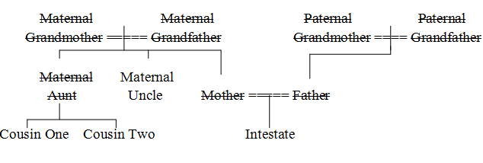
Degree of Relationship – Civil Law

Slide 9
Degree of Relationship – Canon Law
Count number of steps as with civil law method.
The degree of relationship is the larger number of steps to the common ancestor.
Uncle = ___
Cousin = ___

Slide 10
Degree of Relationship – Canon Law

Slide 11
Escheat
If no heirs, property escheats to the state.
Real property – use law of property’s situs
Personal property – use law of intestate’s domicile at death

Slide 12
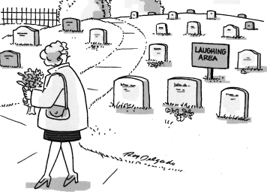
Laughing Heirs

Slide 13
Ohio Statute -- § 2105.06
(F) If there is no spouse and no children or their lineal descendants, to the parents of the intestate equally, or to the surviving parent;

Slide 14
Ohio Statute
(G) If there is no spouse, no children or their lineal descendants, and no parent surviving, to the brothers and sisters, whether of the whole or of the half blood of the intestate, or their lineal descendants, per stirpes;

Slide 15
Ohio Statute
(H) If there are no brothers or sisters or their lineal descendants, one-half to the paternal grandparents of the intestate equally, or to the survivor of them, and one-half to the maternal grandparents of the intestate equally, or to the survivor of them;

Slide 16
Ohio Statute
(I) If there is no paternal grandparent or no maternal grandparent, one-half to the lineal descendants of the deceased grandparents, per stirpes; if there are no such lineal descendants, then to the surviving grandparents or their lineal descendants, per stirpes; if there are no surviving grandparents or their lineal descendants, then to the next of kin of the intestate, provided there shall be no representation among the next of kin;

Slide 17
Ohio Statute
(J) If there are no next of kin, to stepchildren or their lineal descendants, per stirpes;

Slide 18
Ohio Statute
(K) If there are no stepchildren or their lineal descendants, escheat to the state.

Slide 19

Locating Heirs

