Slide 1
Descendants

Slide 2
Basic Principles
If no surviving spouse, descendants receive entire intestate estate of deceased parent.

Slide 3
Basic Principles
If surviving spouse, descendants receive all property (if any) of the deceased parent that does not pass to the surviving spouse.

Slide 4
Basic Principles
Surviving prior generation descendant precludes later generation descendant.

Slide 5
Per Capita among children
Each surviving child receives an equal share if:
All children survive, or
No deceased child has a surviving descendant.

Slide 6
Distribution Methods
When there are heirs from more than one generation, you must determine how the state allocates among the different generations.
Three approaches.

Slide 7
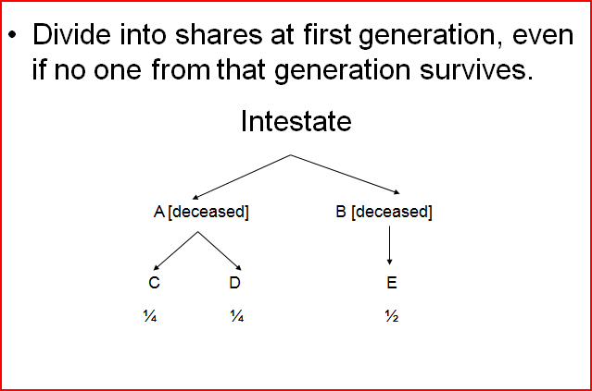
1. Per Stirpes

Slide 8
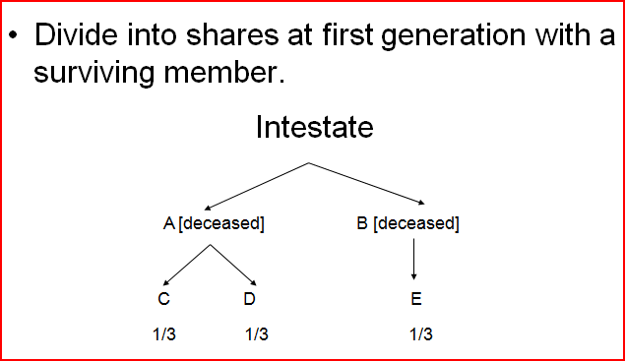
2. Per Capita with Representation

Slide 9
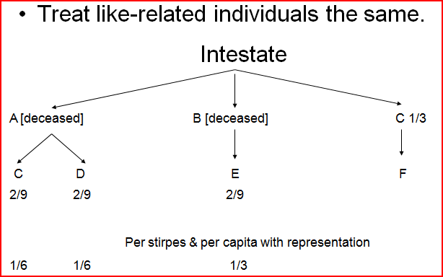
3. Per Capita at Each Generation

Slide 10
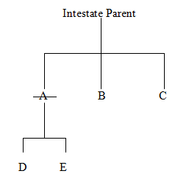
Example 1

Slide 11
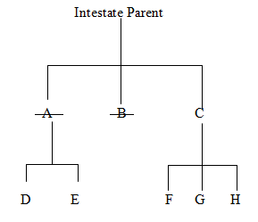
Example 2

Slide 12
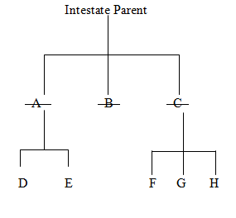
Example 3

