Slide 1
Intestate Succession

Slide 2
When does intestacy occur?
1. As to person – total intestacy

Slide 3
When does intestacy occur?
1. As to person – total intestacy
2. As to property – partial intestacy

Slide 4

Failure to Execute a Will

Slide 5
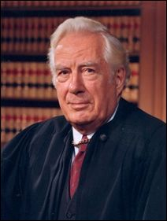
Will or No Will?

Slide 6
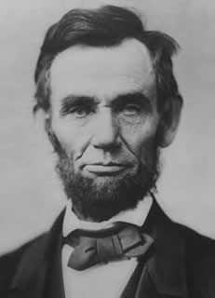
Will or No Will?

Slide 7
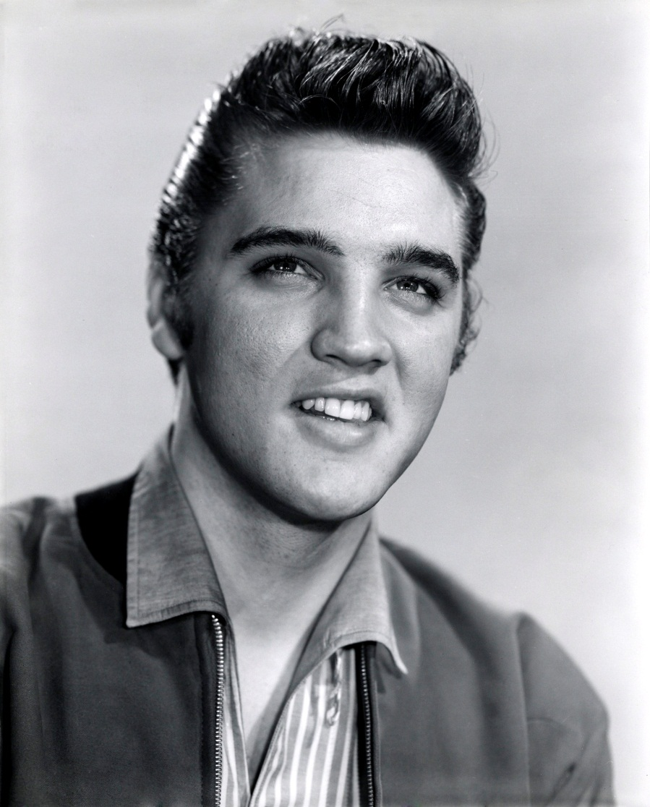
Will or No Will?

Slide 8
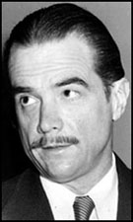
Will or No Will?

Slide 9
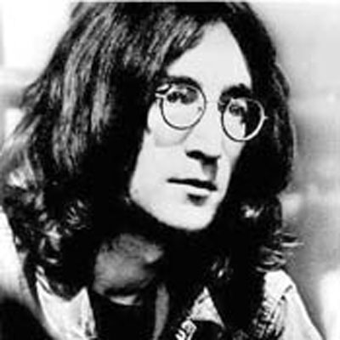
Will or No Will?

Slide 10
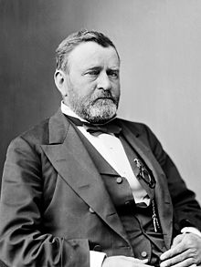
Will or No Will?

Slide 11
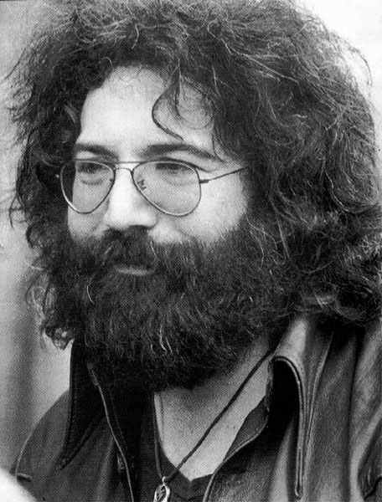
Will or No Will?

Slide 12
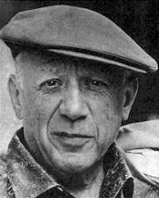
Will or No Will?

Slide 13
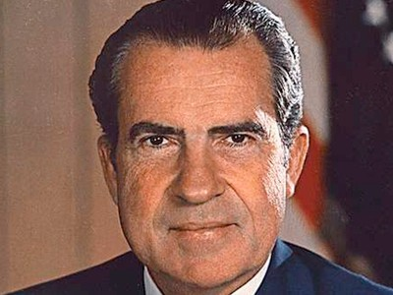
Will or No Will?

Slide 14

Will or No Will?

Slide 15

Will or No Will?

Slide 16

Will or No Will?

Slide 17

Will or No Will?

Slide 18
Why no Will?
1. Lack of property.

Slide 19
Why no Will?
2. Unaware of Importance

Slide 20
Why no Will?
3. Indifference.

Slide 21
Why no Will?
4. Cost.

Slide 22
Why no Will?
5. Time & Effort.

Slide 23
Why no Will?
6. Complexity.

Slide 24
Why no Will?
7. Admission of Mortality.

Slide 25
Why no Will?
8. Reluctance to Divulge Private Facts.

