Slide 1
Wills, Trusts, and Estates
------
Introduction

Slide 2
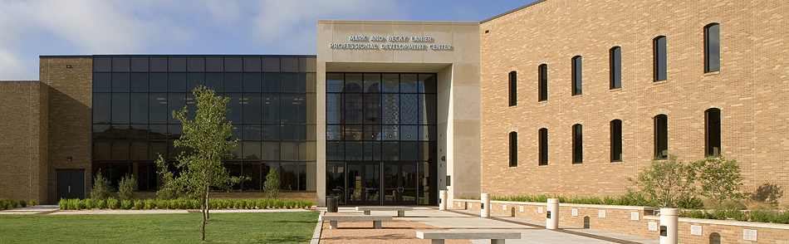
Visiting from Texas Tech University

Slide 3
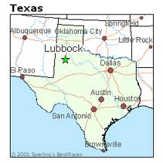
Lubbock, Texas

Slide 4
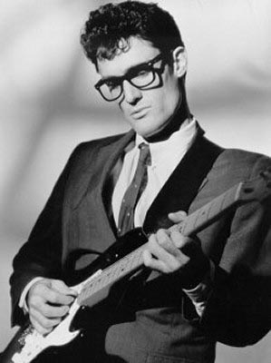
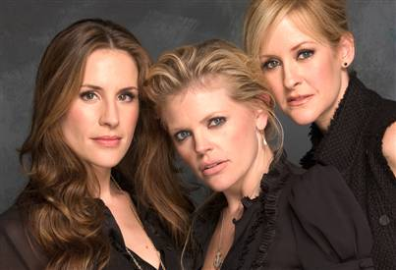
Lubbock, Texas

Slide 5
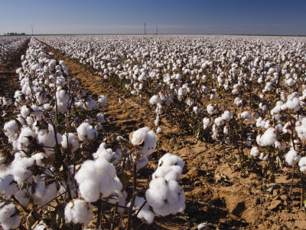
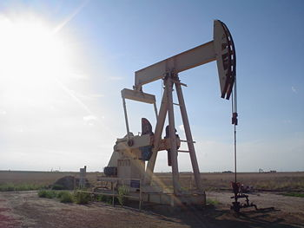
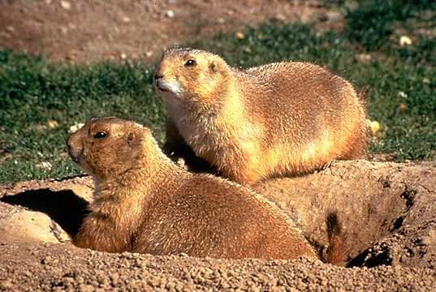
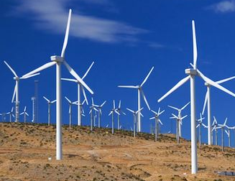
Lubbock, Texas

Slide 6

OSU Alum

Slide 8
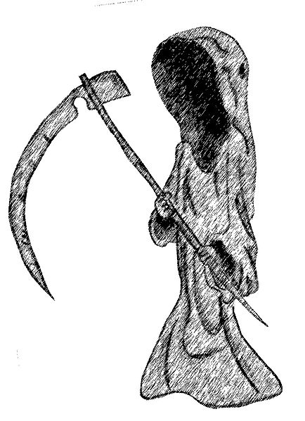
Basic Premise
Life is 100%
fatal.

Slide 9
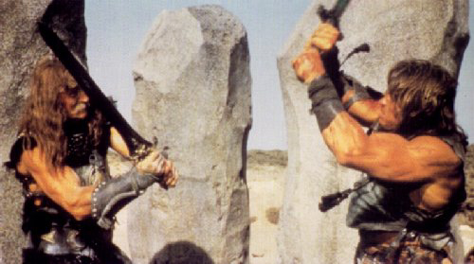
History of At-Death Property Disposition
1. Physical Strength and/or Finding

Slide 10
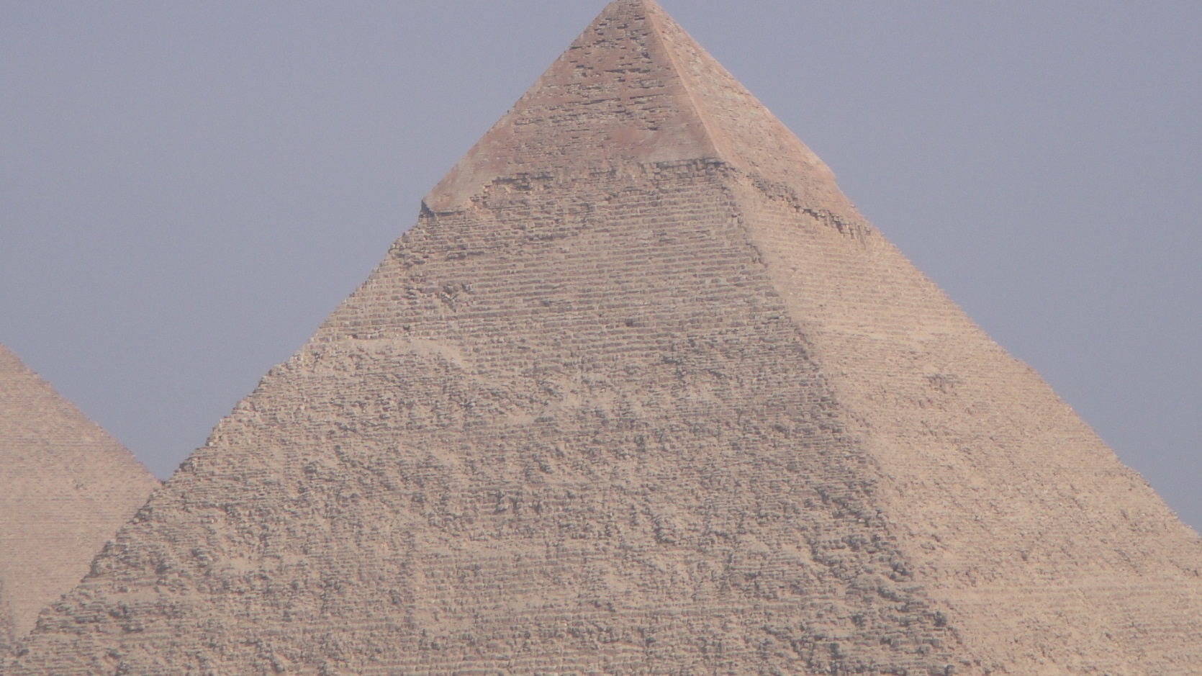
History of At-Death Property Disposition
2. Bury with Decedent

Slide 11
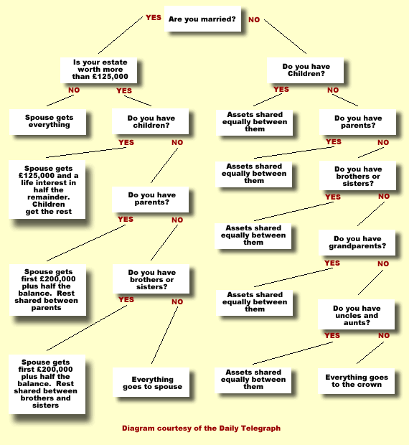
History of At-Death Property Disposition
3. Intestate Succession

Slide 12
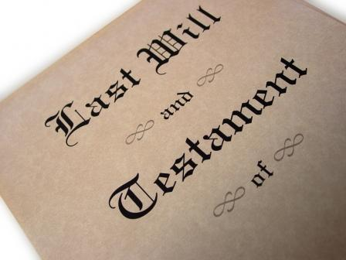
History of At-Death Property Disposition
4. Wills

Slide 13
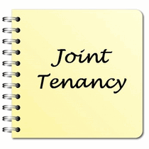
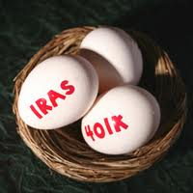
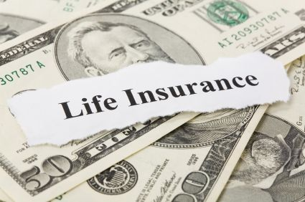

History of At-Death Property Disposition
5. Will Substitutes

Slide 15
Intestate Succession Terminology

Slide 16
Intestate Succession
Common Law Split:
  Crown = real property
  Church = personal property

Slide 17
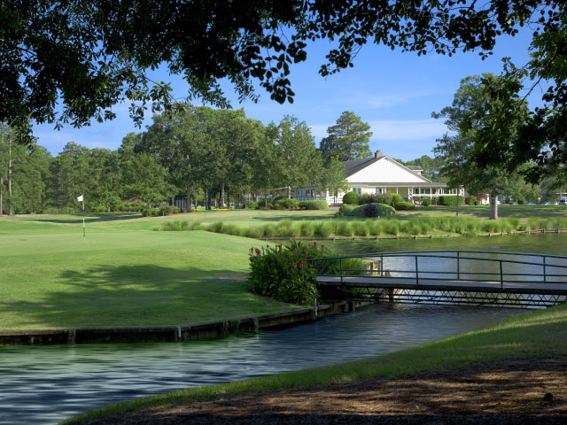
Intestate Succession -- Terminology
Descent = succession to real property

Slide 18

Intestate Succession -- Terminology
Distribution = succession to personal property

Slide 19
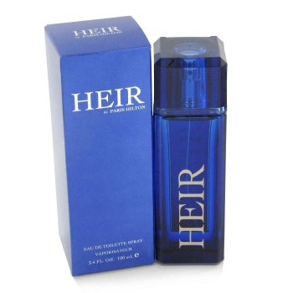
Intestate Succession -- Terminology
Heir = person who receives property from an intestate decedent

Slide 20
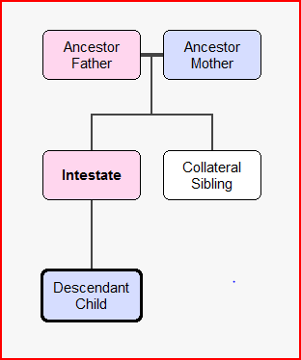
Intestate Succession -- Terminology

Slide 21
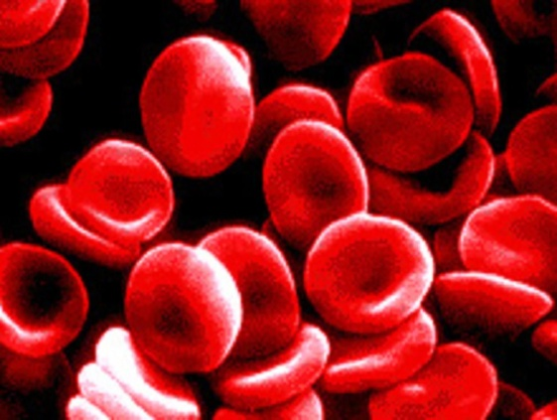
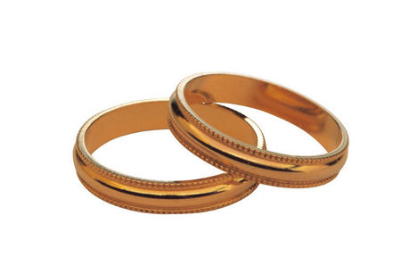
Intestate Succession -- Terminology
Consanguinity = blood
Affinity = marriage

Slide 22
Testate Succession Terminology

Slide 23
Testate Succession -- Terminology
At common law –
  Will = real property
  Testament = personal property

Slide 24
Testate Succession -- Terminology
Devise = gift of real property

Slide 25
Testate Succession -- Terminology
Bequest = gift of personal property

Slide 26
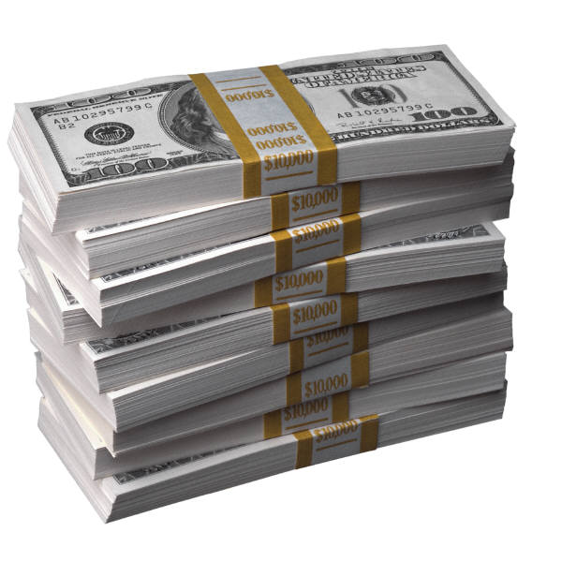
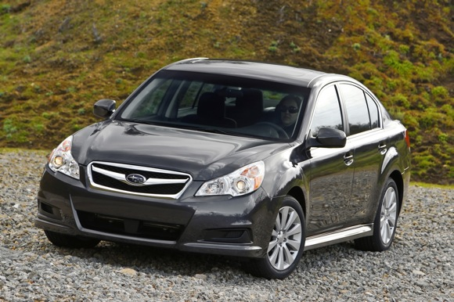
Testate Succession -- Terminology
Legacy – gift of money
X

Slide 27
Testate Succession -- Terminology
Beneficiary = any recipient of property (any type)

Slide 28
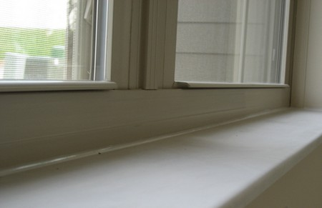
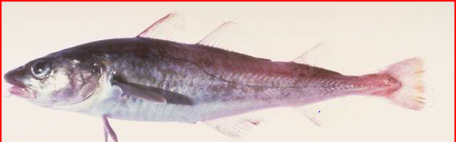
Testate Succession -- Terminology
Codicil = amendment to an existing will

