Slide 1
Issuance of Letters

Slide 2
When entitled to letters?
After the person:
Takes oath, and
Posts any required bond.
PC § 182
EC Chapter 306

Slide 3
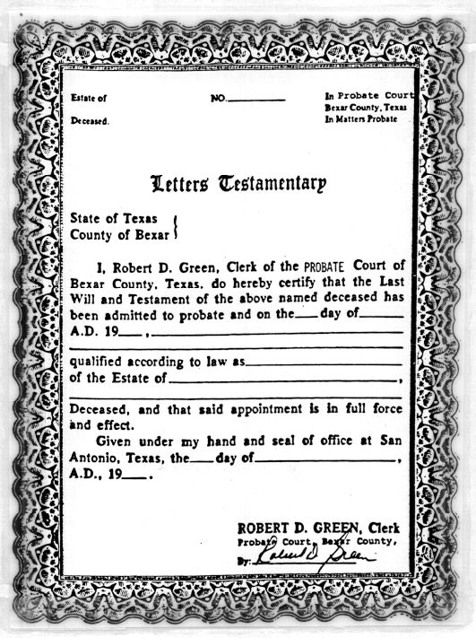
Form of Letters

Slide 4
Multiple Copies
Obtain multiple copies to assist in property transfer.
PC § 187
EC § 306.006

Slide 5
BFP Protection
BFP from holder of letters protected even if letters later deemed invalid.
PC § 188
EC § 307.001

Slide 6
BFP Protection
1. Purchaser paid valuable consideration.

Slide 7
BFP Protection
1. Purchaser paid valuable consideration.
2. Purchaser acted in good faith.

Slide 8
BFP Protection
1. Purchaser paid valuable consideration.
2. Purchaser acted in good faith.
3. Purchaser was without notice of an illegality

Slide 9
BFP Protection
American Finance v. Herrera – p. 108
Independent Executor Beneficiary of Will
[same person as beneficiary]
Mortgaged property
Defaulted
Successor PR
Foreclosure sale
Mortgagee purchases property
Purchaser from mortgagee

Slide 10
Expiration of Letters
Probate/Estates Code = no expiration
U.C.C. § 8.402(c) for stock transfers = letters no older than 60 days may be requested
Advice = get fresh letters if someone complains they are stale

