Slide 1
Qualification of
Personal Representative

Slide 2
1. Oath of Office
Statute provides the PR’s oath
  PC § 190
  EC § 305.051 (executor)
  EC § 305.052 (administrator)
  EC § 305.053 (temporary administrator)

Slide 3
1. Oath of Office
Oath of Executor:
  I do solemnly swear that the writing which has been offered for probate is the last will of _______, so far as I know or believe, and that I will well and truly perform all the duties of executor of said will of the estate of said ________.

Slide 4
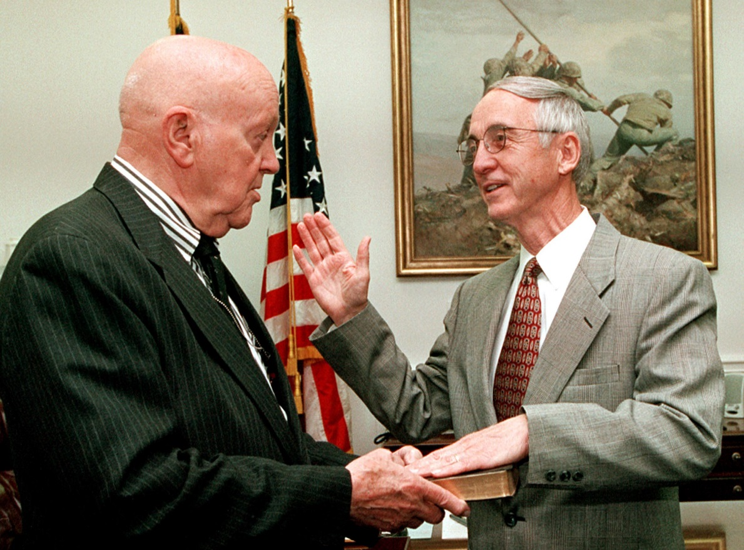
1. Oath of Office
Who administers?
  Judge
  Notary
  PC § 190
  EC § 305.054

Slide 5
1. Oath of Office
When done?
  Before the 21st day after the date the order granted
    PC § 192
    EC § 305.003

Slide 6
1. Oath of Office
Filing
  With the clerk of the court granting letters
    PC § 190
    EC § 305.054

Slide 7


2. Bond

Slide 8
2. Bond
Presumption = required
  PC § 194
  EC § 305.101
Purpose of bond is to protect heirs, beneficiaries, and creditors from evil PR.

Slide 9
2. Bond
Exceptions to requirement of bond
  1. Testator waives in will
    PC § 195
    EC § 305.101
    Should the testator waive bond?
      Yes: ______________________________
      No: ______________________________
    Court may require bond even it testator waived it.

Slide 10
2. Bond
Exceptions to requirement of bond
  2. Corporate Fiduciary
    PC § 195
    EC § 305.101
    Why is bond automatically waived for corporate fiduciary?

Slide 11
2. Bond
Exceptions to requirement of bond
  3. Court waives in an independent administration
    PC § 145(p)
    EC § 401.005
    Whether to grant a waiver application is in court’s discretion.

Slide 12
2. Bond
When done?
  Before the 21st day after the date the order granted [same as for oath]
    PC § 192
    EC § 305.003

Slide 13
2. Bond
Filing
  With the clerk of the court granting letters
    PC § 197
    EC § 305.109

