Slide 1
Court’s Action on Application

Slide 2
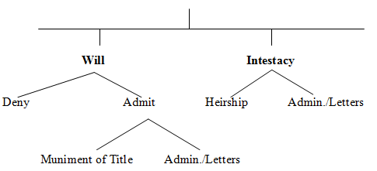
Overview

Slide 3
Admission to Probate -- Generally
Judge signs order
Usually prepared by applicant’s attorney
Some courts supply form
PC § 89
EC § 256.201

Slide 4
Admission to Probate -- Generally
Judge signs order
Original will and order filed in county clerk’s office.
PC § 90
EC § 256.202

Slide 5
Admission to Probate -- Generally
Judge signs order
File certified copy of will and order in other Texas counties where real property is located
Follow procedure of other states/nations where real property is located

Slide 6
Muniment of Title
Authority
PC §§ 89A-89C
EC Chapter 257

Slide 7
Muniment of Title
When use allowed:
No unpaid debts (other than those secured by real property)
For other reason, the court finds no necessity for administration

Slide 8
Muniment of Title
Why used:
Fast, simple, and inexpensive
Late probate (too late for administration)

Slide 9
Muniment of Title
Passage of property
Under terms of will
Holders of testator’s property may transfer to beneficiaries

Slide 10
Muniment of Title
Duty of applicant
Report to court compliance with will terms within 180 days
Almost always waived in the court order

Slide 11
Muniment of Title
Combine with Declaratory Judgment
Permissible if need interpretation or construction of will

Slide 12
Muniment of Title
In re Estate of Kurtz – p. 100

Slide 13
Muniment of Title
No executor appointed so no one has to do the things an executor normally does such as:
Notice to beneficiaries
File inventory
Give notice to creditors

Slide 14
Admit will to probate and Grant letters
The court order:
Admits will to probate, and
Grants letters testamentary to the executor.

Slide 15
Determination of Heirship
Court determines the heirs and their shares under intestate succession.

Slide 16
Grant letters of administration
Court appoints an administrator for the intestate decedent.
Heirs may be determined at a later time.

Slide 17

Deny application

