Slide 1
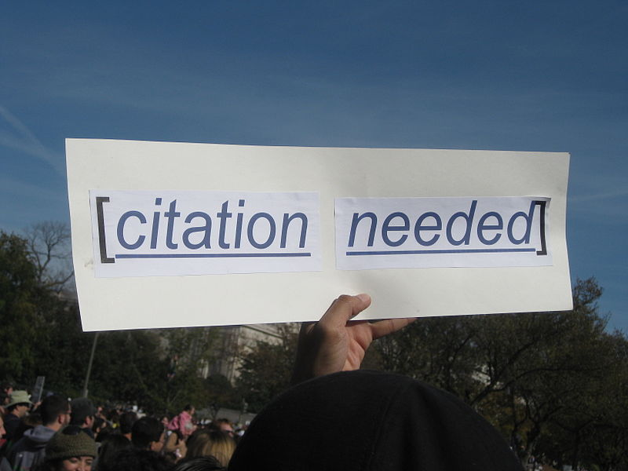
Citation

Slide 2
General Rule PC § 128(a)(1); EC § 258.001
Posting on the courthouse door or a place nearby where notices are customarily posted.
Done by clerk (covered by filing fee).

Slide 3
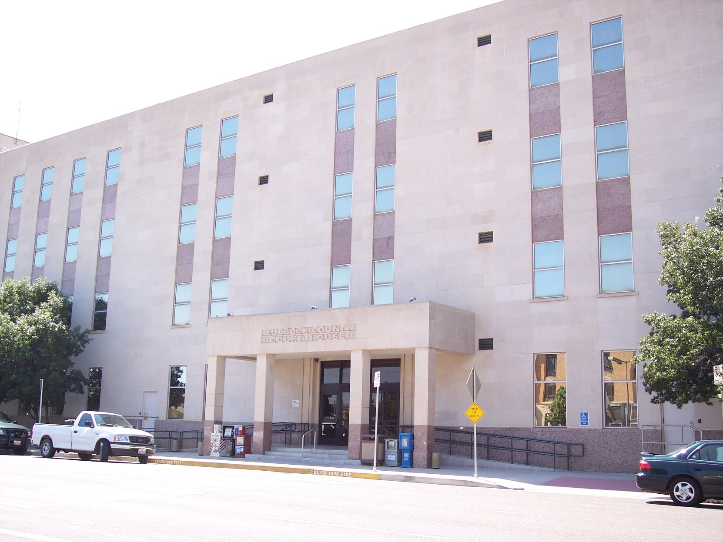
Lubbock County Courthouse

Slide 4
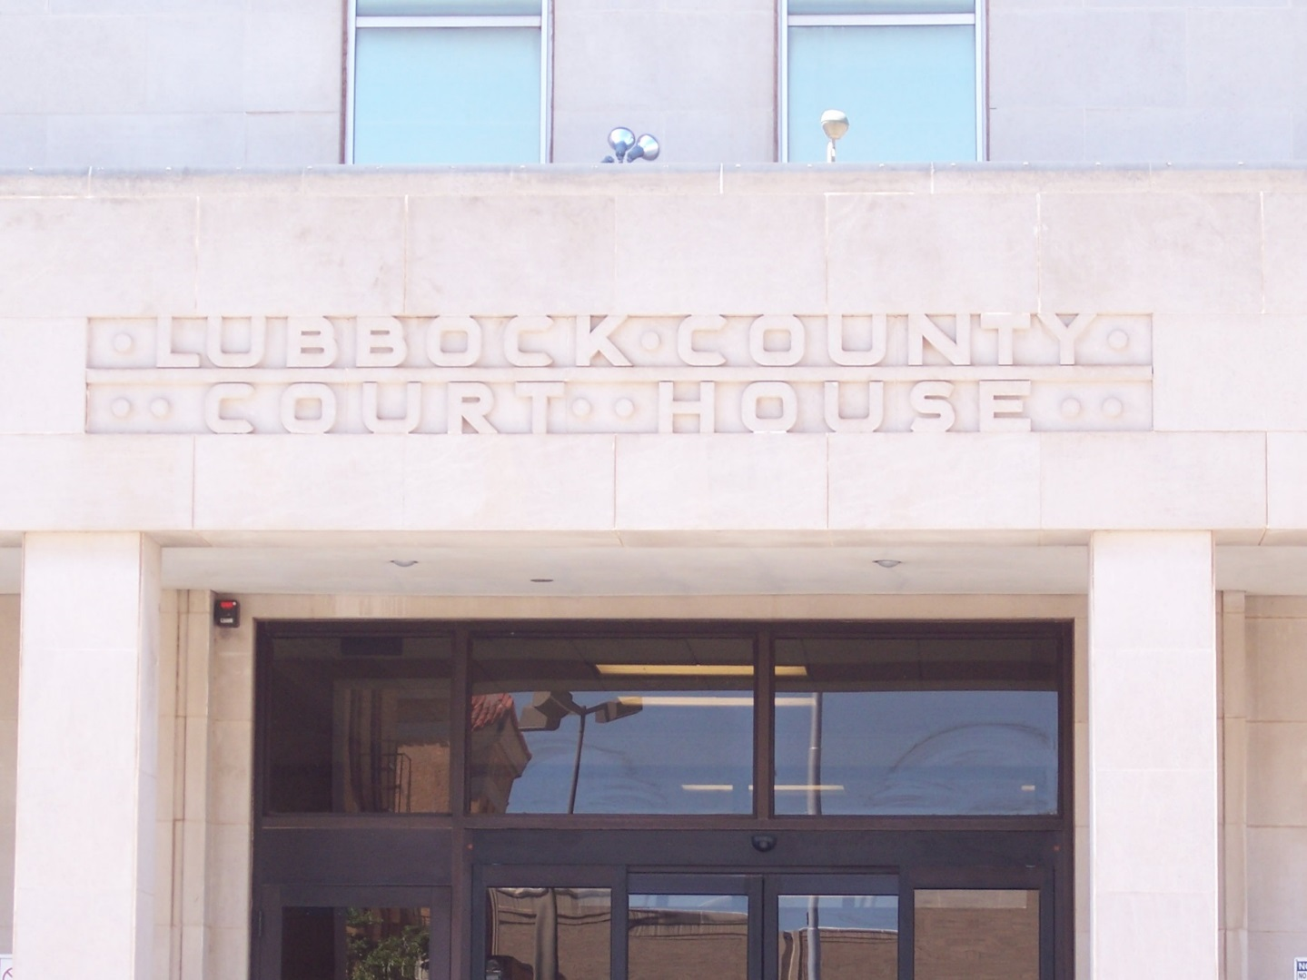
Lubbock County Courthouse

Slide 5
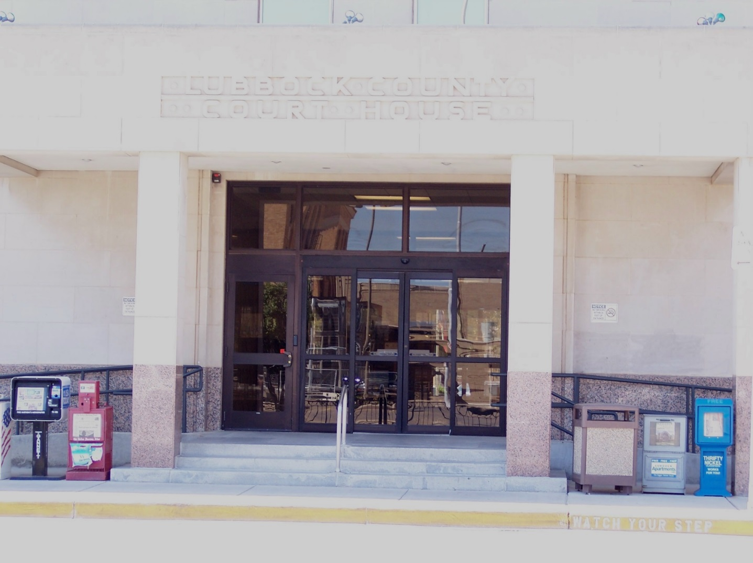
Courthouse Door

Slide 6
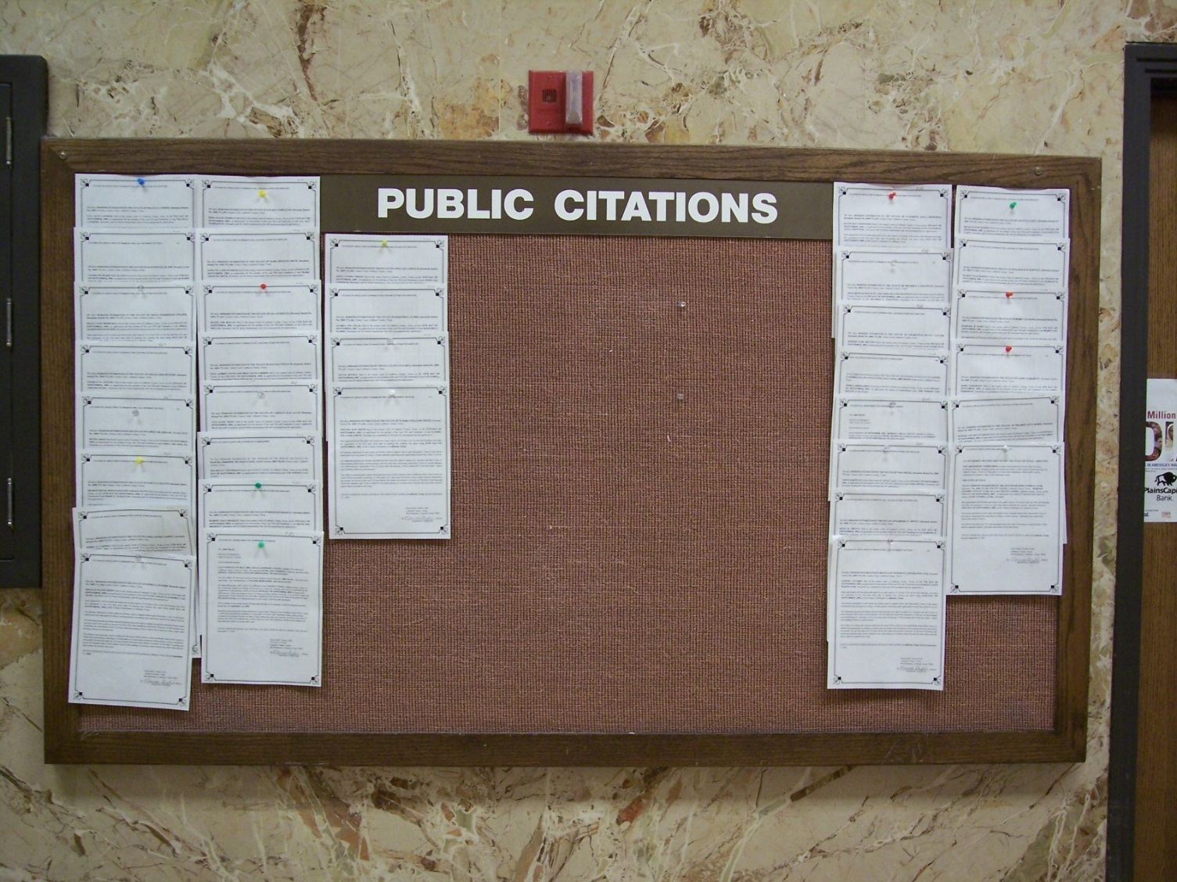
Bulletin Board

Slide 7
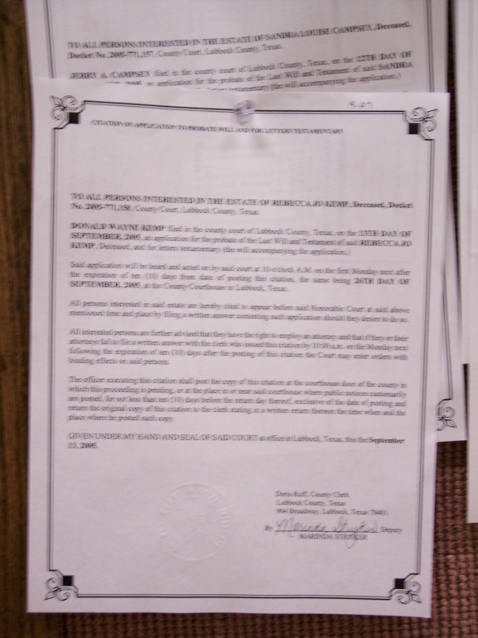
Citation for Probate Application

Slide 8
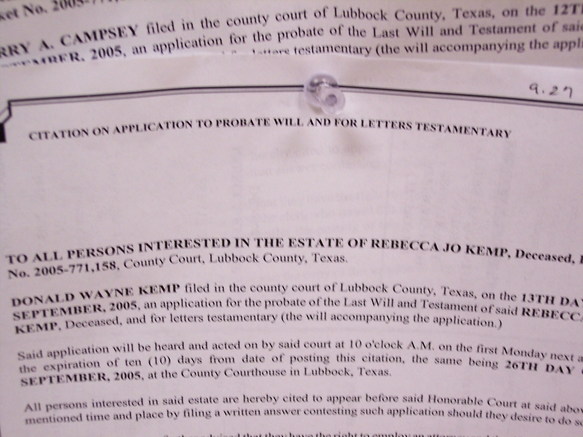
Citation for Probate Application

Slide 9
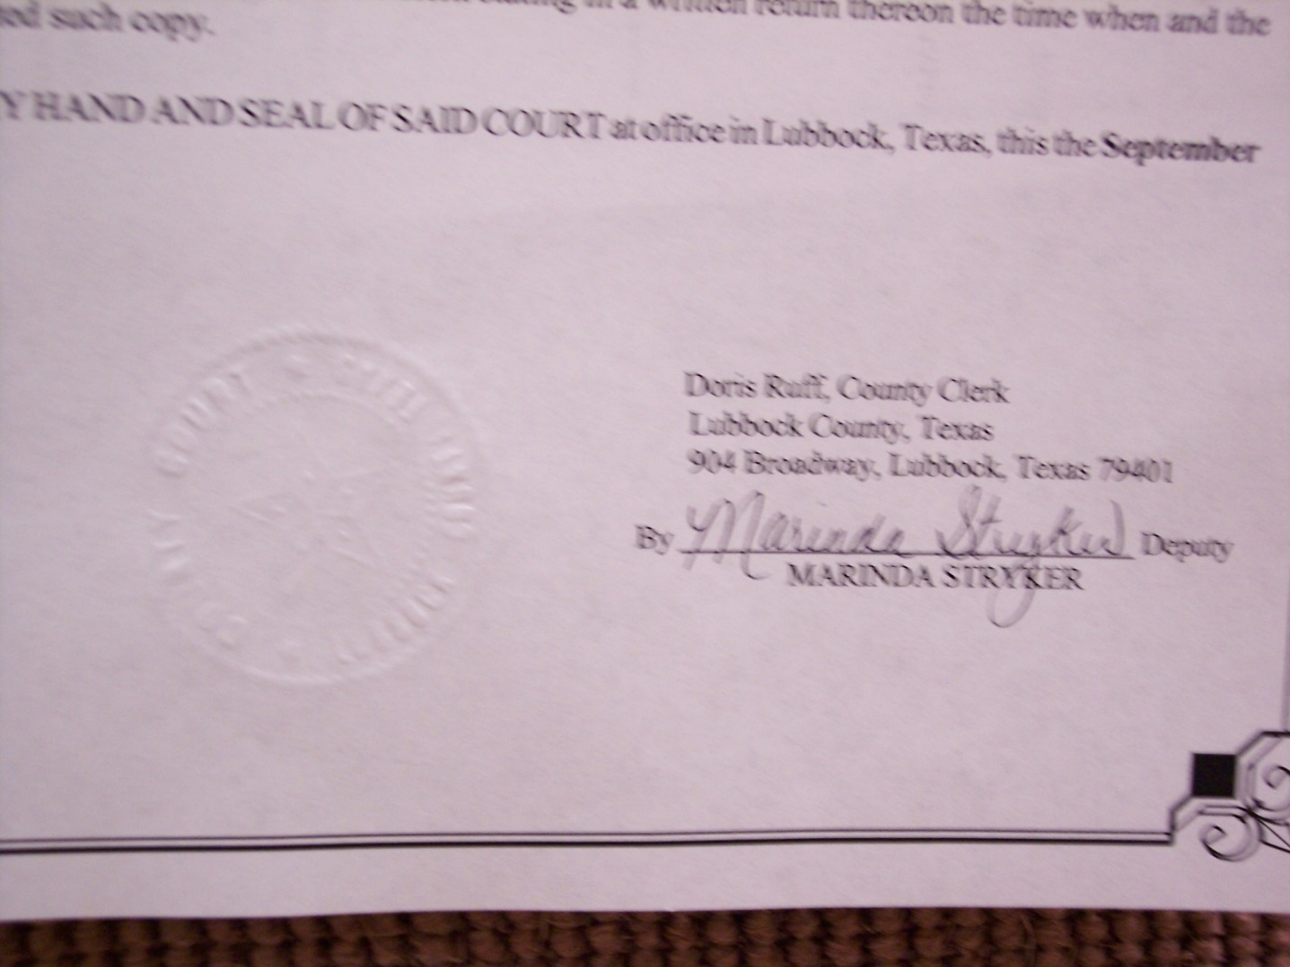
Citation for Probate Application

Slide 10
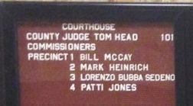
Constitutional County Court Judge

Slide 11

County Court at Law Judges

Slide 12
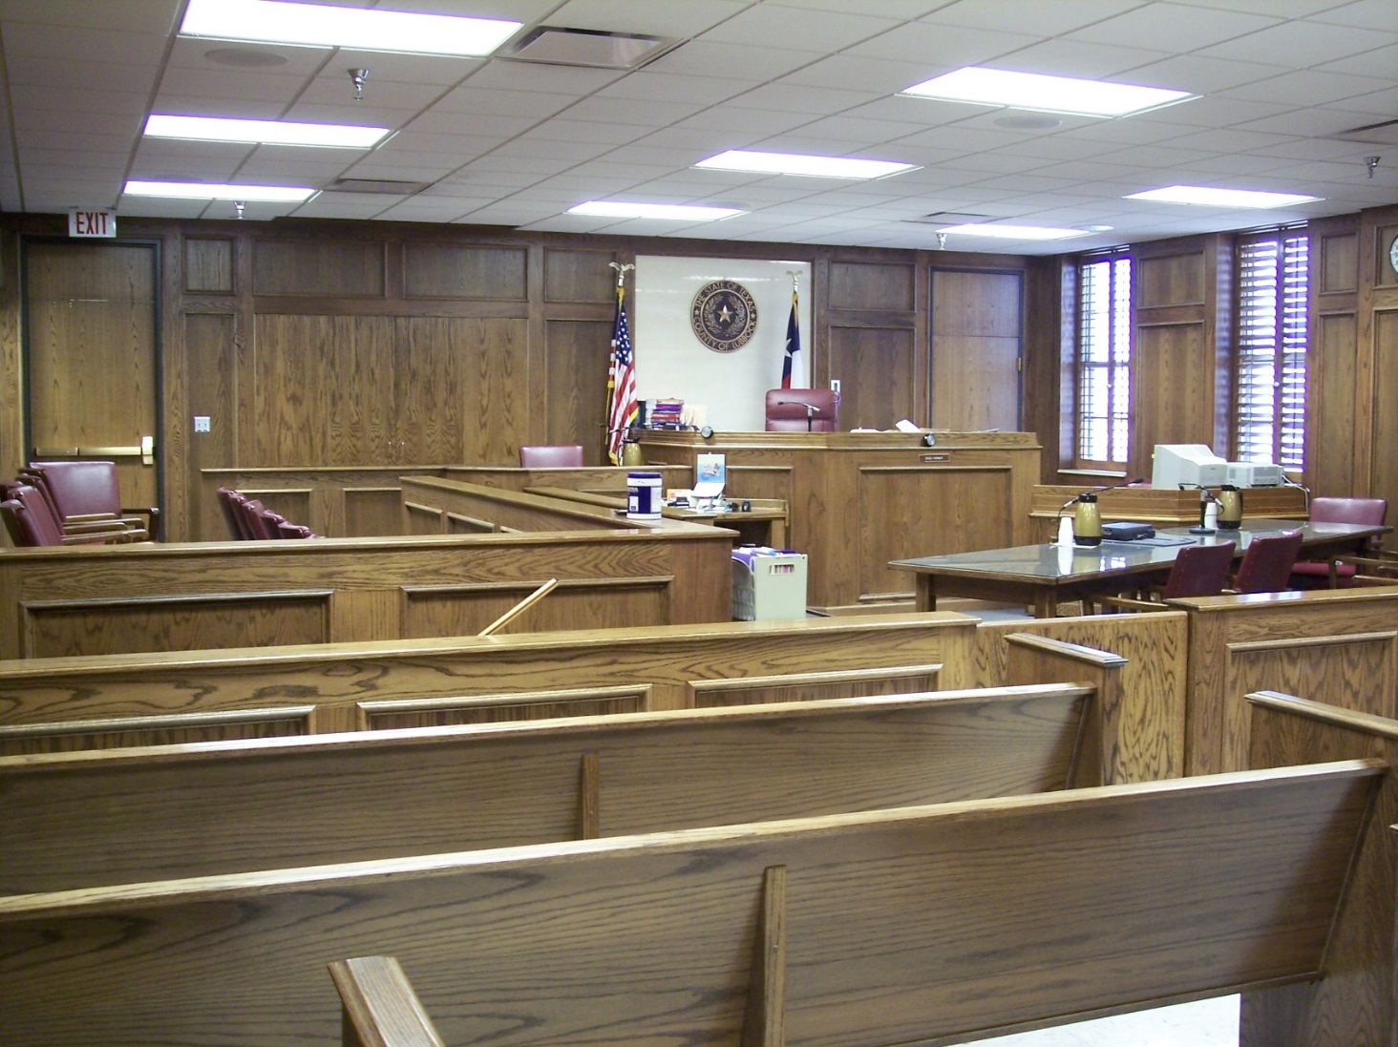
Courtroom

Slide 13

Estate of Ross – p. 80
Does posting comport with due process?

Slide 14
Exceptions to posting
1. Local Rules
Local court rules may imposed additional notice requirements.

Slide 15
Exceptions to posting
2. Written will not produced in court
Personal Service to testator’s heirs, if they are Texas residents and their residence known.
Publication Service in other cases.
PC § 128(b); EC § 258.002

Slide 16
Exceptions to posting
3. Late probated will
Service on testator’s heirs or, if another will has already been probated, the beneficiaries of that will.
Statute does not state method of service. Thus, a court order is needed.
PC § 128B; EC § § 258.051-258.053

Slide 17
Timing
Must be posted (or served or published) for not less than 10 days before the return date.
On the first Monday after those ten days, a hearing may be held.
PC § 33(g); EC § 51.104

