Slide 1
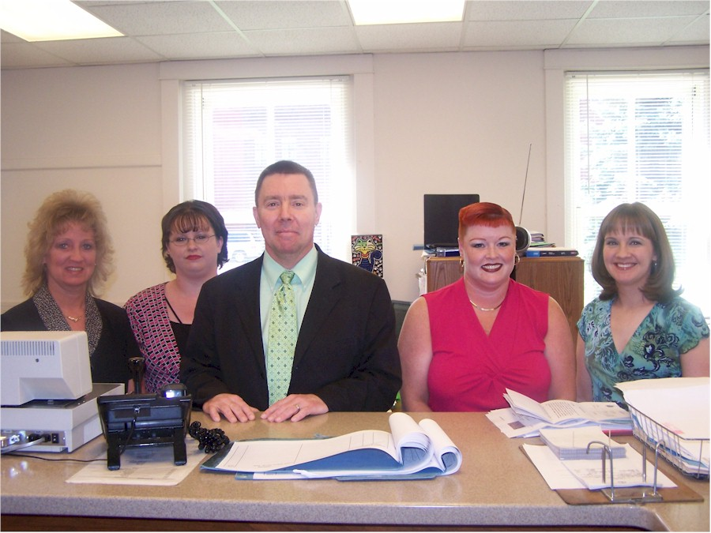
Filing

Slide 2
Where?
Court with:
Jurisdiction, and
Venue

Slide 3
What?
Intestacy
The application

Slide 4
What?
Intestacy
The application
Probate
The application
Original will

Slide 5
Cost?
Lubbock
$275 to probate will and open administration
$271 to probate will as muniment of title
Travis
$284 to probate will (muniment or admin.)
$736 for intestate administration

