Slide 1
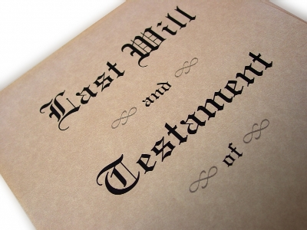
Locate Will

Slide 2
The Problem
Hard to prove a negative, that is, that a person died without a will.
Thus, must perform due diligence to locate the will.

Slide 3
1. Home and Office

Slide 4
2. Safe Deposit Box
Procedures in:
Probate Code §§ 36B-36F
Estates Code Chapter 151
Without court order
With court order

Slide 5
2. Safe Deposit Box
Without Court Order
Discretionary with bank

Slide 6
2. Safe Deposit Box
Without Court Order
Persons who may ask:
Spouse
Parent
Adult descendant
Named executor who can prove it with a copy of will

Slide 7
2. Safe Deposit Box
Without Court Order
Delivery of found documents:
Will = clerk of court with jurisdiction and venue, or named executor
Burial plot deed or burial instructions = person inspecting
Life insurance policy = any named beneficiary

Slide 8
2. Safe Deposit Box
With Court Order
Court designates person who may inspect
Examination occurs in presence of this person AND the judge or the judge’s agent

Slide 9
2. Safe Deposit Box
With Court Order
Delivery of found documents
Will = clerk of court with jurisdiction in same county as ordering judge
Burial plot deed = person designated in court order
Life insurance policy = any named beneficiary

Slide 10
3. Significant Individuals
Duty of Custodian
PC § 75
EC §§ 252.201-252.204

Slide 11
3. Significant Individuals
Duty of Custodian
No duty to probate will

Slide 12
3. Significant Individuals
Duty of Custodian
No duty to probate will
Duty to deliver to court with jurisdiction

Slide 13
3. Significant Individuals
Duty of Custodian
No duty to probate will
Duty to deliver to court with jurisdiction
If failure to deliver, may be arrested and imprisoned until person delivers and is liable for damages.

Slide 14
4. Clerk of Court
All counties where decedent lived
PC § 71
EC §§ 252.001-252.153

