Slide 1
Jurisdiction

Slide 2
Counties with only a Constitutional County Court -- PC § 4C(a); EC § 32.002(a)
Rural, low population counties.
File in Constitutional County Court.

Slide 3
Counties with only a Constitutional County Court -- PC § 4D(a); EC § 32.003(a)
If contested, judge may retain case.
If contested, judge may (or must on request of a party):
Request assignment of statutory probate judge, or
Transfer contested portion to district court.

Slide 4

In re Lewis – p.26

Slide 5
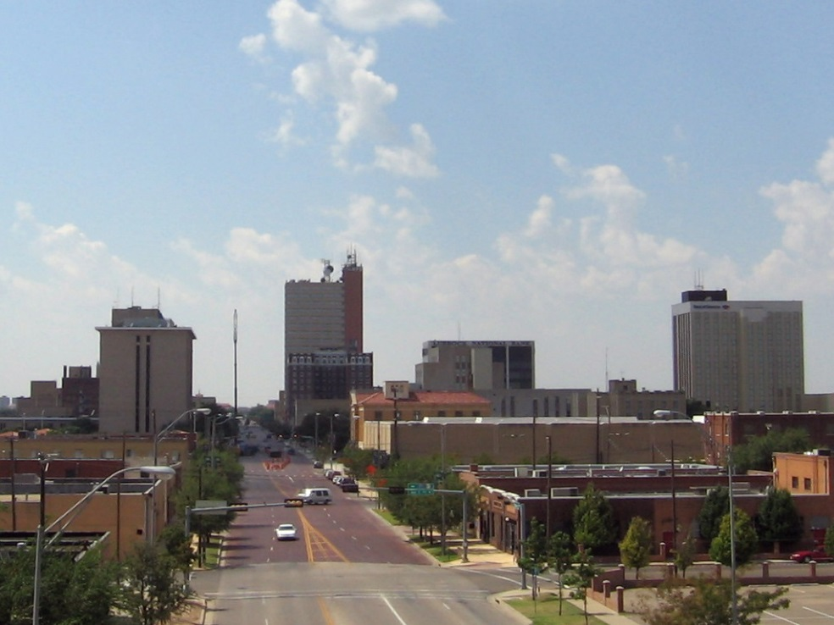
Counties with statutory court exercising probate jurisdiction (but not SPC) -- PC § 4C(b); EC § 32.002(b)
Medium population counties.
File in either:
Constitutional county court, or
Statutory court exercising probate jurisdiction.

Slide 6
Counties with statutory court exercising probate jurisdiction (but not SPC) -- PC § 4E; EC § 32.004
If action filed in Constitutional County Court is contested:
Judge may retain case, or
Transfer case (or contested issue) to statutory court exercising probate jurisdiction.
Must do so if a party requests.

Slide 7
Counties with Statutory Probate Court – PC § 4C(c); EC § 32.005
Urban, high population counties
10 counties (18 total courts)
All filings in these courts; no transfers.

Slide 8
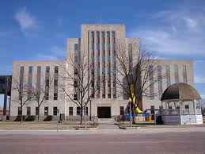
Lubbock Procedure

Slide 9
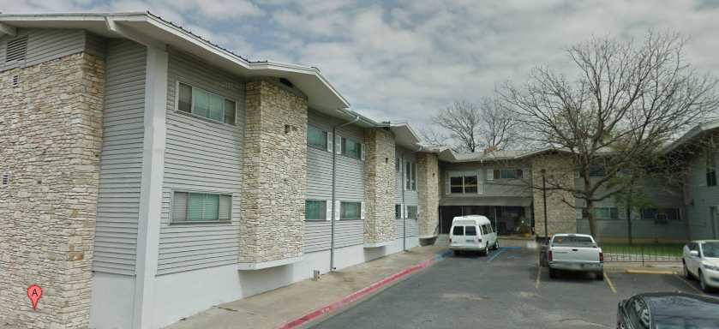
Austin Nursing Center v. Lovato p. 31

