Slide 1
Disability Planning for Health Care

Slide 2
Introduction
More important than property matters as impacts client’s medical care and thus quality of life.
  Life and death decisions included.

Slide 3
Statutory
Surrogates

Slide 4
Statutory Surrogates
What happens if no planning done and no guardian has been appointed?
Health & Safety Code Chapter 313 provides list of decision-makers.

Slide 5
Priority List
Spouse
One child who has consent of other children.
Majority vote of children.
Parents
Any person previously informally identified by patient.
Any family member
Any clergy member

Slide 6
Prohibited Decisions
Remove life support
Authorize electroshock
Inpatient mental health services
Delegation of decision-making authority

Slide 7
Discussion Questions
Are family members the right people to be default decision-makers?
Are your family members according to the priority list the people you would want making decisions for you?

Slide 8
Disability Planning for Health Care
[continued]

Slide 9
Medical Power of Attorney

Slide 10
Historical Background
Common Law
  Medical decisions non-delegable
Modern Law
  Started with California in 1983
  Virtually all states now allow either with their own acts or adoption of Uniform laws

Slide 11
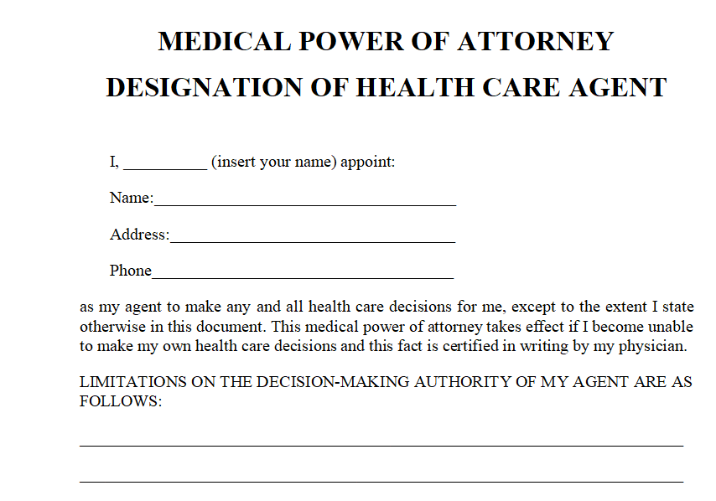
Texas Statutory Form

Slide 12
Texas Statutory Form Comments
Must be in substantially the statutory form.
Opportunity to provide express instructions.
Mandatory disclosure statement.
Notarized or two witnesses.

Slide 13
Special Concerns
Select agent carefully
  Life-changing and life-ending decisions may be made.
  Discuss with agent your thoughts so agent can do a good job of making substitute decisions.
Consider special instructions for any particular desires you may have.

Slide 14
HIPAA
Authorization

Slide 15
Basic Issues
Can medical agent get needed information?
Split of opinion
  MPA is sufficient to grant authority
  Separate HIPAA authorization needed
Recommendation – Separate document
Warning – Do not combine with MPA as federal law requires it to be separate.

Slide 16
Declaration for
Mental Health Treatment

Slide 17
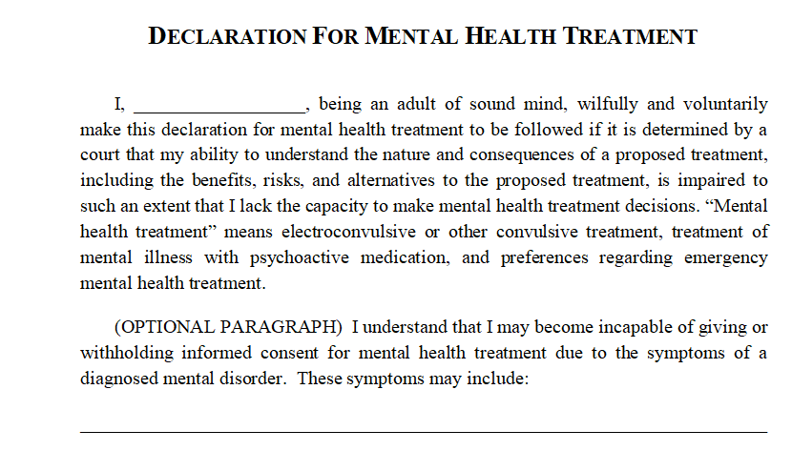
Statutory Form

Slide 18
Texas Statutory Form Comments
Must be in substantially the statutory form
Decision items
  Psychoactive medications
  Convulsive treatment
  Preferences for emergency treatment
    Rank order: restraint, seclusion, and medication
    Gender of person to administer
Additional preferences or instructions
Notarized or two witnesses

Slide 19
Guardian
Self-Designation

Slide 20
General Comments
Same form as for guardian of the estate.
Normally, select same people in same order as health care agents.
Disqualification of individuals who would have statutory priority possible.

Slide 21
Methods of Funding Care
[not discussing medical insurance]
Your own money.
Long-term care insurance.
Accelerated life insurance payments.
Viatical settlements.
Home care contracts.
Welfare (Medicaid).

Slide 22
Long-Term Care
Insurance

Slide 23
Cost and Need
Cost of LTC per month average:
  Lubbock = $6,500
  Dallas = $6,600
  Austin = $7,000
  Houston = $7,600
  New York City = $13,000
40% who need LTCI are under age 65.

Slide 24
Insurance Concerns -- Cost
Expensive
  Probably not cost effective for someone earning less than $75,000 per year or net worth less than $250,000.

Slide 25
Insurance Concerns -- Benefits
Type of care covered
  In home?
  Non-health care professionals?
Cap on benefits?
Waiting period?
Is hospitalization a prerequisite
How “sick” must person be to receive benefits?
  Normal activities?
  Alzheimer’s?

Slide 26
Accelerated Life Insurance and
Viatical Settlements

Slide 27
Accelerated Life Insurance
Insurer prepays insured part of death benefit if insured in terminal condition.
Purposes:
    Medical care
    Non-medical assistance
    Bucket list
    Party

Slide 28
Decision Issues
Unlikely available on term policies.
Death benefit reduced.
    Original plans for use of proceeds impacted.
Not deemed taxable income to insured.
Potential of tax savings

Slide 29
Viatical Settlements
Company purchases policy
  Insured gets cash now
  Company pays premiums
Company collects proceeds upon death
[read advertisement]

Slide 30
Home Care Contracts

Slide 31
Basic Idea
In exchange for in-home care, person leaves caregiver property in caregiver’s will (home, cash, etc.).
    Person lacks funds to pay caregiver outright
    “Property rich but cash poor”

Slide 32

Problem
Subject to abuse, fraud, undue influence, duress, etc.

Slide 33
Solutions
Complete background check of caregiver.
Cameras to monitor conduct.
Random inspections.
Place property in trust and have trustee arrange care, etc.
  Best option!

Slide 34
Medicaid Planning

Slide 35
Basic Idea
Transfer property to have quickly eligibility for Medicaid benefits.
  “Plan to be poor” to save assets for family members.
Very complex area.
  In law school:
    take Elder Law
  In practice:
    Attend CLEs
    Consult expert

Slide 36
Medicaid Recovery
After death, priority claim against estate is for Medicaid amounts received by the decedent.
  If money in estate at death, really did not need Medicaid benefits.

