Slide 1
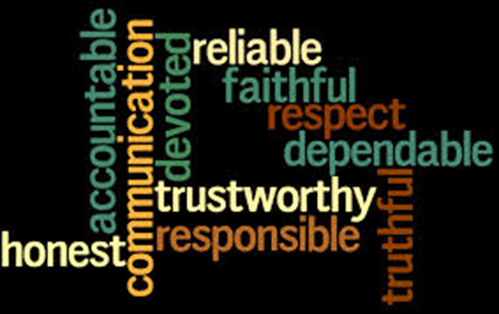
Fiduciary Selection

Slide 2


Follow the “Cocaine Rule”

Slide 3
Types of Fiduciaries
Executor
Guardian (estate and person)
  Client’s minor or disabled children
  Client him/herself
Trustee
Agent
  Property management
  Health care
  Body disposition

Slide 4

Client Needs Guidance

Slide 5
Legal Requirements
Adult
Competent
For some positions, not a convicted felon
Not someone the court would remove for being “unsuitable”
Corporations (banks, trust companies, etc.) in compliance with state law

Slide 6

Desirable Fiduciary Characteristics
1. Honest

Slide 7

Desirable Fiduciary Characteristics
2. Common Sense and Good Judgment

Slide 8

Desirable Fiduciary Characteristics
3. Financial Responsibility

Slide 9

Desirable Fiduciary Characteristics
4. Investment Experience and Skill

Slide 10

Desirable Fiduciary Characteristics
5. Awareness of Legal Issues

Slide 11

Desirable Fiduciary Characteristics
6. Impartiality

Slide 12
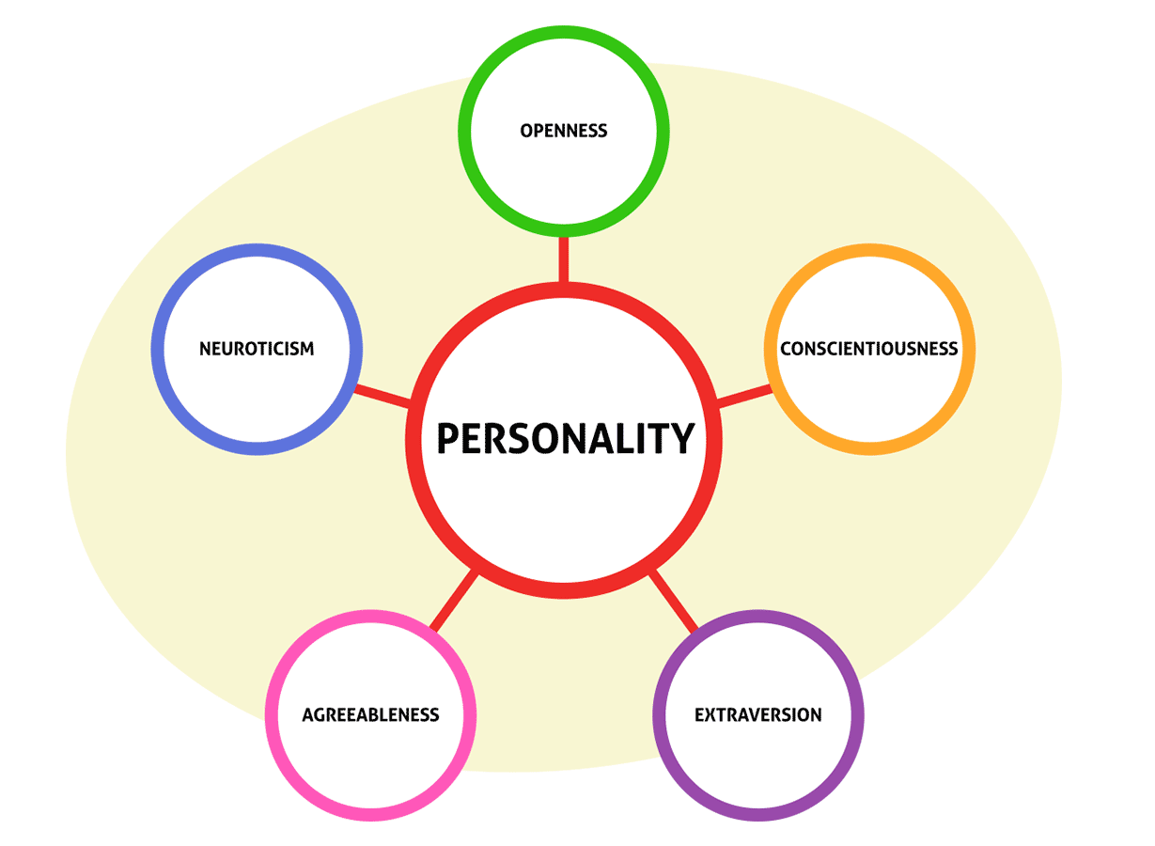
Desirable Fiduciary Characteristics
7. Fiduciary “Personality”

Slide 13

Desirable Fiduciary Characteristics
8. Longevity

Slide 14

Desirable Fiduciary Characteristics
9. Proximity

Slide 15

Desirable Fiduciary Characteristics
10. Lack of Distractions

Slide 16

Desirable Fiduciary Characteristics
11. Prior Approval

Slide 17

Individual Fiduciary -- Benefits
1. No or reduced fee

Slide 18

Individual Fiduciary -- Benefits
2. Knowledge of Person and Family

Slide 19

Individual Fiduciary – Problems
1. Unless professional, unfamiliar with carrying out fiduciary obligations

Slide 20

Individual Fiduciary – Problems
2. Lack of investment skills

Slide 21
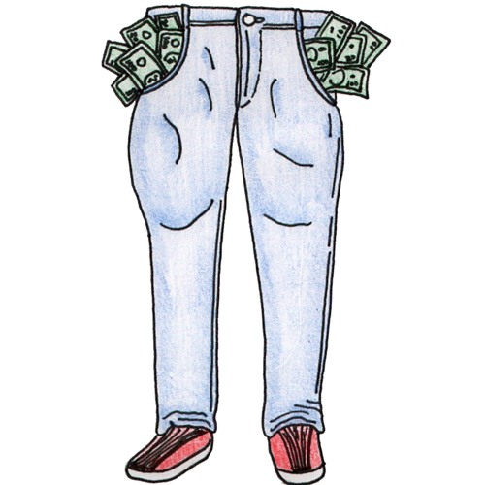
Individual Fiduciary – Problems
3. Lack of deep pockets for recovery
X

Slide 22

Individual Fiduciary – Problems
4. Family strife

Slide 23

Corporate Fiduciary – Benefits
1. Skill and Expertise

Slide 24

Corporate Fiduciary – Benefits
2. Continuous existence

Slide 25
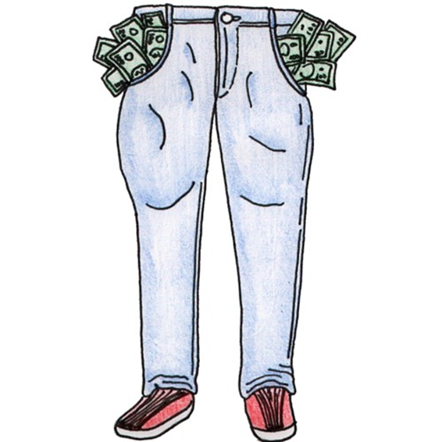
Corporate Fiduciary – Benefits
3. Deep pockets

Slide 26

Corporate Fiduciary – Problems
1. Fees

Slide 27

Corporate Fiduciary – Problems
2. Impersonal

Slide 28

Multiple Fiduciaries – Benefits
1. Enhanced expertise

Slide 29

Multiple Fiduciaries – Benefits
2. Continuity of management

Slide 30
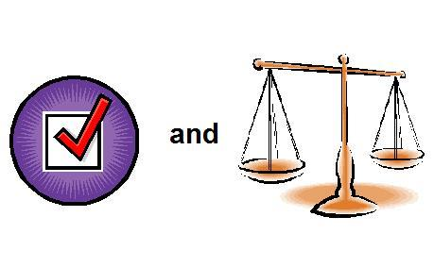
Multiple Fiduciaries – Benefits
3. Checks and balances

Slide 31


Multiple Fiduciaries – Benefits
4. Individual plus corporate fiduciary

Slide 32

Multiple Fiduciaries – Benefits
5. Encourages trustees to accept

Slide 33

Multiple Fiduciaries – Problems
1. Increased fees

Slide 34
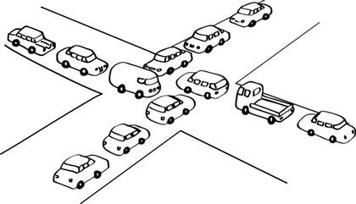
Multiple Fiduciaries – Problems
2. Tie votes

Slide 35

Multiple Fiduciaries – Problems
3. Delay in acting

Slide 36
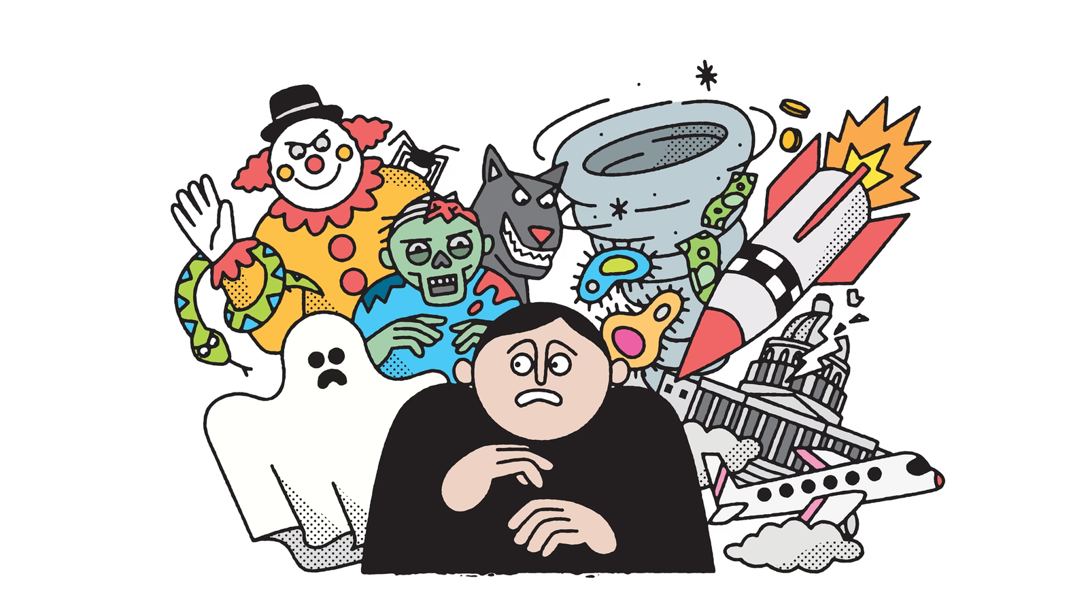
Multiple Fiduciaries – Problems
4. Fear of liability

Slide 37
Successor Fiduciaries
Name successors
  At least one, preferably two
Provide a method of selecting successor
If not done:
  No one serves, or
  Court involvement needed.

Slide 38


Bond
or

Slide 39
Bond
Presumption = required for executors and trustees
  Some states have opposite presumption
Not required if:
  Waived in will or trust (unless court nonetheless requires), or
  Corporate trustee
    Why?

Slide 40

Bond
Client makes decision whether to waive
  If client wants fiduciary to be bonded, suggest finding someone the client trusts.

Slide 41
Tax Concerns
In some cases, if the trustee is a family member of the beneficiary, adverse tax consequences could result depending on terms of the trust.
  Beyond scope of this presentation.

