Slide 1
Perfection

Slide 2
Perfection – Generally
Process by which a creditor protects (strengthens) security interest from other claimants to the same collateral.
Perfection is not relevant between the creditor and the debtor.

Slide 3
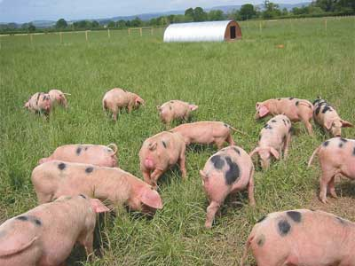



The Three Pigs Analogy
Secured but unperfected
Unsecured
X
Complete protection not possible
Secured and Perfected

Slide 4
Elements of Perfection
(1) Attachment
Plus
(2) Act of perfection
[depends on type of collateral]

Slide 5

Perfection by Creditor Possessing the Collateral

Slide 6
Perfection by Creditor Possessing the Collateral
The following types of collateral cannot be perfected by possession as there is nothing for the creditor to possess:
  Accounts
  Deposit accounts
  Electronic collateral
  General intangibles

Slide 7

Perfection by Creditor Possessing the Collateral
What is possession?

Slide 8
Perfection by Creditor Possessing the Collateral
What is possession? Undefined in UCC.
  CR has physical possession.
  CR’s agent has physical possession.
  Escrow
    CR controlling approach
    DR not controlling approach
    Problem 296 – p. 826 – Escrow holder (bailee) must acknowledge in an authenticated record that it holds for secured party.
  Field Warehousing – Problem 297(a), p. 826

Slide 9
Perfection by Creditor Possessing the Collateral
Loss of possession
  Perfection lost unless perfected by some other method first.
  20 Day Exception for Instruments, Negotiable Documents, and Certificated Securities
  Problem 297(b)-(d), p. 827
  Problem 298, p. 827

Slide 10

Automatic Permanent Perfection
Attachment Perfection

Slide 11
Automatic Permanent Perfection
1. Purchase-Money Security Interest in Consumer Goods except for:
  Fixtures
  Certificate of title items

Slide 12
Automatic Permanent Perfection
Problem 299 – p. 829
Federal regulations prevent creditors from taking non-possessory security interests in consumer goods other than PMSIs.
Problem 300 – p. 838

Slide 13
Perfection Review
1. Possession
2. Automatic and Permanent
  a. PMSI in consumer goods (except fixtures
  and COT items

Slide 14
Automatic Permanent Perfection
2. Assignment of insignificant amount of debtor’s accounts
  Issue = what is “insignificant amount”?
    Percentage test
    Casual or isolated transaction (Official Comment) test

Slide 15
Automatic Permanent Perfection
3. Sale of Promissory Notes
  Problem 301, p. 850
  Must be a “sale” – not a secured transaction

Slide 16


Automatic Temporary Perfection

Slide 17
Automatic Temporary Perfection
1. Proceeds
  Proceeds are automatically perfected for 20 days from debtor’s receipt.
  Details on how to extend perfection later.

Slide 18
Automatic Temporary Perfection
2. New value for instruments, negotiable documents, and certificated securities
  Creditor is automatically perfected for 20 days (a grace period to perfect using normal methods) from time of attachment if the creditor gave new value.

Slide 19
Automatic Temporary Perfection
3. Delivery of instrument, negotiable document, or certificated security for certain purposes such as:
  Sale
  Exchange
  Collection
  Presentation
Perfection continues for 20 days.

Slide 20
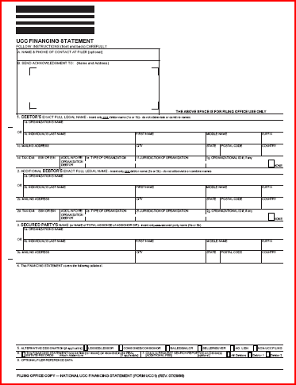
Perfection by Filing a Financing Statement
UCC-1
http://www.sos.state.tx.us/ucc/index.shtml

Slide 21
Perfection by Filing a Financing Statement
All collateral may be perfected by filing
except:
  Deposit accounts, and
  Money

Slide 22
Perfection by Filing a Financing Statement
Requirements:
  1. Names of debtor and creditor

Slide 23
Perfection by Filing a Financing Statement
Requirements:
  2. Addresses of debtor and creditor

Slide 24
Perfection by Filing a Financing Statement
Requirements:
  3. Debtor’s authorization in authenticated record
    Automatic if debtor authenticated the underlying security agreement.

Slide 25
Perfection by Filing a Financing Statement
Requirements:
  4. Description of collateral
    Broad descriptions allowed.
    After-acquired property covered by security agreement automatically covered.
    Problem 288 – p. 807
    Problem 289 – p. 811
    Problem 290 – p. 812
    Problem 291 – p. 813
    Problem 292 – p. 813
    Problem 293 – p. 813

Slide 26
Perfection by Filing a Financing Statement
Requirements:
  5. Description of land if collateral is:
    timber,
    minerals,
    fixtures, or
    crops.

Slide 27
Perfection by Filing a Financing Statement
Requirements:
  Names of debtor and creditor
  Addresses of debtor and creditor
  Debtor’s authorization in authenticated record
  Description of collateral
  Description of land if collateral is timber, minerals, fixtures, or crops

Slide 28
Perfection by Filing a Financing Statement
Errors
  By creditor -- Minor errors that are not seriously misleading are excused.
  Problem 284 – p. 806 – “search engine test”

Slide 29
Perfection by Filing a Financing Statement
Errors
  By Secretary of State’s office – Creditor protected if provided financing statement and the fee:
    Mail = $15
    Electronic = $5
    Delaware = $50
  Problem 303 – p. 852

Slide 30
Perfection by Filing a Financing Statement
Designation of Debtor
Important as FS filed under debtor’s name

Slide 31
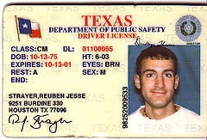
Perfection by Filing a Financing Statement
Designation of Debtor
  Individual = Individual’s name
  As on drivers license deemed sufficient.

Slide 32
Perfection by Filing a Financing Statement
Designation of Debtor
  Registered organization = Registered name
    Corporate name
    Partnership name

Slide 33
Perfection by Filing a Financing Statement
Designation of Debtor
  Trade name = Owner’s name (not trade name)
    Problem 283 – p. 805
    Problem 287, p. 807

Slide 34
Perfection by Filing a Financing Statement
Change in Debtor’s Name
  Collateral debtor owns at time of name change = perfection continues

Slide 35
Perfection by Filing a Financing Statement
Change in Debtor’s Name
  After-acquired collateral within 4 months = perfection continues

Slide 36
Perfection by Filing a Financing Statement
Change in Debtor’s Name
  After-acquired collateral after 4 months = no perfection
  Problem 285 – p. 806

Slide 37
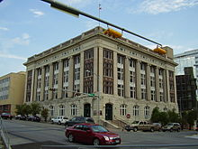
Perfection by Filing a Financing Statement
Place of Filing:
  General rule = Secretary of State’s Office (in state capital).

Slide 38
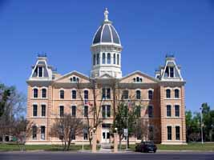
Perfection by Filing a Financing Statement
Place of Filing:
  Fixtures, minerals, and timber = County land records where land mortgage would be recorded
County courthouse of
________ County in
________, Texas

Slide 39

Perfection by Filing a Financing Statement
Duration
  Five years from date of filing.
  But, a recorded real property mortgage covering fixtures is effective until mortgage released or satisfied.
  Problem 304(a) – p. 853

Slide 40
Perfection by Filing a Financing Statement
Continuation Statement – extends by 5 years
  File within 6 months prior to the expiration date of prior filing.
  Filing 4½ 5
  Problem 304(b)-(e) – p. 853

Slide 41

Perfection by Filing a Financing Statement
Termination Statement

Slide 42
Perfection by Filing a Financing Statement
Termination Statement
  Consumer goods = required by earlier of:
    20 days of debtor’s written demand, or
    1 month after no outstanding secured obligation or commitment to make advances (even without debtor’s demand).
    Creditor must file and pay the fee.

Slide 43
Perfection by Filing a Financing Statement
Termination Statement
  Non-Consumer goods
    Creditor provides within 20 days of debtor’s written demand.
    Debtor handles filing, cost, etc.
  Problem 305 – p. 854
    Damages for non-compliance
    Actual damages plus $500

Slide 44
Perfection by Filing a Financing Statement
Fraudulent Filing:
  Forged
  Material false statement
  Groundless
  Minimum penalty:
    $5,000
    Court costs
    Reasonable attorney’s fees
  Problem 306 – p. 854

Slide 45
Perfection by Control
Investment property
Deposit accounts
Electronic collateral
  Documents
  Chattel paper
Creditor may sell or transfer the collateral without further action from debtor.

Slide 46
Perfection by Notation on Certificate of Title
Motor Vehicles
Boats
Manufactured Housing

Slide 47
Perfection by Notation on Certificate of Title
If consumer goods or equipment = must note security interest on the certificate of title
If inventory, perfect normally.

Slide 48
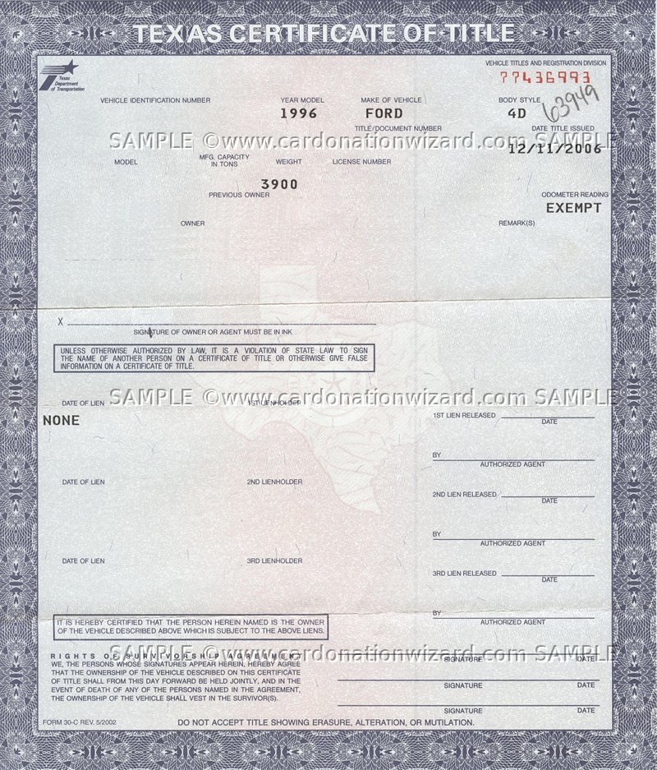
Perfection by Notation on Certificate of Title

Slide 49

Perfection by Notation on Certificate of Title

Slide 50
Perfection by Notation on Certificate of Title
Problem 311 – p. 861
Problem 312 – p. 866
Problem 313 – p. 867

Slide 51
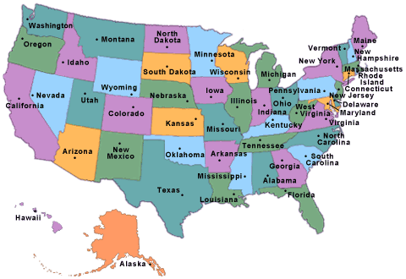
Multistate Transactions
What state’s law is used to determine how to perfect a security interest?

Slide 52
What state’s law governs how to perfect?
General Rule = law of state where debtor is located.

Slide 53
What state’s law governs how to perfect?
General Rule = law of state where debtor is located.
  Individual = Principal residence
  Problem 307 – p. 858

Slide 54
What state’s law governs how to perfect?
General Rule = law of state where debtor is located.
  Registered organization = Where organized
  Problem 308 – p. 858

Slide 55
What state’s law governs how to perfect?
General Rule = law of state where debtor is located.
  Unregistered organization = place of business; if more than one, chief executive office

Slide 56
What state’s law governs how to perfect?
Special Cases = Law of state where the collateral is located
  Perfection is by possession
  Fixtures
  Timber
  Agriculture Liens

Slide 57
What state’s law governs how to perfect?
Special Rule for Certificate of Title Items =
Law of state which issued most recent certificate

Slide 58
What state’s law governs how to perfect?
If debtor moves to a different state:
  Creditor has 4 months to perfect under the law of the debtor’s new state.
    Problem 309 – p. 859
    Problem 310 – p. 859
  But, if perfected by possession, continues if perfection is proper method in new state.
  But, if COT item, perfection continues for as long as it would have under original COT.

