Slide 1
Classification of Collateral

Slide 2
Basic Concepts
Critical importance as many rules depend on type of collateral.
Categories are mutually exclusive.
Debtor’s use is determinative.

Slide 3
Goods
Moveable items and fixtures
Specific Inclusions
Specific Exclusions

Slide 4

Goods
1. Consumer Goods – personal, family, or household purposes

Slide 5

Goods
2. Equipment – business purposes

Slide 6
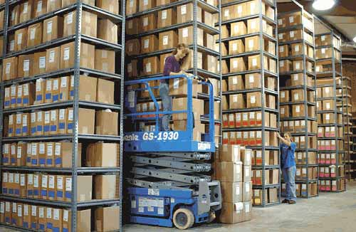
Goods
3. Inventory
Held for sale
Held for lease
Raw material
Work in progress
Consumed materials

Slide 7


Goods
4. Farm Products – crops & livestock

Slide 8
Goods
4. Farm Products – crops & livestock
In possession of farmer who grew or raised the farm product, and
In an unmanufactured condition.

Slide 9

Goods
The “Egg” Example

Slide 10
Goods
Multiple Uses – principal use is determinative
CR may usually rely on DR’s statement of intended use.
Later change in use does not change category.
But, be safe – perfect for all uses!

Slide 11
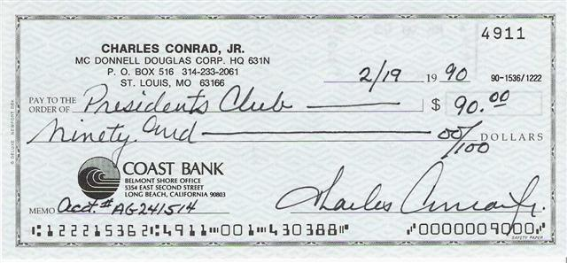
Instruments
Instruments (represent money) – notes, drafts, checks, CDs

Slide 12
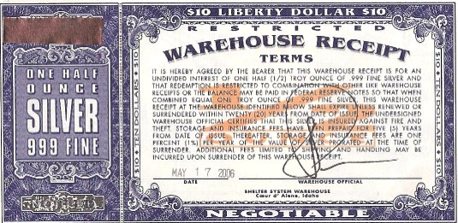
Documents
Warehouse receipt – goods in storage

Slide 13
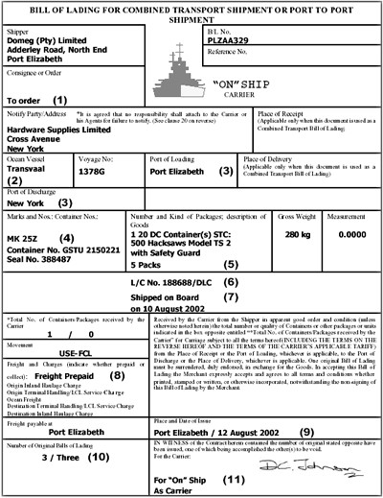
Documents
Bill of lading – goods in transit

Slide 14
Chattel Paper
Monetary Obligation
E.g., promissory note
plus
Security interest in or lease of goods

Slide 15
Account
Right to money for
Goods sold or leased, or
Services rendered
Not evidenced by an instrument or chattel paper.
Includes:
Contract rights not yet earned by performance
Computer software license fees
Credit card receivables
Health care receivables

Slide 16


Deposit accounts
Checking or savings account in a business transaction

Slide 17

Investment Property
Stocks, bonds, mutual funds, commodity contracts, etc.

Slide 18

Commercial Tort Claims

Slide 19



General Intangibles
Payment intangible if benefit is to receive money.

Slide 20
Proceeds
What the debtor receives (money or other property) upon collateral disposition:
Sale
Exchange
Collection
Proceeds may be collateral CR could not have obtained an interest in originally.

Slide 21
Problems
Problem 275 – p. 792
Problem 276 – p. 798
Problem 277 – p. 799
Problem 278 – p. 799
Problem 279 – p. 802
Problem 280 – p. 802
Problem 281 – p. 802

