Slide 1
Scope of Article 9

Slide 2
1. Collateralized transaction in personal property or fixtures
A. Property DR already owns.
Problem 263, p. 765

Slide 3
1. Collateralized transaction in personal property or fixtures
B. Property DR acquires with the loan:
Purchase-Money Security Interest (PMSI)
Lender and seller may be same entity, or
Lender and seller may be different entities.

Slide 4
1. Collateralized transaction in personal property or fixtures
C. After-Acquired Property
Floating Lien.
Most common use = inventory

Slide 5
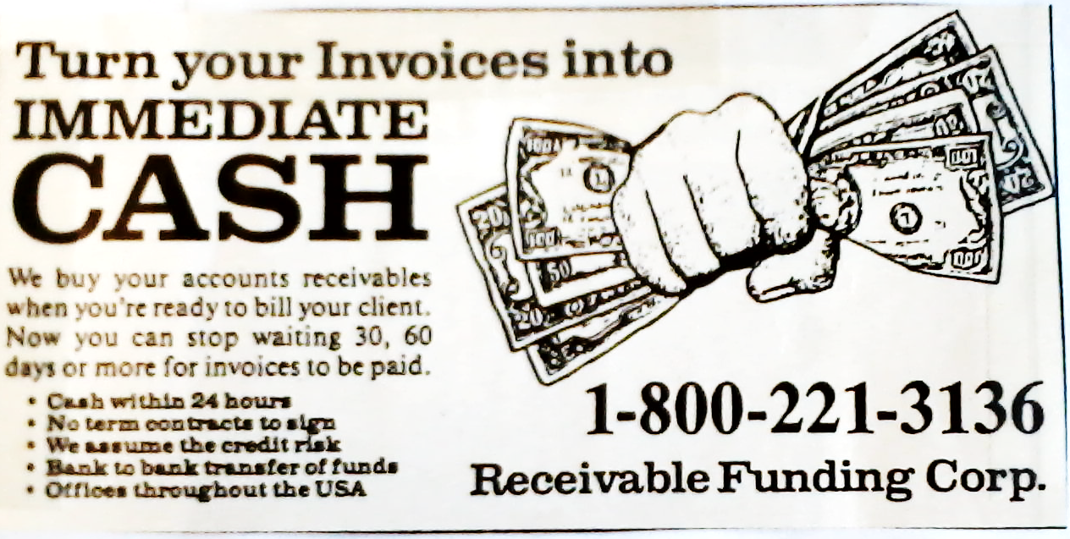
2. Sale of Receivables

Slide 6
2. Sale of Receivables
Examples:
Accounts
Chattel paper
Payment intangibles
Promissory notes
Problem 264, p. 766

Slide 7
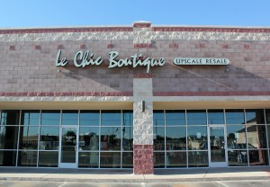
3. Consignments

Slide 8
3. Deceptive Consignments
Owner of goods Seller Buyer
Bailor Bailee
Consignor Consignee
Consignee’s Creditors
In battle between Consignor (owner) and
Consignee’s Creditors, who will prevail?
Possession (not ownership) of goods
Proceeds of sale minus commission

Slide 9
3. Deceptive Consignments
A. Consigned goods worth a total of $1,000 or more.

Slide 10
3. Deceptive Consignments
B. Not used as consumer goods.

Slide 11
3. Deceptive Consignments
C. Potentially deceptive consignee:
Consignee deals with goods of that kind under a name other than the consignor’s name,
Consignee is not an auctioneer, and
Consignee is not generally known by consignee’s creditors to be substantially engaged in selling consigned goods
Problem 265 – p. 767
Problem 266 – p. 770

Slide 12
4. Statutory Agricultural Liens

Slide 13
5. Lease-Purchase Agreements
Lessor Lessee
Owner
Lessee creditors
In battle between Lessor (owner) and
Lessee’s Creditors, who will prevail?
Possession of goods
Rent

Slide 14
5. Lease-Purchase Agreements
True leases are not covered by Article 9.
Lease which is actually an installment sale is covered by Article 9.
How distinguish?

Slide 15
5. Lease-Purchase Agreements
Facts evidencing a secured transaction –
Cannot terminate lease at any time and
Lease term equal to or greater than remaining economic life of goods (“junk pile” lease),
Lessee owns the property at the end of the lease term, or
Lessee has option to buy for nominal consideration at end of lease term.

Slide 16
5. Lease-Purchase Agreements
Problem 267 – p. 770
Problem 268, p. 773

Slide 17

Protective Compliance
When in doubt if “consignment” or “lease” will be covered by Article 9, do a protective filing.
Under § 9-505, no harm – cannot use filing as an “admission” that it is a secured transaction rather than something else.

Slide 18
Subrogation
Equitable right of subrogation arises as a matter of law and thus is not a security interest.
Thus, in Problem 269 (p. 780), Surety will prevail over bank even though Surety is unperfected (did not file a financing statement).

Slide 19


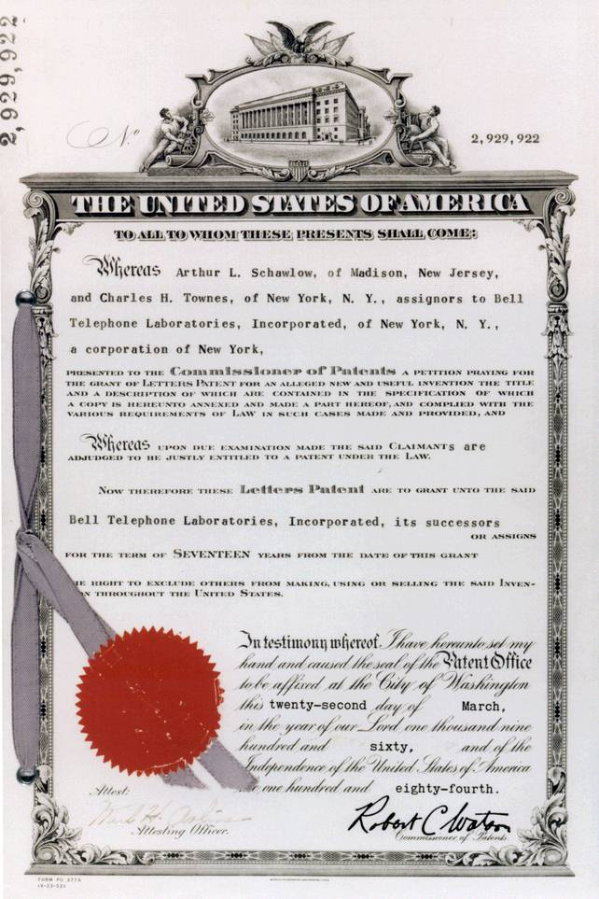
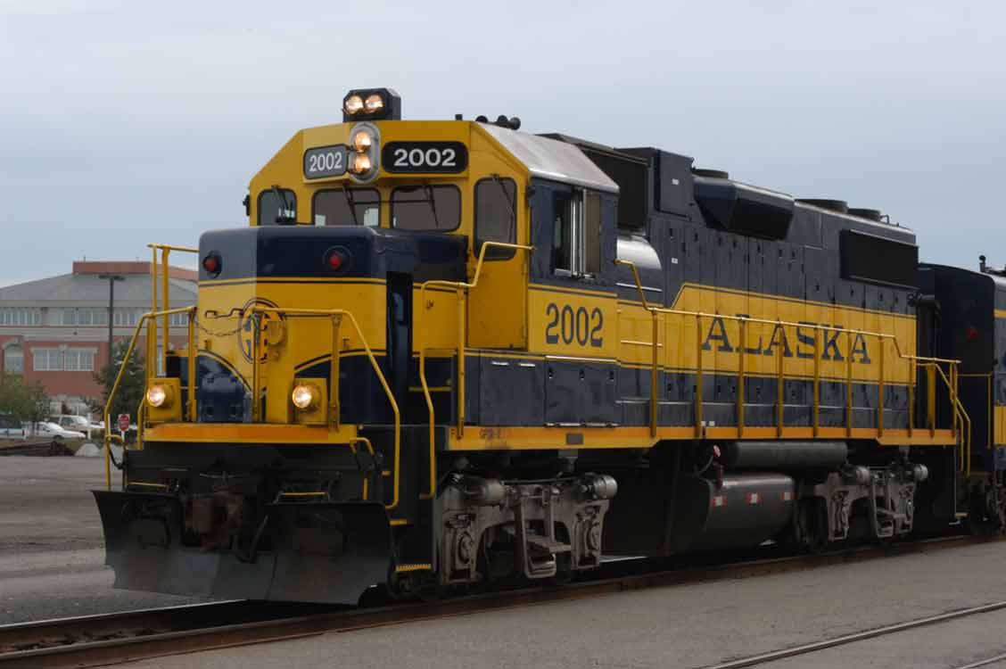
Exclusions from Article 9
1. Rights governed by federal law

Slide 20


Exclusions from Article 9
2. Real property (except fixtures)
Problem 273, p. 788

Slide 21
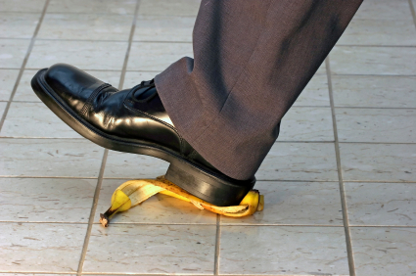
Exclusions from Article 9
3. Tort claims (except commercial tort claims)

Slide 22


Exclusions from Article 9
4. Deposit accounts in consumer transactions
Problem 274 – p. 789

Slide 23


Exclusions from Article 9
5. Statutory liens
Problem 270, p. 787

Slide 24
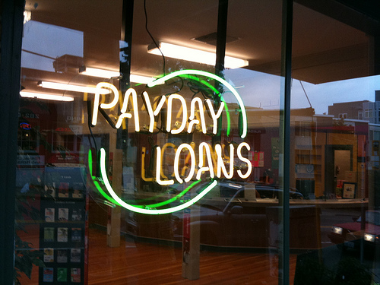
Exclusions from Article 9
6. Wage assignments
Problem 271, p. 787

Slide 25
Exclusions from Article 9
7. Non-financing assignments
Problem 272 – p.788

Slide 26
Practice Question
Check 4009
Bjorn Scrub Scrub
[alleged drawer] [drawer/forger] [payee]
Eagle Bank Roach Bank

Slide 27
Practice Question
Check 5061
Bjorn Clark Scott Woodford
[drawer] [payee] [thief]
Eagle Credulous Clark Scott Reavis
[alteration]

