Slide 1
Secured Transactions
Introduction

Slide 2

Secured Transactions – Basic Idea
A person wants property (real or personal) or services but does not have money.
  Person needs to become a debtor.

Slide 3

Secured Transactions
Creditor Options
1. Refusal

Slide 4
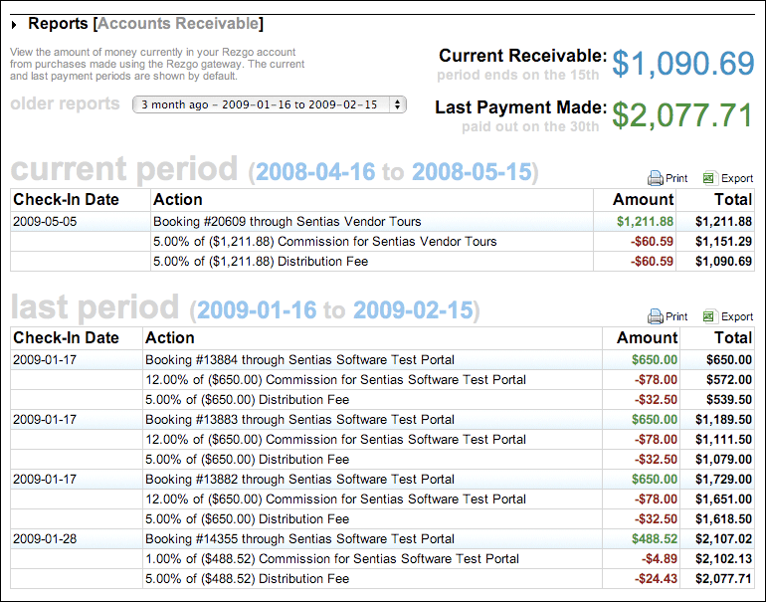
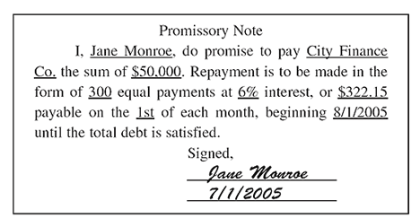
Secured Transactions
Creditor Options
2. Obtain promise to repay
  Unsecured creditor
  General creditor

Slide 5

Secured Transactions
Creditor Options
3. Obtain surety
  Co-signer
  Accommodation party
  Guarantor

Slide 6

Secured Transactions
Creditor Options
4. Obtain Collateral
  Real property = mortgage or deed of trust

Slide 7
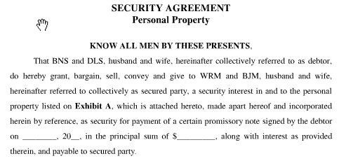
Secured Transactions
Creditor Options
4. Obtain Collateral
  Personal Property = Article 9 security interest

Slide 8
Basic Approach
1. Is the transaction within scope of Article 9?

Slide 9
Basic Approach
2. Classify the collateral.

Slide 10
Basic Approach
3. Determine if a security interest has been created, that is, has attachment occurred.

Slide 11
Basic Approach
4. Determine if the security interest has been properly perfected.

Slide 12
Basic Approach
5. Determine the persons who are making claims to the collateral.

Slide 13
Basic Approach
6. Apply proper priority rules and rules regarding repossession.

Slide 14
Very Brief History

Slide 15
Benedict v. Ratner – p. 756
Loan of money
Hub Carpet Ratner
Debtor Creditor
Benedict
Bankruptcy Trustee
Issue: Who has priority to the accounts receivable?
Accounts receivable as collateral

Slide 16

Pre-Code Security Devices
1. The pledge
  DR gives CR physical possession of the collateral.
  Pros?
  Cons?

Slide 17

Pre-Code Security Devices
2. Chattel Mortgage
  360 Financial Services
  Queensland, Australia

Slide 18
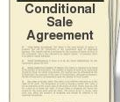
Pre-Code Security Devices
3. Conditional Sale
  Problem 262, p. 761

Slide 19
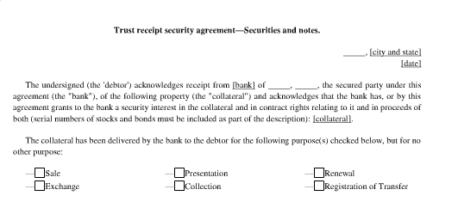
Pre-Code Security Devices
4. Trust Receipt

Slide 20
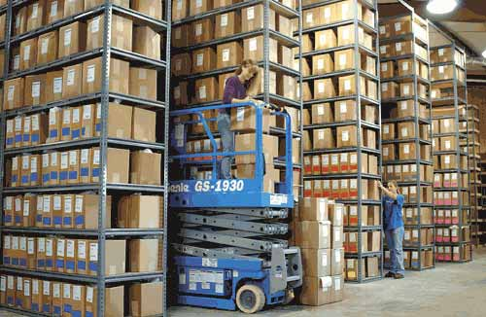
Pre-Code Security Devices
5. Factor’s Lien

Slide 21

Pre-Code Security Devices
6. Field Warehousing

