Slide 1
Forgery and Alteration

Slide 2
Forgery – First Step
Ascertain whose name is forged:
Maker of note
Payee (indorser)
Drawer
Different rules apply based on identity/status of person whose name is forged.

Slide 3
Forged Maker’s Signature on Note
Alleged maker not liable (not sign).
Forger is liable (signed).

Slide 4
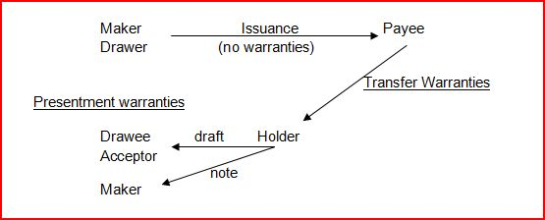
Warranties

Slide 5
Warranties
Implied – arise automatically.

Slide 6
Warranties
Implied – arise automatically.
Off-instrument liability so possession of the instrument is NOT necessary to recover.

Slide 7
Warranties
Implied – arise automatically.
Off-instrument liability so possession of the instrument is NOT necessary to recover.
Goal is to get money back that was improperly paid previously.

Slide 8
Transfer Warranties

Slide 9
Transfer Warranties
Who makes transfer warranties [defendant]?
Person who
transfers the instrument AND
receives consideration for the instrument.
Examples:
Payee to special indorsee
Payee to depositary bank
Depositary bank to collecting bank

Slide 10
Transfer Warranties
To whom are transfer warranties made [plaintiff]?
1. Immediate transferee, and
2. Subsequent transferees if
transferor indorsed, or
if instrument is a check and is passing through collection process.

Slide 11
Transfer Warranties
1. Transferor was entitled to enforce at time of transfer.
Basically, a warranty of holder status (good title).

Slide 12
Transfer Warranties
2. All signatures authentic and authorized.
Even if not needed for chain of title.

Slide 13
Transfer Warranties
3. The instrument has not been altered.

Slide 14
Transfer Warranties
4. No defense would defeat the transferor’s ability to collect the money
A “perfect plaintiff” warranty.

Slide 15
Transfer Warranties
5. Transferor has no knowledge of bankruptcy of maker, acceptor, or drawer
Only warranty where transferor’s knowledge is relevant.

Slide 16
Transfer Warranties
6. If remotely created item, that alleged drawer authorized the item.

Slide 17
Transfer Warranties
Disclaiming warranties:
1. Check = transferor cannot disclaim
2. Notes and non-check drafts – transferor may disclaim with indorsement including phrase such as “without warranties”

Slide 18
Transfer Warranties
Requirements to recover:
Claimant must give notice to warrantor within 30 days of when claimant has reason to know of breach.
If late notice, only discharged for loss caused by delay (if any).
Statute of limitations = 3 years

Slide 19
Presentment Warranties

Slide 20
Presentment Warranties
Who makes presentment warranties [the defendant]?
1. Person who presents the instrument for payment to drawee, maker, or acceptor, and
2. All previous transferors of the instrument.

Slide 21
Presentment Warranties
To whom are presentment warranties made [plaintiff]?
1. Note = Maker
2. Draft = Drawee or acceptor

Slide 22
Presentment Warranties
Transfer and Presentment warranties are mutually exclusive:
A plaintiff can sue on only one (if any) warranty.
But, a defendant could make both warranties, but to different people.

Slide 23
Presentment Warranties – unaccepted draft (check)
1. Presenter (and prior transferors) were entitled to enforce at the time of presentment (or transfer).
A warranty of holder status (good title).

Slide 24
Presentment Warranties – unaccepted draft (check)
2. No alteration.

Slide 25
Presentment Warranties – unaccepted draft (check)
3. No knowledge that drawer’s signature was unauthorized.
This is NOT a warranty that the drawer’s signature is good (not forged); just a warranty of no knowledge.

Slide 26
Presentment Warranties – unaccepted draft (check)
4. If remotely created item, that alleged drawer authorized the item.

Slide 27
Presentment Warranties -- Note
Presenter (and prior transferors) were entitled to enforce at the time of presentment (or transfer).
A warranty of holder status (good title).
A maker should know if maker’s name is a forgery or if amount altered.

Slide 28
Presentment Warranties
Disclaiming warranties:
1. Check = cannot disclaim
2. Notes and non-check drafts = may disclaim

Slide 29
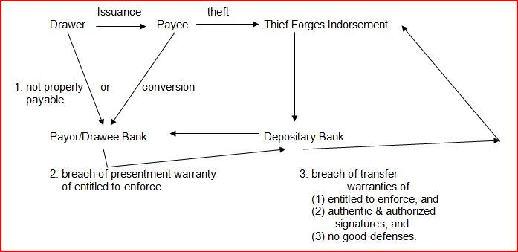
Forged Indorsement

Slide 30
Forged Indorsement – Liability of payee (indorser) if no defenses
Payee whose name was forged is not liable as did not sign.

Slide 31
Forged Indorsement – Liability of Drawee Bank if no defenses
Conversion liability to the payee,
or
Not properly payable liability to the drawer.

Slide 32
Forged Indorsement – Drawee Bank’s Cause of Action
Bank will sue presenter and prior transferors for breach of presentment warranty of entitled to enforce (presenters and prior transferors were not holders of the check).

Slide 33
Forged Indorsement – Presenting Bank’s Cause of Action
Presenting bank will sue transferors for breach of transfer warranties:
1. Entitled to enforce (holder status)
2. All signatures authentic or authorized
3. No good defenses

Slide 34
Forged Indorsement Problems
Problem 185 – p. 554
Problem 186 – p. 186

Slide 35
Forged Indorsement Problems
Problem 187 -189, pp. 555-557
Portia John Harry
Drawer Payee Forges John’s name
ONB Merchant’s Bank Tower Drug
Drawee Depositary Bank
stolen

Slide 36
Conversion
Examples of events triggering conversion liability:
State law
Receiving instrument from person not entitled to enforce
Bank pays someone not entitled to enforce (e.g., pays check on forged indorsement)
Violation of “for deposit only” indorsement by depositary bank

Slide 37
Conversion
Plaintiff
Person who would be true owner.
E.g., payee whose indorsement was forged.

Slide 38
Conversion
Non-Plaintiffs
Issuer
Acceptor
Payee who did not receive delivery of the instrument (e.g., lost in the mail)

Slide 39
Conversion Liability
Presumption = amount payable on instrument
Limitation = if plaintiff’s interest is less than full amount payable
E.g., check payable to A & B and A forges B’s name; B may only have a 50% interest

Slide 40
Conversion Liability
Problems:
Problem 190 – p. 558
Problem 191 – p. 558
Problem 192 – p. 560
Problem 193 – p. 560
Problem 194 – p. 564

Slide 41
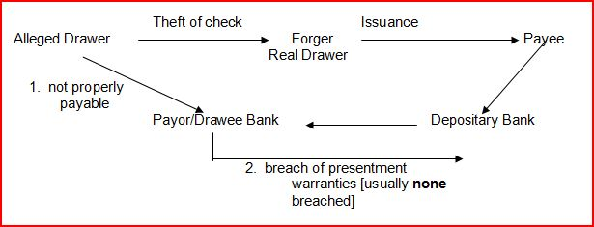
Forged Drawer’s Signature

Slide 42
Forged Drawer’s Signature
Basic concepts:
Alleged drawer not liable as alleged drawer did not sign.
Forger is liable and is treated as the drawer.
Drawee bank must recredit drawer’s (customer’s) account unless it has a defense because the check was not properly payable.

Slide 43
Forged Drawer’s Signature
Can drawee bank who recredits customer’s account pass on liability?
Price v. Neal (1762) – p. 566
UCC – presentment warranty = no knowledge that drawer’s signature is forged

Slide 44
Forged Drawer’s Signature
Problem 195 – p. 572
Problem 196 – p. 576
Problem 197 – p. 576

Slide 45
Forgery Validation 1. Ratification
Party estopped from denying validity of a signature if:
With full knowledge of the forgery (or alteration),
Accepts the benefits thereof or actively assents to the wrongful activity.
Problem 198 – p. 579

Slide 46
Forgery Validation 2. No Damages
Problem 199 – p. 584

Slide 47
Forgery Validation Review
1. Ratification
2. No Damages

Slide 48
Forgery Validation 3. Impostor Rule
Prevents issuer (maker or drawer) from asserting a forged indorsement.
Policy = Issuer was careless in issuing a check or note on which the payee’s indorsement is likely to be forged.
In a check context, bank would not have to recredit the drawer’s account in a not properly payable action.
Validates forgery so it passes good title.

Slide 49
Forgery Validation 3. Impostor Rule
1. Impersonation of payee
Problem 200 – p. 585
Problem 201 – p. 586

Slide 50
Forgery Validation 3. Impostor Rule
2. False claim of being an agent for the payee
Im Postor tells Drawer that Postor is collecting money for the American Red Cross. Drawer issues check for $500 payable to the American Red Cross. Postor then forges American Red Cross’s indorsement and cashes the check.

Slide 51
Forgery Validation 3. Impostor Rule
3. Non-interested Payee – Evil Signer
Issuer does not intend the named payee to have an interest in the instrument.
Problem 202 – p. 586

Slide 52
Forgery Validation 3. Impostor Rule
4. Non-interested Payee – Evil Employee
Employee (e.g., secretary) prepares fraudulent check with employer (e.g., corporate treasurer) innocently signs.
Problem 203 – p. 587

Slide 53
Forgery Validation 4. Fraudulent Indorsement by Employee
Prevents payee from asserting that the payee’s indorsement was forged in a conversion action.
Payee cannot assert a forgery made by a payee’s employee who was entrusted with the check.
Problem 204, p. 587

Slide 54
Forgery Validation The “double forgery” situation
Problem 205 – p. 588

Slide 55
Forgery Validation 5. Negligence
Person precluded from raising forgery (or alteration) if:
Failed to exercise ordinary care,
Substantially contributed to forgery/alteration,
Person asserting the estoppel is in good faith, and
Person asserting the estoppel:
Paid the instrument,
Took it for value, or
Took it for collection.

Slide 56
Forgery Validation 5. Negligence
Fact question so no bright-line rule as to what constitutes negligence.
Damages are computed on a comparative negligence basis.
Burden of proof is on the person asserting the negligence.

Slide 57
Forgery Validation 5. Negligence
Problem 206 – p. 589
Problem 207 – p. 589
Problem 208 – p. 596
Problem 209 – p. 596
Problem 210 – p. 603

Slide 58
Forgery Validation 6. Bank Statement Rule
Bank has no duty to provide a bank statement but if bank does:
Must follow Code’s specifications, and
May gain defense to customer’s not properly payable claims.

Slide 59
Forgery Validation 6. Bank Statement Rule
Duty if bank provides statement:
Return checks, or
Provide sufficient information about checks:
Check number,
Amount, and
Date of payment.

Slide 60
Forgery Validation 6. Bank Statement Rule
Duties if bank does not return checks:
Retain checks, or
Destroy checks retaining ability to furnish legible copies for seven years.
Provide customer with check or copy within reasonable time of customer’s request (two free per statement).

Slide 61
Forgery Validation 6. Bank Statement Rule
Customer’s Duties:
Inspect statement and items for:
Unauthorized customer’s signature, and
Alterations.
Report promptly to bank.

Slide 62
Forgery Validation 6. Bank Statement Rule
Ramifications of tardy reporting:
Customer is precluded from asserting the forgery or alteration in a not properly payable action.
But, Bank must prove it suffered a loss by reason of the delay to trigger the preclusion.
Problem 211 – p. 604

Slide 63
Forgery Validation 6. Bank Statement Rule
Repeat Offender Rule:
If same wrongdoer forged or altered checks, customer precluded from asserting later forgeries/alterations if not report within 30 days of bank statement.

Slide 64
Forgery Validation 6. Bank Statement Rule
Time limit of absolute preclusion
One year.
If customer does not report within one year, customer precluded regardless of bank’s potential fault.
Problem 212 – p. 604

Slide 65
Forgery Validation 6. Bank Statement Rule
Effect of Improper Bank Conduct
Bank pays in bad faith – no preclusion.
Bank fails to exercise ordinary care – loss allocated between bank and customer.
Problem 213 – p. 611

Slide 66
Forgery Validation 6. Bank Statement Rule
Can bank and customer shorten the time period to report in the account contract?
If too short, does it violate bank’s duty of good faith?
Problem 214 – p. 612
Problem 215 – p. 612

Slide 67
Forgery Validation 6. Bank Statement Rule
“Bank cannot be too nice” rule
If bank recredits customer’s account for the forgery or alteration even though one year has elapsed, bank cannot pass on loss by asserting a breach of presentment warranty.
Problem 216 – p. 613
Problem 217 – p. 613

Slide 68
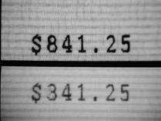
Alteration

Slide 69
Alteration – a defense to payment
Obligor (maker or drawer) does not want to pay because the instrument shows a different obligation from that which the obligor originally agreed.

Slide 70
Alteration -- Types
1. Change in obligation
Amount changed: $10.00 to $10,000

Slide 71
Alteration -- Types
1. Change in obligation
Date due changed: November 1, 2013 to November 1, 2011.

Slide 72
Alteration -- Types
1. Change in obligation
Name of payee changed: “I.N.G.” to “I.N. Garrison.”

Slide 73
Alteration -- Types
1. Change in obligation
Interest rate changed 5% to 15%.

Slide 74
Alteration -- Types
2. Unauthorized completion
Amount of check is left blank.
Drawer tells payee, “fill in $50.00.”
Payee says “OK.”
Payee later fills in for $700.00.

Slide 75
Alteration and Holders in Due Course
1. Change in obligation HDC can enforce for original amount.
Problem 221 – p. 615

Slide 76
Alteration and Holders in Due Course
2. Unauthorized completion: HDC can enforce as completed –
Drawer signs check and says to Friend, “You can buy yourself a present with the check but no more than $100.”
Friend buys present from Payee (e.g., a store) costing $500 and writes check for $500.
Payee transfers check to HDC (Payee’s bank).
HDC can enforce for $500.

Slide 77
Alteration and Non- Holders in Due Course
1. Fraudulently made by holder: Total discharge of obligor
Problem 218 – p. 614

Slide 78
Alteration and Non- Holders in Due Course
2. Not fraudulently made by holder: no effect on obligation
On January 2, 2012, Drawer signs check for $100 payable to Payee and writes the date as “January 2, 2011.”
Payee changes the date to “January 1, 2012.”
Payee may still enforce for $100.
Problem 220, p. 615

Slide 79
Altered checks are not properly payable
If bank pays an altered check from your account, bank must return the money to your account as the check was not properly payable ----
Unless bank has a defense.

Slide 80
Bank’s defenses to recrediting account for paying an altered check
1. Drawer was negligent.
Wrote in pencil.
Left blank spaces.
Problem 219 – p. 614

Slide 81
Bank’s defenses to recrediting account for paying an altered check
2. Bank Statement Rule: Drawer waited more than 1 year to report the alteration (or 30 days if repeat offender scenario).

Slide 82
If bank recredits account ---
1. Drawee bank sues presenter (or prior transferors) for breach of presentment warranty of no alteration.
2. Presenter sues prior transferors for breach of transfer warranty of no alteration.

Slide 83
Payment in Full Checks
Check (or accompanying communication) which conspicuously states that it is in full payment of an obligation that is:
1. Subject to a bona fide dispute, or
2. Unliquidated (exact amount owed not yet determined).

Slide 84
Payment in Full Checks
If payee cashes the check, the check operates as an “accord and satisfaction” of the debt unless:

Slide 85
Payment in Full Checks
If payee cashes the check, the check operates as an “accord and satisfaction” of the debt unless:
1. Payee returns the money within 90 days, or

Slide 86
Payment in Full Checks
If payee cashes the check, the check operates as an “accord and satisfaction” of the debt unless:
1. Payee returns the money within 90 days, or
2. Payee is an organization and notified drawer of a particular person or address where payment in full checks are to be sent.

