Slide 1
Banks and Their Customers

Slide 2
Terminology
Customer Payee
Drawer
Checking account
contract
Drawee Payee’s Bank
Payor Bank Depositary Bank
Presenting Bank Collecting Banks
Issuance
Transfer
Transfer
Presentment
Transfer

Slide 3
Checking Account Relationships
1. Debtor—Creditor
Debtor = Bank (borrowed customer’s money)
Creditor = Customer (lent money to Bank by depositing funds)

Slide 4
Checking Account Relationships
2. Principal—Agent
Bank is customer’s agent to:
Pay checks the customer writes.
Collect checks the customer deposits.

Slide 5

“Properly Payable” Rule -- § 4-401
Bank may pay check out of customer’s money only if it follows the customer’s orders exactly unless it has a defense.

Slide 6
When may bank charge customer’s account?
1. Check is properly payable.

Slide 7
When may bank charge customer’s account?
2. Item is not properly payable but bank has a defense.

Slide 8
When may bank charge customer’s account?
3. Overdraft
Bank may pay item even if it creates overdraft.
Customer liable to bank unless customer
did not sign check, and
did not benefit from the proceeds.

Slide 9

When may bank charge customer’s account?
4. Postdated check
Technically, no such thing as checks are payable on demand.

Slide 10
When may bank charge customer’s account?
4. Postdated check
Bank may pay early unless ---
The customer (drawer) gives bank a notice of the postdating which describes the check with reasonable certainty.

Slide 11
When may bank charge customer’s account?
5. Original terms of altered check
Assuming bank pays a holder in good faith.

Slide 12
When may bank charge customer’s account?
6. Terms of a completed item
Bank may pay an item even if obviously completed by someone other than the customer unless it has notice that the completion is improper.
Assuming bank pays a holder in good faith.

Slide 13
“Stale” Checks -- § 4-404
Bank has no obligation to pay customer’s noncertified check more than six months after its date.
Bouncing such a check is not wrongful.
But, bank may pay the check in good faith if it so desires.

Slide 14
Statute of Limitations -- § 3-118(c)
Sooner of:
10 years after date of check, or
3 years after dishonor.

Slide 15
Problems
Problem 151 – p. 475
Problem 152 – p. 475
Problem 153 – p. 475
Problem 154 – p. 476
Problem 155 – p. 155

Slide 16
Wrongful Dishonor
Bank liable to customer for damages if dishonors a properly payable check unless:
Paying check would create overdraft, or
Check is more than 6 months old (a “stale” check).

Slide 17
Wrongful Dishonor
Bank not liable to payee for damages if Bank dishonors a properly payable check as bank did not sign the check.

Slide 18
Wrongful Dishonor
Damages recoverable by drawer:
All proximately caused damages – a fact question
Examples:
Actual damages (e.g., bounced check fees)
Arrest or prosecution for writing hot checks
Consequential damages
Twin City Bank – p. 478 – mental suffering and punitive damages

Slide 19
Wrongful Dishonor
Problem 156 – p. 481
Section 4-402(b) rejects “the trader rule” and thus damages from a wrongful dishonor must be proved.

Slide 20
Wrongful Dishonor
Problem 157 – p. 482
Drawee bank risks wrongful dishonor if requires payee to have account at drawee bank.
But, bank may include provision in account contract stating that such a dishonor is not wrongful.

Slide 21
Effect of Customer’s Death or Incompetence
Common Law
Revoked bank’s ability to pay checks.
Caused great problems as bank would need to confirm customer still alive.

Slide 22
Effect of Customer’s Death or Incompetence
UCC – Incompetence
General Rule – Bank may continue to pay checks.
Exception – Bank knows of adjudication of incompetency and has reasonable opportunity to act.

Slide 23
Effect of Customer’s Death or Incompetence
UCC – Death
General Rule – Bank may continue to pay checks until notice of death and reasonable opportunity to act.
Exception – For up to 10 days after death, Bank may continue to pay even with notice of death unless person claiming interest in account says not to pay.
Practical note – most banks stop paying the second they hear about customer’s death

Slide 24
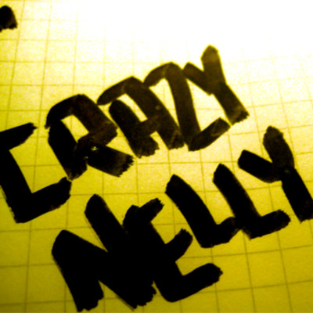
Effect of Customer’s Death or Incompetence
Problem 158 – p. 482

Slide 25
Bank’s Setoff Right
Basic Idea = If customer owes money to same bank where customer has account, bank may use account funds to pay debt.
Setoff rights not governed by UCC.

Slide 26
Bank’s Setoff Right
Notice is not needed.
Not unconstitutional.
Not covered by Truth in Lending Act
But, special rules for credit card debt under Fair Credit Billing Act.

Slide 27
Bank’s Setoff Right
Accounts against which setoff is proper
General accounts
Checking
Savings
Accounts against which setoff is improper
Special accounts for limited purpose
Escrow
Attorney trust account

Slide 28
Bank’s Setoff Right
Walter v. National City Bank – p. 484
Generally, cannot set off debt not yet due.
But, if debtor becomes insolvent, then setoff allowed.
In this case, bank setoff unmatured debt because another creditor attempted to garnish account and debtor was insolvent.
Did it matter in this case that debtor was already insolvent when bank lent debtor the money?

Slide 29
Bank’s Setoff Right
Impact of Bankruptcy
Bank cannot setoff once customer files for bankruptcy.
But, bank can freeze the account so customer cannot use the funds.

Slide 30
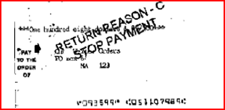
Stop Payment Orders
Drawer can tell drawee not to pay check.

Slide 31
Stop Payment Orders
Requirements of a stop payment order:
1. In writing
UCC allows oral stop payment order to be enforceable for 14 days.
Some banks will honor an oral stop payment order, but it is not enforceable so if bank pays, too bad for customer.

Slide 32
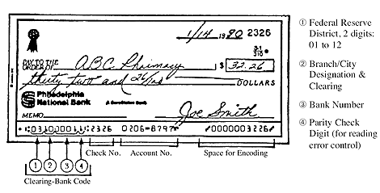
Stop Payment Orders
Requirements of a stop payment order:
2. Describe the check with reasonable certainty:
Account number
Check number
Amount

Slide 33
Stop Payment Orders
Requirements of a stop payment order:
3. Bank has reasonable opportunity to act.

Slide 34
Stop Payment Orders
Review of Elements of Enforceable SPO:
1. In writing
2. Identifies check with certainty
3. Bank has reasonable opportunity to act

Slide 35
Stop Payment Orders
Valid for 6 months
Can be renewed.
Lesson?

Slide 36
Stop Payment Orders
Damages if bank pays check over valid stop payment order:
Customer has burden of proof.
Can include damages for wrongful dishonor of later checks.

Slide 37
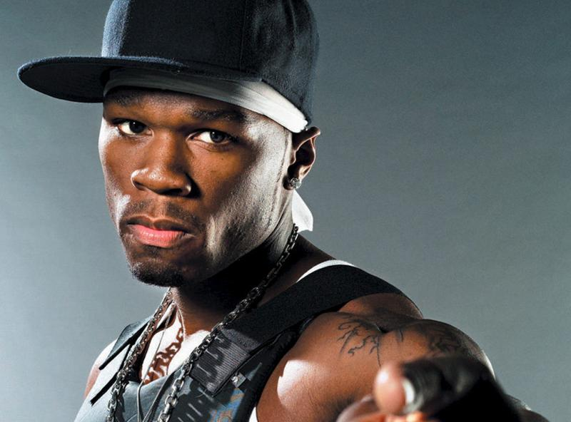
Stop Payment Orders
Parr v. Security National Bank – p. 488
Was bank not liable for paying check because customer’s description was wrong by 50 cents?

Slide 38
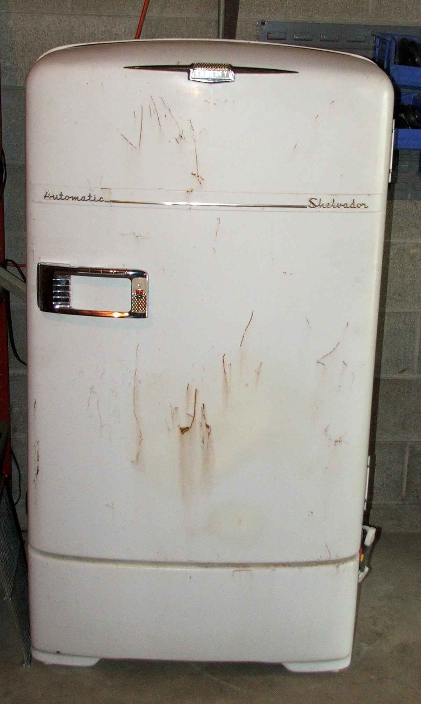
Stop Payment Orders
Problem 159 – p. 491

Slide 39
Stop Payment Orders
Bank’s Defenses paying over SPO
1. Statutory requirements not satisfied.

Slide 40
Stop Payment Orders
Bank’s Defenses paying over SPO
2. Subrogation -- § 4-407
Bank has rights of the person it paid against the customer.

Slide 41
Stop Payment Orders
Bank’s Defenses paying over SPO
3. No loss
Even if bank had stopped payment, customer would have to pay the check (e.g., it reached the hands of HDC who takes free of drawer’s defense against the payee).

Slide 42
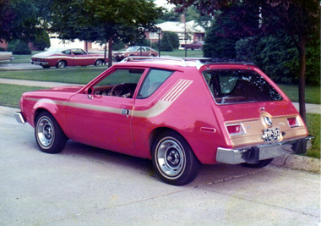
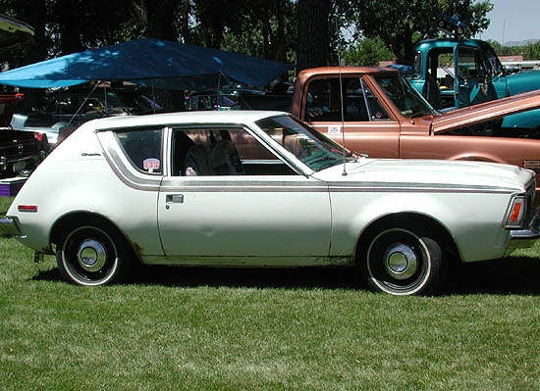
Stop Payment Orders
Problem 160 – p. 492

Slide 43

Stop Payment Orders
Problems 161-162 – p. 496

Slide 44
Stop Payment Orders
Cashier’s, Teller’s, and Certified Checks
Remitter has no right to stop payment; bank is the drawer.
The drawer (bank) could stop payment.
Problem 163, p. 497

Slide 45
Stop Payment Orders
Cashier’s, Teller’s, and Certified Checks – § 3-312
Holder who lost possession (lost, stolen, etc.) can file a sworn declaration of loss.
Up to 90 days after date of check – Bank must pay a holder, but
After 90 days, Bank pays person who filed declaration of loss.
Problem 164, p. 504

Slide 46
“Holder” who lacks possession
A person who wants payment may not have possession:
Lost the original.
Original destroyed.
Original stolen.

Slide 47
“Holder” who lacks possession
To enforce the instrument, this person must prove:
1. Was holder when loss occurred.

Slide 48
“Holder” who lacks possession
To enforce the instrument, this person must prove:
1. Was holder when loss occurred.
2. Did not voluntary transfer the instrument.

Slide 49
“Holder” who lacks possession
To enforce the instrument, this person must prove:
1. Was holder when loss occurred.
2. Did not voluntary transfer the instrument.
3. Instrument not lawful seized.

Slide 50
“Holder” who lacks possession
To enforce the instrument, this person must prove:
1. Was holder when loss occurred.
2. Did not voluntary transfer the instrument.
3. Instrument not lawful seized.
4. Why unable to produce the original.

Slide 51
“Holder” who lacks possession
To enforce the instrument, this person must prove:
1. Was holder when loss occurred.
2. Did not voluntary transfer the instrument.
3. Instrument not lawful seized.
4. Why unable to produce the original.
5. Posted a security or bond to protect payor from double payment.

Slide 52
Bank Statements
Basic Concepts:
Old school = bank returns physical checks each month along with statement
Modern = bank returns “sufficient information” about check (but must be able to supply check or copy upon customer’s request for seven years):
Check number
Amount
Date of payment

Slide 53
Bank Statements
Customer’s duty
Inspect statement and checks in a timely manner and report:
forgeries of the customer’s name and
alterations.
Problem 166, p. 166

Slide 54
Bank Collection
Coverage of Funds Availability and Check Truncation: Due to our shortage of time, these two topics (pp. 506-525) will not be discussed directly in class although we will often refer to the general concepts. You will not be tested on any details unless we discuss them in class but I do expect you to know the basic concepts.

Slide 55
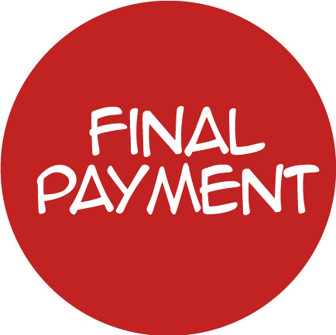
Final Payment

Slide 56
Final Payment
Once a payor bank (drawee bank) finally pays a check:
Bank is accountable = cannot dishonor check
On instrument actions (e.g., drawer’s contract, indorser’s contract) = canceled as bank cannot dishonor to satisfy condition precedent
Off instrument actions (e.g., presentment warranties, common law restitution) = still viable

Slide 57
Final Payment
Final payment occurs upon the first of:
1. Cash payment
2. Non-provisional settlement
3. Provisional settlement not timely revoked

Slide 58
Final Payment
Problem 172 – p. 526
Once payor bank hands over cash, payment is final.

Slide 59
Final Payment
Problem 173 – p. 526
What would Sally claim happened?
What would Bank claim happened?

Slide 60
Final Payment
Problem 174 – p. 527
Compare with cashier’s check situation.

Slide 61
Final Payment
Problem 175 – p. 528
Latest time to dishonor.
Problem 176 – p. 537
Receipt at processing center is receipt at branch.

Slide 62
Check Return
Protections in Reg. CC for depositary banks who are at risk if check bounces after customer withdraws money (customer may be turnip).
Example – Direct notice of dishonor for bounced check of $2,500 or more.

Slide 63
Ways for Depositary Bank to Recover Funds Improperly Paid
From customer based on underlying account contract
Indorser’s contract
Transfer warranty
Charge back

Slide 64
Charge Back
If check bounces, depositary bank recovers funds from customer under § 4-214.
By midnight deadline or a longer reasonable time.
Return item or send notice to customer.
Does not matter that customer has already withdrawn the funds.

Slide 65
Charge Back
Problem 177 – p. 538
Damon Pythias
Drawer Payee
Bulfinch Bank Dionysius Bank Payor/Drawee Depositary Bank
Check issued for $500
Charge back $500 causing checks to bounce
Deposited July 8
July 10
Returned NSF July 11

Slide 66

Charge Back
Problem 178 – p. 539
Click graphic to learn about this scam.

Slide 67
Undoing Final Payment

Slide 68
Undoing Final Payment
Problem 179, p. 547
Fraud
Restitution
Violation of duty of good faith

Slide 69
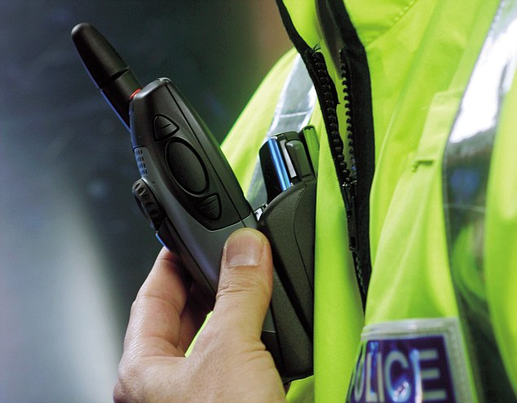
Undoing Final Payment
Problem 180, p. 547

Slide 70
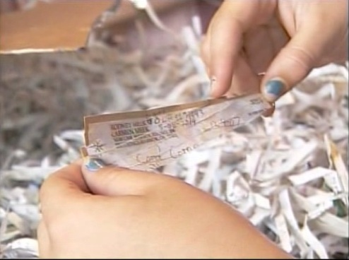
Delays
Problem 181 – p. 548

Slide 71
Restrictive Indorsements
1. Transfer prohibiting
“Pay only to Steve McGarrett” /s/ Wo Fat
Prohibition not effective.
Operates like special indorsement (ignore “only”).

Slide 72
Restrictive Indorsements
2. Conditional
“Pay to Steve McGarrett only if he leaves me alone” /s/ Wo Fat
Restriction not effective.
Operates like special indorsement (ignore the condition).

Slide 73
Restrictive Indorsements
3. For deposit or collection only
“For deposit in my Bank of Hawaii account #NCC-1701 only” /s/ Wo Fat
Non-bank = must comply
Depositary bank = must comply
Intermediary bank = need not comply
Payor bank = need not comply unless also depositary bank or presented over the counter for payment.

Slide 74
Restrictive Indorsements
4. Trust, Agent, or Fiducary
“Pay to Steve McGarrett in trust for Danny Williams.” /s/ Wo Fat
First person taking from Steve = may pay without regard for indorsement unless this person has notice that Steve is in breach of a fiduciary duty.
Subsequent takers of instrument = may pay without regard for indorsement unless this person has actual knowledge that Steve is in breach of a fiduciary duty.

Slide 75
Restrictive Indorsements
Problem 182, p. 549
For deposit only Max Runner /s/ Nina Needy
Welfare Payor Bank Innocent Bank Pursesnatchers Bank
[final payment]
Stolen by Max

Slide 76
Priorities
“The Four Legals”
Knowledge or notice (e.g., customer’s death)
Stop payment order
Service of legal process (e.g., garnishment)
Bank’s right of setoff
Issue = Do these have priority over payment of check?

Slide 77
Priorities
Any claim of priority for one of the four legals ends upon:
Bank accepts or certifies the check.
Bank finally pays the check.
Closing of the next banking day after the banking day on which the bank received the check.

Slide 78
Priorities
Order of paying or bouncing checks
Any order bank so desires.

Slide 79
Priorities
Problem 183 – p. 550
Problem 184 – p. 552

