Slide 1
Drawee’s Contract

Slide 2
Drawee’s Contract -- Generally
None – drawee did not sign draft/check.
Problem 145 – p. 456

Slide 3
Acceptance
A drawee may become liable by accepting the draft.
Must be written on the instrument.
Acceptance is typically done by the drawee signing diagonally across the front.
Liability is primary (like a maker).

Slide 4
Acceptance – Non-Bank Drawee
The situation:
  Buyer does not want to pay without the goods.
  Seller does not want to ship without the money.
  They are located too far apart to make an in-person exchange of money for goods.

Slide 5
Acceptance – Non-Bank Drawee
The parties
  1. Seller = Drawer
  2. Seller (or seller’s bank) = Payee
  3. Buyer = Drawee

Slide 6
Acceptance – Non-Bank Drawee
The action:
  Seller draws draft on Buyer
  Seller ships the goods and has shipper create a bill of lading.
  Seller sells draft to Seller’s Bank in Seller’s city at a discount and gives Seller’s Bank the bill of lading for the goods.
  Seller’s Bank indorses over to Buyer’s Bank in Buyer’s city and delivers bill of lading.
  Buyer’s Bank presents draft to Buyer (the drawee).

Slide 7
Acceptance – Non-Bank Drawee
The action:
  Buyer could pay and get the bill of lading.
  But, Buyer does not have the money. Buyer needs the goods to resell them or to use them to make the money.
  Draft often provides for payment x days after presentment.
  Thus, Buyer will accept the draft becoming primarily liable, get the bill of lading, use the goods, and (hopefully) be able to pay the draft when it is presented in x days.

Slide 8
Norton v. Knapp – p. 458
Norton [π] Exchange Bank
Drawer Payee
Seller
Miles Knapp [Δ]
Drawee
Buyer
  “Kiss my foot. Miles Knapp.”
  Is this an acceptance?
Presentment

Slide 9
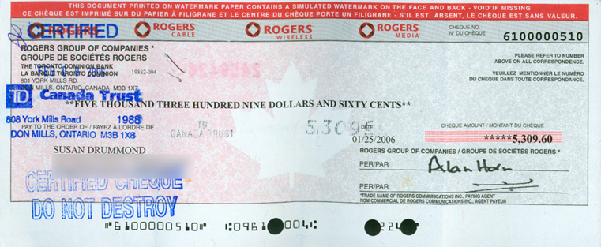
Acceptance – Bank Drawee
Certification

Slide 10
Acceptance – Bank Drawee
1. Drawee primarily liable.
2. Drawer discharged.
3. Prior indorsers discharged.

Slide 11
Acceptance – Bank Drawee
Gaylen Petroleum Co. v. Hixson – p. 460

Slide 12
Acceptance – Bank Drawee
Problem 146 – p.463
George Church
Drawer Payee
Drawee
Issuance of gift check
Presentment for acceptance
Refusal to accept

