Slide 1
Drawers

Slide 2
To whom is Drawer liable?
1. Holder (person entitled to enforce)
2. Indorser who has already paid the draft
But, liability is secondary – two conditions precedent.

Slide 3
Conditions precedent to Drawer’s liability
1. Presentment to Drawee
  Within 30 days of issue.
  But, untimely presentment is only a problem if drawee becomes insolvent.

Slide 4
Conditions precedent to Drawer’s liability
2. Dishonor by Drawee
  The drawee refuses to pay, e.g.,
    Insufficient funds
    Stop payment
    Check is “stale”
    Wrongfully

Slide 5
Limitation of Liability
Check = limitation not possible.
Non-check draft = may draw “without recourse.”

Slide 6
Problems
Problem 141 – p. 446
Problem 142 – p. 447

Slide 7
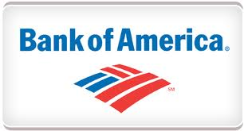
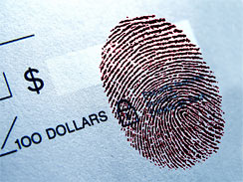
Messing v. Bank of America – p.447
Issue = May bank require non-account holder to provide thumbprint signature before it will honor a check?

Slide 8
Thumbprint Signatures
But, what if payee has no biological arms?

Slide 9
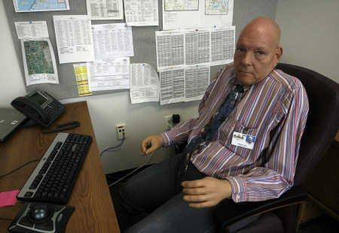
Thumbprint Signatures
BoA refused to cash check (from his wife who had an account) as he could not make a thumbprint signature.

Slide 10
Waiver of condition precedents
Problem 143, p. 454
  Is a waiver allowed?
  If so, will it prevent instrument from being negotiable?

Slide 11
Problem 144 – p. 454
Request to stop payment
Dan Frank [Δ]
Drawer Payee
Indorser
Drawee Bank Holdit [π]
Creditor’s National
Depositary Bank
Issuance
Stop payment order
Presentment
Charge back
Dishonor

