Slide 1
Maker’s Obligation

Slide 2
Liability of Maker -- Generally
Primary liability.
No conditions precedent (other than instrument being due)
If maker has defense, effectiveness depends on HDC status of holder (plaintiff).
Similar to contract of bank on cashier’s or teller’s check.

Slide 3
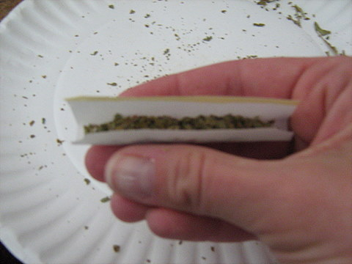

Joint Makers

Slide 4
Joint Makers
Jointly and severally liable.
If one pays more than fair share, entitled to contribution
Problem 127, p. 421

