Slide 1
Liability -- Introduction

Slide 2
Types of Liability
Suits outside of U.C.C.
Contract (on instrument due to signature)
Warranty (off instrument due to transfer or presentment)
Conversion (tort)
Arising out of banking relationship

Slide 3
Underlying Obligation
Instruments often issued because of underlying obligation such as:
Contract to purchase goods.
Contract to receive services.
Contract to purchase land.
Repayment of a loan.
What is interface between underlying obligation and instrument?

Slide 4
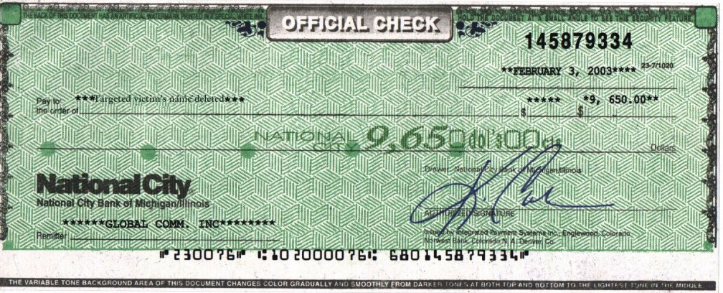
Underlying Obligation
If paid by certified check, cashier’s check, or teller’s check, underlying obligation discharged.

Slide 5
Underlying Obligation
If paid by uncertified check or note, underlying obligation is suspended.
If later paid, underlying obligation discharged.
If dishonored, holder may sue on:
Underlying obligation, or
Instrument.

Slide 6
Underlying Obligation
Problem 124 – p. 414
Problem 125 – p. 415
Problem 126 – p. 415

