Slide 1
Holders in Due Course

Slide 2
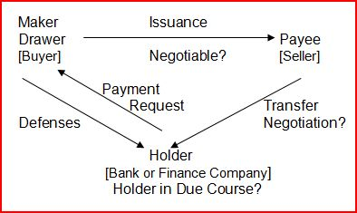
Holders in Due Course

Slide 3
Holders in Due Course
1. Negotiable instrument.
In writing
Signed by obligor
Unconditional promise or order to pay
Fixed amount
Payable in money
No other undertaking or instruction
Payable on demand or at a definite time
Words of negotiability (order or bearer language)

Slide 4
Holders in Due Course
2. Held by a holder
Bearer paper = possession
Order paper = possession plus necessary indorsements

Slide 5
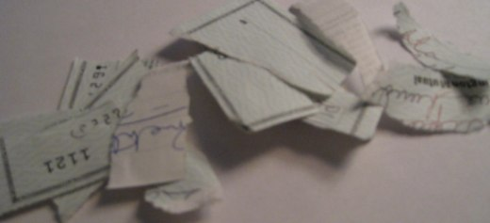
Holders in Due Course
3. Authenticity of instrument not apparently questioned.

Slide 6
Holders in Due Course
4. Holder paid value (not a gift).
Completed performance or irrevocable commitment; not executory contract.
Value may be different from face value.
Paying antecedent debt is value (even though doing so is not contract consideration)
Problems 102-103 (pages 343-344)

Slide 7
Holders in Due Course
4. Holder paid value (not a gift).
In a bank context, bank gives value when it has a security interest in the item such as allowing the depositor to withdraw the money.
Problem 104 – p. 343
Falls Church Bank – p. 344
Problem 105 – p. 345

Slide 8
Review of HDC Elements Already Covered:
Negotiable Instrument
Properly negotiated into possession of a holder
Authenticity of instrument not apparently questioned
Holder paid value

Slide 9
Holders in Due Course
5. Holder in good faith:

Slide 10
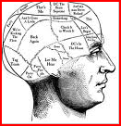
Holders in Due Course
5. Holder in good faith:
a. Honesty in fact (subjective), plus

Slide 11

Holders in Due Course
5. Holder in good faith:
a. Honesty in fact (subjective), plus
b. Observance of reas0nable commercial standards of fair dealing (objective).

Slide 12
Holders in Due Course
6. Without notice of six things at the time instrument acquired.
But first, what does “notice” mean?

Slide 13
Holders in Due Course
What does notice mean?
1. Actual knowledge (subjective)

Slide 14
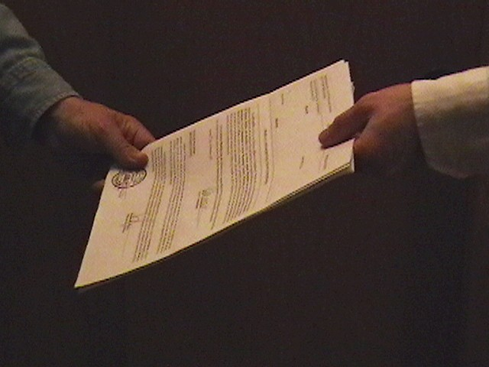
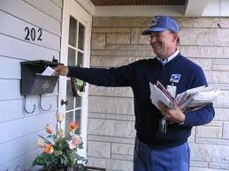
Holders in Due Course
What does notice mean?
2. Receipt of a notice

Slide 15

Holders in Due Course
What does notice mean?
3. Reason to know based on facts and circumstances

Slide 16

Holders in Due Course
What does notice mean?
Constructive notice (such as filing a document in the public records) is NOT notice.
X

Slide 17
Holders in Due Course
6. Without notice of the following things at the time instrument acquired:
a. Principal overdue
Note = due date has passed
Check = more than 90 days from date of issue

Slide 18
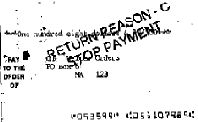
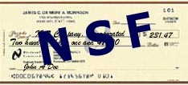
Holders in Due Course
6. Without notice of the following things at the time instrument acquired:
b. Instrument dishonored Note = maker refused to pay Check = drawee bounces check (e.g., insufficient funds, stop payment order by drawer)

Slide 19
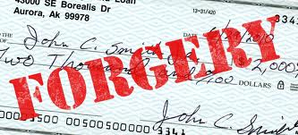
Holders in Due Course
6. Without notice of the following things at the time instrument acquired:
c. Unauthorized signature

Slide 20
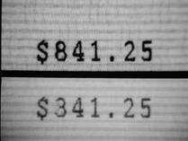
Holders in Due Course
6. Without notice of the following things at the time instrument acquired:
d. Alteration

Slide 21
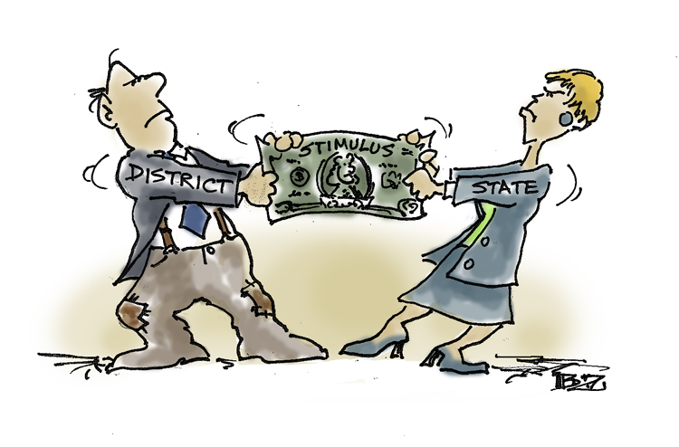
Holders in Due Course
6. Without notice of the following things at the time instrument acquired:
e. Any claim

Slide 22

Holders in Due Course
6. Without notice of the following things at the time instrument acquired:
f. Any defense or claim in recoupment (counterclaim)

Slide 23

Holders in Due Course
6. Without notice of the following things at the time instrument acquired:
General Investments – p. 346
Holder has no duty to inquire but cannot have reason to inquire and fail to look for fear of what might see.
“Closed eyes doctrine”

Slide 24
Holders in Due Course
6. Without notice of the following things at the time instrument acquired:
Problem 106 – p. 350
Can a payee be HDC?

Slide 25

Holders in Due Course
6. Without notice of the following things at the time instrument acquired:
Any Kind Checks Cashed – p. 350
http://www.akccfinancial.com/index.htm

Slide 26
Holders in Due Course
6. Without notice of the following things at the time instrument acquired:
Question – p. 359
Impact of taking post-dated check.

Slide 27
Holders in Due Course
6. Without notice of the following things at the time instrument acquired:
Winter v. Hirsch – p. 359
Under the facts, could plaintiff qualify as HDC and take free of maker’s usury defense?
Question – p. 363
Would Federal HDC rules apply to Winter?

Slide 28
Holders in Due Course
6. Without notice of the following things at the time instrument acquired:
Problem 107 – p. 363
Impact of altered date near beginning of year.

Slide 29
Holders in Due Course
6. Without notice of the following things at the time instrument acquired:
Problem 108 – p. 363
Impact of notice of overdue interest payments.

Slide 30
Holders in Due Course
6. Without notice of the following things at the time instrument acquired:
Problem 109 – p. 364
When is a check deemed overdue?

Slide 31
Holders in Due Course
6. Without notice of the following things at the time instrument acquired:
Problem 110 – p. 364
Forgotten Notice Doctrine

Slide 32
Holders in Due Course
6. Without notice of the following things at the time instrument acquired:
Problem 111 – p. 365
Impact of transferee having notice prior to good title (indorsement) but after possession.

Slide 33
Holders in Due Course
6. Without notice of the following things at the time instrument acquired:
Jones v. Approved Bancredit Corp. – p. 365
Closely Connected Doctrine

Slide 34
Holders in Due Course
6. Without notice of the following things at the time instrument acquired:
Sullivan v. United Deals Corp. – p. 371
Mere knowledge of underlying transaction is NOT sufficient to deny holder HDC status.
Notice after value given will not destroy HDC status.

Slide 35
Shelter Rule -- § 3-203(b)
Transferee obtains rights of transferor.
If transferor is HDC, transferee obtains HDC rights even if not qualify as HDC.
Maker Payee
HDC
Holder with HDC rights
gift

Slide 36
Shelter Rule -- § 3-203(b)
Shelter Rule not apply if transferee engaged in:
Fraud, or
Illegality
which affected the instrument.

Slide 37
Shelter Rule -- § 3-203(b)
Policies supporting Shelter Rule:
Assure market for instrument
No harm to obligor

Slide 38
Shelter Rule -- § 3-203(b)
Problems
Problem 112 – p. 374
Problem 113 – p. 374
Problem 114 – p. 374

Slide 39
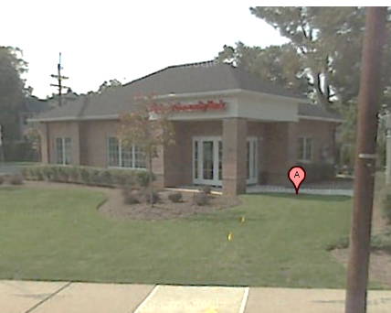
Shelter Rule -- § 3-203(b)
Triffin v. Somerset Valley Bank – p. 375

Slide 40


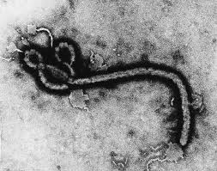
Defenses of maker/drawer that can defeat holder in due course
The HDC is not invincible.
If the obligor (e.g., maker or drawer) has a “real” defense, the HDC will lose.

Slide 41

Defenses of maker/drawer that can defeat holder in due course
1. Infancy
Normally, under 18 years old

Slide 42

Defenses of maker/drawer that can defeat holder in due course
2. Duress

Slide 43
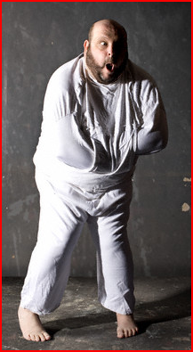
Defenses of maker/drawer that can defeat holder in due course
3. Lack of Legal Capacity

Slide 44

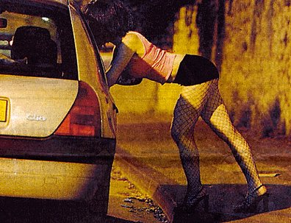
Defenses of maker/drawer that can defeat holder in due course
4. Illegality making obligation void

Slide 45
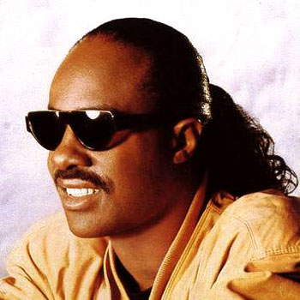
Defenses of maker/drawer that can defeat holder in due course
5. Fraud in the execution (fraud in the factum)
Lacked knowledge of instrument’s character or essential terms, and
Lacked reasonable opportunity to learn character and terms.
“excusable ignorance”

Slide 46
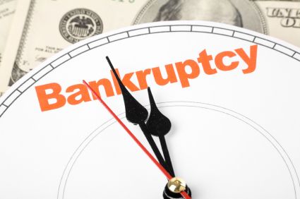
Defenses of maker/drawer that can defeat holder in due course
6. Bankruptcy discharge

Slide 47
Defenses of maker/drawer that can defeat holder in due course
7. Omission of required consumer protection language (if should have been there, pretend it is)
ANY HOLDER OF THIS CONSUMER CREDIT CONTRACT IS SUBJECT TO ALL CLAIMS AND DEFENSES WHICH THE DEBTOR COULD ASSERT AGAINST THE SELLER OF GOODS OR SERVICES OBTAINED PURSUANT HERETO OR WITH THE PROCEEDS HEREOF. RECOVERY HEREUNDER BY THE DEBTOR SHALL NOT EXCEED AMOUNTS PAID BY THE DEBTOR.

Slide 48

Defenses of maker/drawer that can defeat holder in due course
8. Statute of Limitations
Note = 6 years from due date

Slide 49
Defenses of maker/drawer that can defeat holder in due course
8. Statute of Limitations
Check = earlier of: 1. 3 years after dishonor, or 2. 10 years after issue.

Slide 50
Defenses of maker/drawer that can defeat holder in due course
9. Obligor pays former holder before receiving notice from current holder that instrument has been transferred.

Slide 51
Defenses of maker/drawer that can defeat holder in due course
10. Alteration
11. Unauthorized signatures and forgeries
[covered in detail later]

Slide 52
Holder in due course safe from all other defenses
Examples of “personal defenses”:
Non-delivery of goods
Defective goods
Non-performance of services
Misrepresentation of goods
Breach of warranty

Slide 53
Holder in due course safe from all claims
No one can take an instrument away from a holder in due course, even the true owner.

Slide 54
Problems & Cases
Problem 115 – p. 382
FDIC v. Culver – p. 383
Problem 116 – p. 388
Problem 117 – p. 389
Problem 118 – p. 389

Slide 55
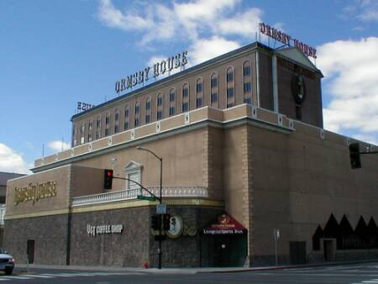
Problems & Cases (continued)
Sea Air Support, Inc. – p. 390

Slide 56
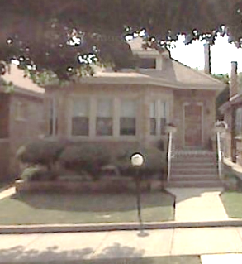
Problems & Cases (continued)
Kedzie & 103rd Currency Exchange – p. 391

Slide 57
Problems & Cases (continued)
Problem 119 – p. 398
Problem 120 – p. 399
Problem 121 – p.400
Problem 122 – p. 400

Slide 58
Burden of Proof -- Signatures
Unless specifically denied in the pleadings, each signature is admitted.
If signature put in issue, person who wants it effective has burden of proof.
But, signature presumed good unless signer is dead or incompetent at the time of trial.

Slide 59

Burden of Proof -- Signatures
Virginia National Bank – p.401
Question – p.403

Slide 60
Burden of Proof – HDC Status
Burden of proof is on person claiming HDC status.

Slide 61
Statutory denial of HDC status

Slide 62
Statutory denial of HDC status
1. Acquired by legal process or by purchase in an execution, bankruptcy, or creditor’s sale.
Federal courts granted federal agencies HDC status when they take over failed banks.
But, only if instrument negotiable; federal law does not give HDC status if instrument nonnegotiable.

Slide 63
Statutory denial of HDC status
2. Purchase as part of a bulk transaction not in the transferor’s ordinary course of business.

Slide 64
Statutory denial of HDC status
3. Successor in interest to an estate or other organization.

Slide 65
Jus Tertii
General Rule – An obligor cannot raise the defenses of other parties in an attempt to avoid paying the holder.
Exception – Against a non-HDC, the obligor may raise the defense that the instrument is lost or stolen (holder is not true owner).
Problem 123 – p. 410

