Slide 1
Negotiation

Slide 2
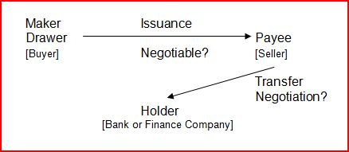
Negotiation

Slide 3
Negotiation
Payee transfers instrument (rather than just keeping it and getting money from obligor):
  Payment to creditor (goods, services, land, loan repayment, etc.)
  Gift to a donee
  Deposit in payee’s bank account

Slide 4
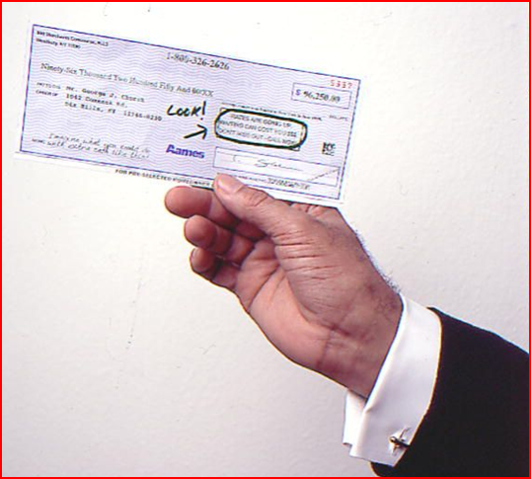
Requirements for Holder Status
1. Possession of the instrument

Slide 5
Requirements for Holder Status
2. Good Title
  Depends on words of negotiability found on the instrument.

Slide 6
Requirements for Holder Status
2. Good Title
  Bearer words = possession alone is good title

Slide 7
Requirements for Holder Status
2. Good Title
  Order words = properly indorsed

Slide 8
Indorsements
Generally
  Signature by payee (or later holder)
  Normally on the back
  Can be on allonge
  Must transfer entire instrument

Slide 9

Blank Indorsement
  Signature by payee only.
  Creates bearer paper so later negotiations are by transfer of possession.

Slide 10


Special Indorsement
  Signature by payee which names new person entitled to the money.
  Creates order paper so later negotiations need indorsement of new person.

Slide 11

Restrictive Indorsement
  Signature by payee indicating “for deposit” or “for collection” only.
  If bank does not comply, bank is liable for conversion.

Slide 12
Intent of issuer determines payee identification
“Pay to the order of George Bush.”
  First U.S. President named George Bush?
  Second U.S. President named George Bush?
  Some other person with the name of George Bush?

Slide 13
Required indorsements
“Pay to the order of William Bell and Walter Bishop.”
  Both must indorse to negotiate.

Slide 14
Required indorsements
“Pay to the order of William Bell or Walter Bishop.”
  Only one must indorse to negotiate.

Slide 15
Required indorsements
“Pay to the order of William Bell and/or Walter Bishop.”
  Only one must indorse to negotiate.

Slide 16
Missing indorsement
If transferred for value, transferee has specifically enforceable right to transferor’s indorsement.

Slide 17
Missing indorsement
If transferred for value, transferee has specifically enforceable right to transferor’s indorsement.
If check deposited in your account, bank becomes holder even without your indorsement.

Slide 18
Misspelled Payee’s Name
“Pay to the order of Jerry W. Beyer.”
  Indorse in incorrect name (“Jerry W. Beyer”), or
  Indorse in correct name (“Gerry W. Beyer”), but
  Person giving value may require both indorsements.

Slide 19



Payee lacking capacity
A payee without legal capacity (e.g., minor or incompetent) may indorse.

Slide 20
Problems 94-101

