Slide 1
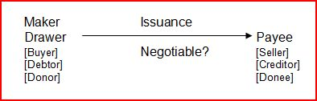
Negotiability
Form of instrument

Slide 2
Obtaining Negotiable Status
Must meet all elements – strict compliance

Slide 3
Obtaining Negotiable Status
Must meet all elements – strict compliance
Stating “Negotiable” ineffective

Slide 4
Obtaining Negotiable Status
Must meet all elements – strict compliance
Stating “Negotiable” ineffective
Stating “Nonnegotiable”
  Generally = effective to make nonnegotiable
  Check = ineffective

Slide 5
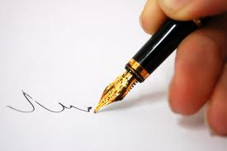
1. In Writing

Slide 6
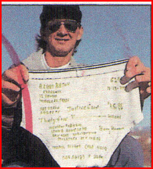
The “famous” underwear check

Slide 7
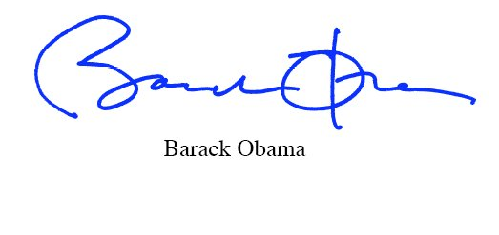
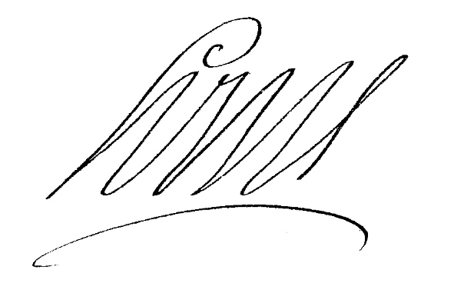



2. Signed by Maker or Drawer

Slide 8

3. Unconditional promise or order to pay

Slide 9
3. Unconditional promise or order to pay
Express condition to payment not allowed.
  “I promise to pay only if I get an A in Commercial Law.”

Slide 10
3. Unconditional promise or order to pay
Triffin – p. 315
  Drawer = American Express
  Drawee = Chase Bank
  Payees = Dillabough (2) and Lynn (1)
  Holder = Chuckie who assigned to Triffin
  Issue = Is instrument negotiable so Triffin can raise HDC shield and win over AmEx’s defenses?

Slide 11
3. Unconditional promise or order to pay
Triffin – p. 315
Does this language make instrument conditional and thus not negotiable?
  IMPORTANT DO NOT CASH FOR STRANGERS THIS MONEY ORDER WILL NOT BE PAID IF IT HAS BEEN ALTERED OR STOLEN OR IF AN ENDORSEMENT IS MISSING OR FORGED.
  BE SURE YOU HAVE EFFECTIVE RECOURSE AGAINST YOUR CUSTOMER.

Slide 12
3. Unconditional promise or order to pay
“Subject to” or “Governed by” another contract not allowed.
  “This note is governed by the contract the parties signed on June 1, 2011.”

Slide 13
3. Unconditional promise or order to pay
Incorporating other writings generally not allowed.
  “This provision incorporates by reference the contract the parties signed on June 1, 2011.”

Slide 14
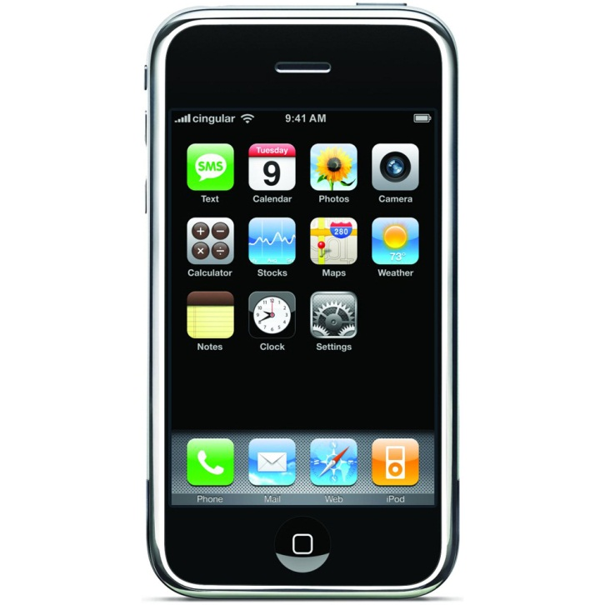
3. Unconditional promise or order to pay
Statement of consideration is allowed.
  “This note is to pay for an Apple iPhone.”

Slide 15
3. Unconditional promise or order to pay
Referring to another contract (“as per” or “in accordance with”) is allowed.
  “This note is executed as per the contract the parties signed on June 1, 2011.”

Slide 16
3. Unconditional promise or order to pay
Incorporating by reference the following terms in a contract is allowed:
  Collateral
  Prepayment
  Acceleration
  “This note incorporates by reference the prepayment terms of the contract the parties signed on June 1, 2011.”

Slide 17

3. Unconditional promise or order to pay
Limitation of payment of a particular fund or source is allowed.
  “This note is payable only from the proceeds of my 2011 cotton crop.”

Slide 18
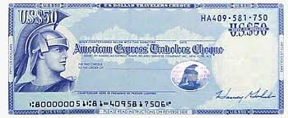
3. Unconditional promise or order to pay
Requirement of a countersignature is allowed.
  Example = Traveler’s Check

Slide 19
3. Unconditional promise or order to pay
FTC Required Consumer Protection Language
NOTICE
ANY HOLDER OF THIS CONSUMER CREDIT CONTRACT IS SUBJECT TO ALL CLAIMS AND DEFENSES WHICH THE DEBTOR COULD ASSERT AGAINST THE SELLER OF GOODS OR SERVICES OBTAINED PURSUANT HERETO OR WITH THE PROCEEDS HEREOF. RECOVERY HEREUNDER BY THE DEBTOR SHALL NOT EXCEED AMOUNTS PAID BY THE DEBTOR HEREUNDER.

Slide 20
3. Unconditional promise or order to pay
Requirement imposed by state or federal law that note contain consumer protection language is allowed.
  But, later holders cannot become holder in due course of the note.

Slide 21
3. Unconditional promise or order to pay
Examples:
  Problem 86
  Problem 87
  Problem 88

Slide 22
4. Fixed amount
Amount of principal is clear.

Slide 23
4. Fixed amount
Interest
  Presumption = no interest

Slide 24
4. Fixed amount
Interest
  Presumption = no interest
  Can state interest with amount or rate

Slide 25
4. Fixed amount
Interest
  Presumption = no interest
  Can state interest with amount or rate
  Can refer to outside source to determine rate (prime rate, rate charged by a particular bank, etc.)

Slide 26
4. Fixed amount
Interest
  Presumption = no interest
  Can state interest with amount or rate
  Can refer to outside source to determine rate (prime rate, rate charged by a particular bank, etc.)
  If state “interest” but not a rate, interest is at the judgment rate.

Slide 27
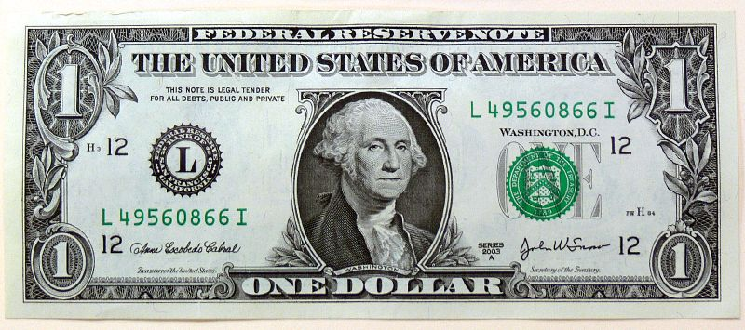
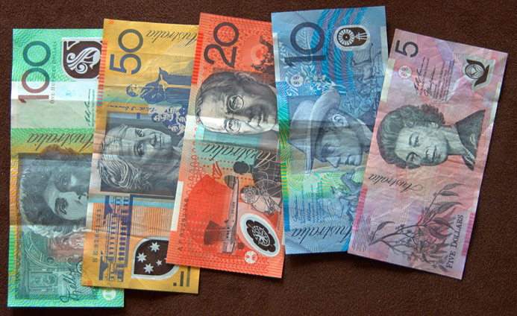
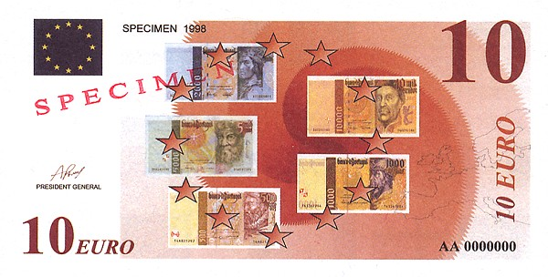
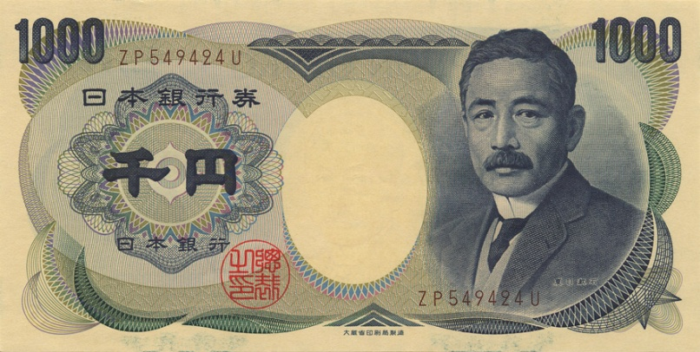
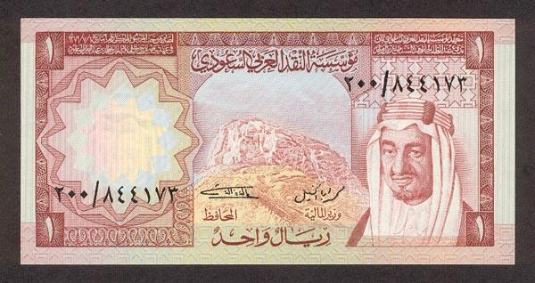
5. In money

Slide 28
6. No other undertaking or instruction
Instrument is just for payment of money.
  Not a full contract
  A “courier without luggage”

Slide 29
6. No other undertaking or instruction
Instrument is just for payment of money.
Exceptions:
  Promises concerning collateral.

Slide 30
6. No other undertaking or instruction
Instrument is just for payment of money.
Exceptions:
  Promises concerning collateral.
  Confession of judgment clauses (cognovit)

Slide 31
6. No other undertaking or instruction
Instrument is just for payment of money.
Exceptions:
  Promises concerning collateral.
  Confession of judgment clauses (cognovit)
  Waiver of rules that would otherwise benefit maker or drawer.

Slide 32
6. No other undertaking or instruction
Woodworth v. The Richmond Indiana Venture
The undersigned agrees that, in the event any payment due pursuant to the terms of this note be not timely made, at the option of the Partnership, the undersigned shall retroactively lose any interest in the Partnership from the date hereof and the Partnership shall have no obligation to account for any payments theretofore made by the undersigned, and that this remedy is in addition to other remedies afforded by the Partnership Agreement.

Slide 33
7. Payable on (1) Demand or (2) at a
Definite Time
On demand:
  Express Statement, or
  Silent about payment date.

Slide 34
7. Payable on (1) Demand or (2) at a
Definite Time
At a definite time:
  Date (“payable on August 1, 2012”)

Slide 35
7. Payable on (1) Demand or (2) at a
Definite Time
At a definite time:
  Date
  Fixed period after sight (“payable 30 days after sight”)

Slide 36
7. Payable on (1) Demand or (2) at a
Definite Time
At a definite time:
  Date
  Fixed period after sight
  Time readily ascertainable (“payable on first day of Winter 2011”)

Slide 37
7. Payable on (1) Demand or (2) at a
Definite Time
At a definite time:
  Prepayment provisions allowed.

Slide 38
7. Payable on (1) Demand or (2) at a
Definite Time
At a definite time:
  Acceleration provisions allowed.

Slide 39
7. Payable on (1) Demand or (2) at a
Definite Time
At a definite time:
  Extension provisions:
    By holder – to any time.
    “The holder may extend the due date to any date the holder desires.”

Slide 40
7. Payable on (1) Demand or (2) at a
Definite Time
At a definite time:
  Extension provisions:
    By obligor – only to later definite time stated in instrument
    “The maker may extend the due date from August 1, 2010 to October 1, 2011.”

Slide 41
7. Payable on (1) Demand or (2) at a
Definite Time
At a definite time:
  Extension provisions:
    By event – only to later definite time stated in instrument
    “If the Detroit Tigers win the World Series in October 2011, the due date of the note is extended from November 1, 2011 to October 1, 2012.”

Slide 42
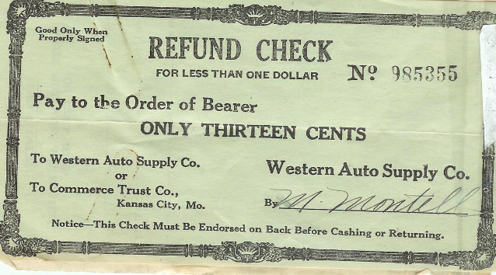
8. Words of Negotiability
(Bearer or Order)
Bearer:

Slide 43
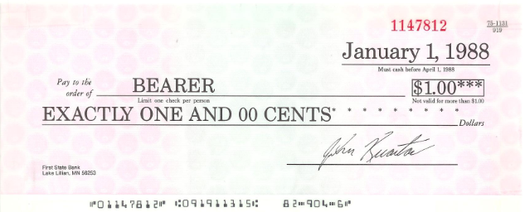
8. Words of Negotiability
(Bearer or Order)
Bearer:

Slide 44
8. Words of Negotiability
(Bearer or Order)
Bearer:
  “Payable to bearer.”
  “Payable to the order of bearer.”
  “Payable to _______________.”
  “Payable to cash.”
  Other language not payable to identified person.

Slide 45
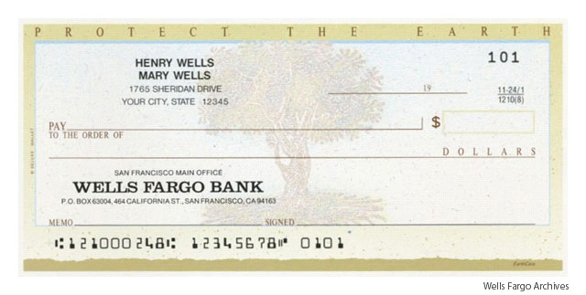
8. Words of Negotiability
(Bearer or Order)
Order:
Walter Bishop-----------------------------------------------

Slide 46
8. Words of Negotiability
(Bearer or Order)
If both types of words on same instrument, bearer language controls.
Walter Bishop or Bearer --------------------------------

Slide 47
8. Words of Negotiability
(Bearer or Order)
If lack of words of negotiability is ONLY element of negotiability missing on a check, the requirement is waived.
Walter Bishop ----------------------------------

Slide 48
8. Words of Negotiability
(Bearer or Order)
Problem 92
Problem 93

