Slide 1
Commercial Law
Prof. Gerry W. Beyer
Fall 2011

Slide 2


Why are written instruments used?

Slide 3

Other types of commercial paper
1. Money/Cash – not governed by U.C.C.

Slide 4
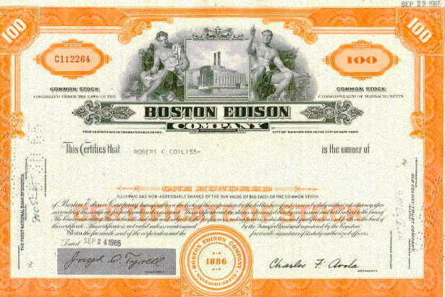
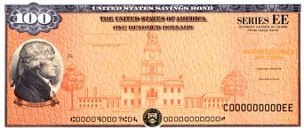
Other types of commercial paper
2. Stocks & Bonds – Article 8

Slide 5
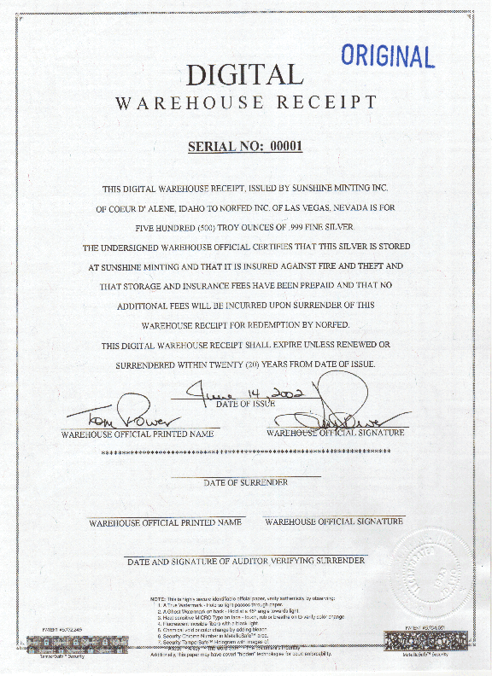
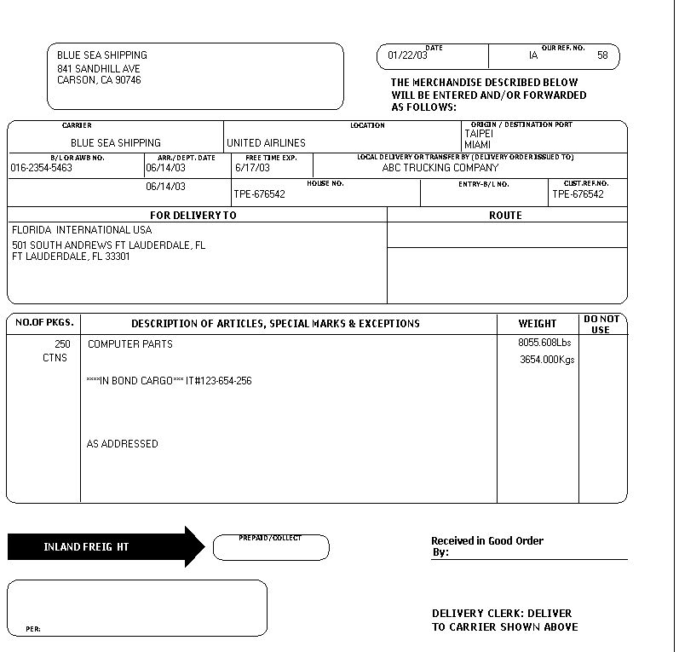
Other types of commercial paper
3. Documents of Title – Article 7 (warehouse receipts & bills of lading)

Slide 6
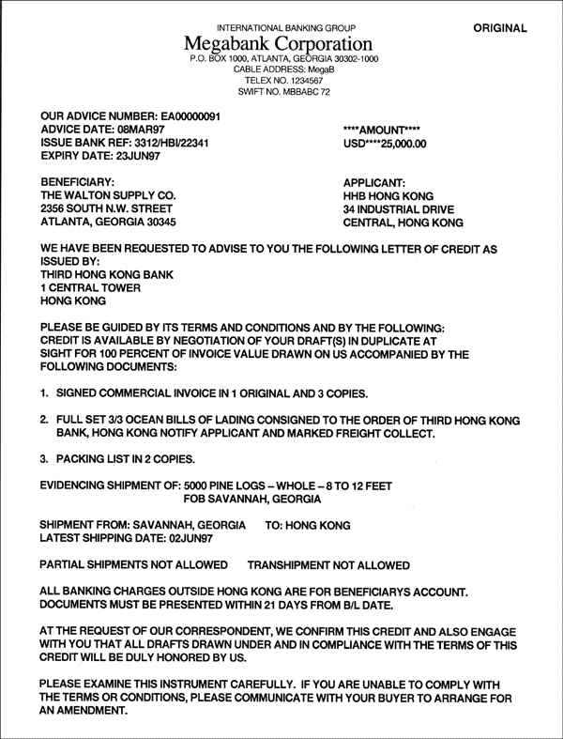
Other types of commercial paper
4. Letters of Credit – Article 5

Slide 7
Law governing commercial paper
Negotiable Instruments Law (1896)
Uniform Commercial Code
1952 Version
1962 Revisions
1990 Version
2002 Revisions

Slide 8
Basic Issues
1. Person possessing instrument wants to be paid.

Slide 9
Basic Issues
1. Person possessing instrument wants to be paid.
2. Person obligated on instrument does not want to pay.

Slide 10
Basic Issues
1. Person possessing instrument wants to be paid.
2. Person obligated on instrument does not want to pay.
3. Person who pays wants to recover from person paid or someone else.

Slide 11
Analytical Framework
1. Identify type of paper.

Slide 12
Analytical Framework
1. Identify type of paper.
2. Identify parties.

Slide 13
Analytical Framework
1. Identify type of paper.
2. Identify parties.
3. Determine negotiability (form).

Slide 14
Analytical Framework
1. Identify type of paper.
2. Identify parties.
3. Determine negotiability (form).
4. Determine negotiation (transfer).

Slide 15
Analytical Framework
1. Identify type of paper.
2. Identify parties.
3. Determine negotiability (form).
4. Determine negotiation (transfer).
5. Is transferee holder in due course (BFP)?

Slide 16
Analytical Framework
1. Identify type of paper.
2. Identify parties.
3. Determine negotiability (form).
4. Determine negotiation (transfer).
5. Is transferee holder in due course (BFP)?
6. Determine plaintiff’s causes of action.

Slide 17
Analytical Framework
1. Identify type of paper.
2. Identify parties.
3. Determine negotiability (form).
4. Determine negotiation (transfer).
5. Is transferee holder in due course (BFP)?
6. Determine plaintiff’s causes of action.
7. Determine defendant’s defenses.

Slide 18
Analytical Framework
1. Identify type of paper.
2. Identify parties.
3. Determine negotiability (form).
4. Determine negotiation (transfer).
5. Is transferee holder in due course (BFP)?
6. Determine plaintiff’s causes of action.
7. Determine defendant’s defenses.
8. If defendant liable, can defendant pass on liability?

